Slide 1
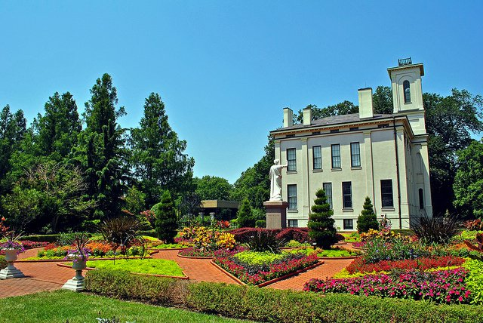
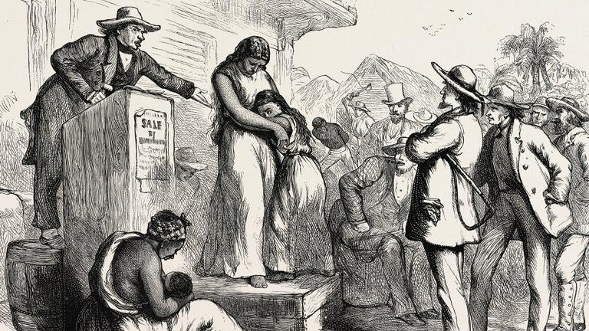
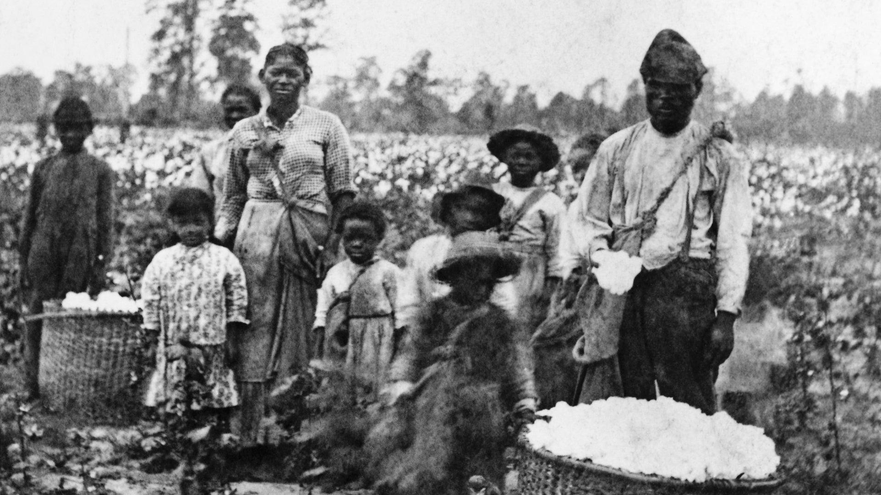
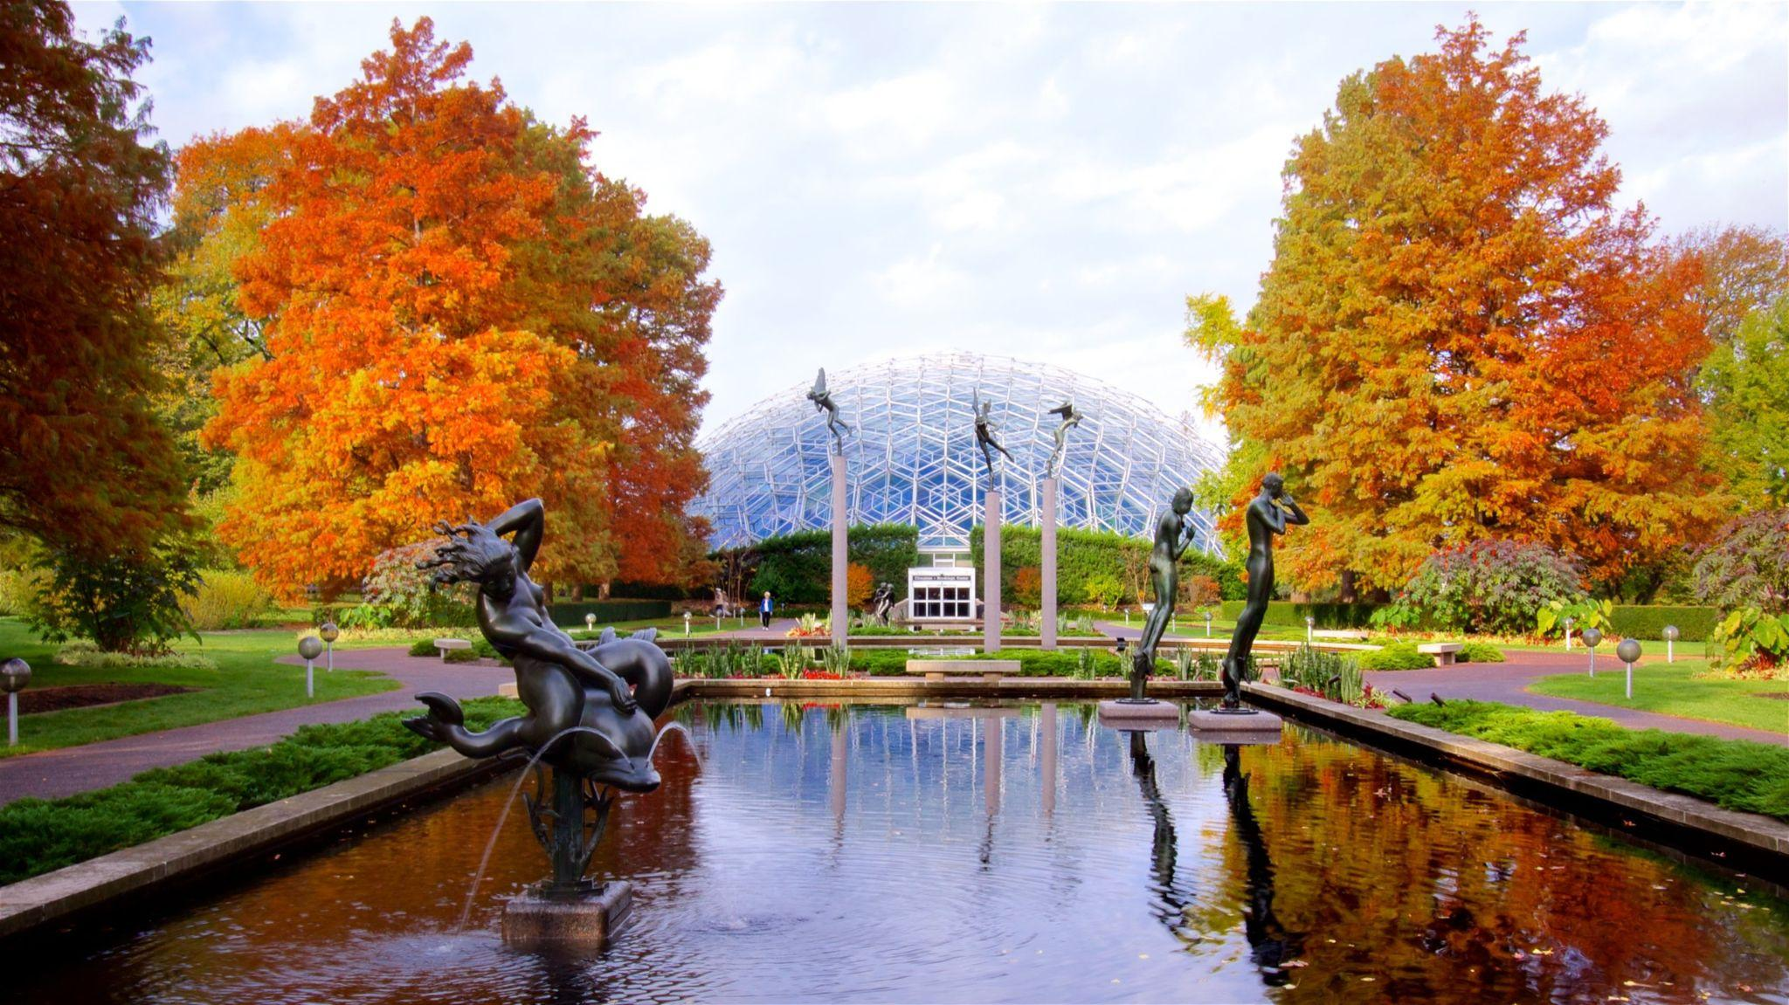
Ways to Include African American Knowledge in the Gardens
Shelby Terrell, Aydien Noel, Priscilla Kincanon, and Aaliyah Lindsey

Slide 2
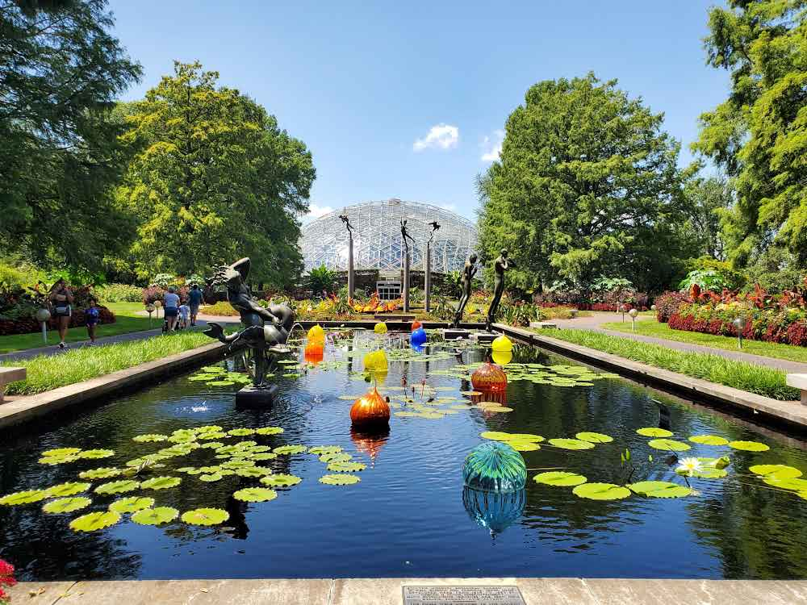
Missouri Botanical Gardens
Opened in 1859, MOBOT is the oldest continuously operating botanical garden in the country. CODES is collaborating with the garden to solve some challenges that have arisen throughout the years. Recognizing history, demonstrating how African Americans have aided botany, and making the garden more accessible are all goals that our MOBOT partners and CODES students share.

Slide 3
Identifying the Wicked Problem
Bias in specimen collection
Binomial Nomenclature process
Inequality in plant knowledge and collection has resulted in the prioritization of western science thus excluding and overshadowing other native systems of thinking. This issue is attributed to by a variety of different entities including plant concentration, bias in specimens, and the binomial nomenclature process.
Plant concentration
Inequality in the gardens
Colonial Extractive Practices
Prioritization of western science
The MOBOT struggles to accurately tell the stories of the unacknowledged people who contributed to the gardens creation and maintenance. This is where the aspect of reparative justice comes into play. Our research team overarching goal is to create ways to publicly disclose these stories and ensure that these brilliant people are accounted for all of their involvement
Hard to Sustain/Fund

Slide 4
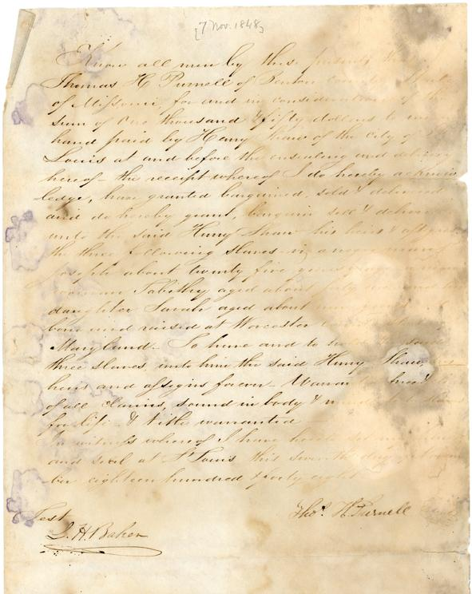
What does this look like at MOBOT?
We do not have enough information about the enslaved people forced to work under Henry Shaw that had knowledge on the Garden.
This Image represents a “Bill of sale for purchase of enslaved persons Joseph, Tabitha, and her daughter Sarah by Henry Shaw in 1848.” as shared on the history of the Missouri Botanical Gardens webpage.

Slide 5
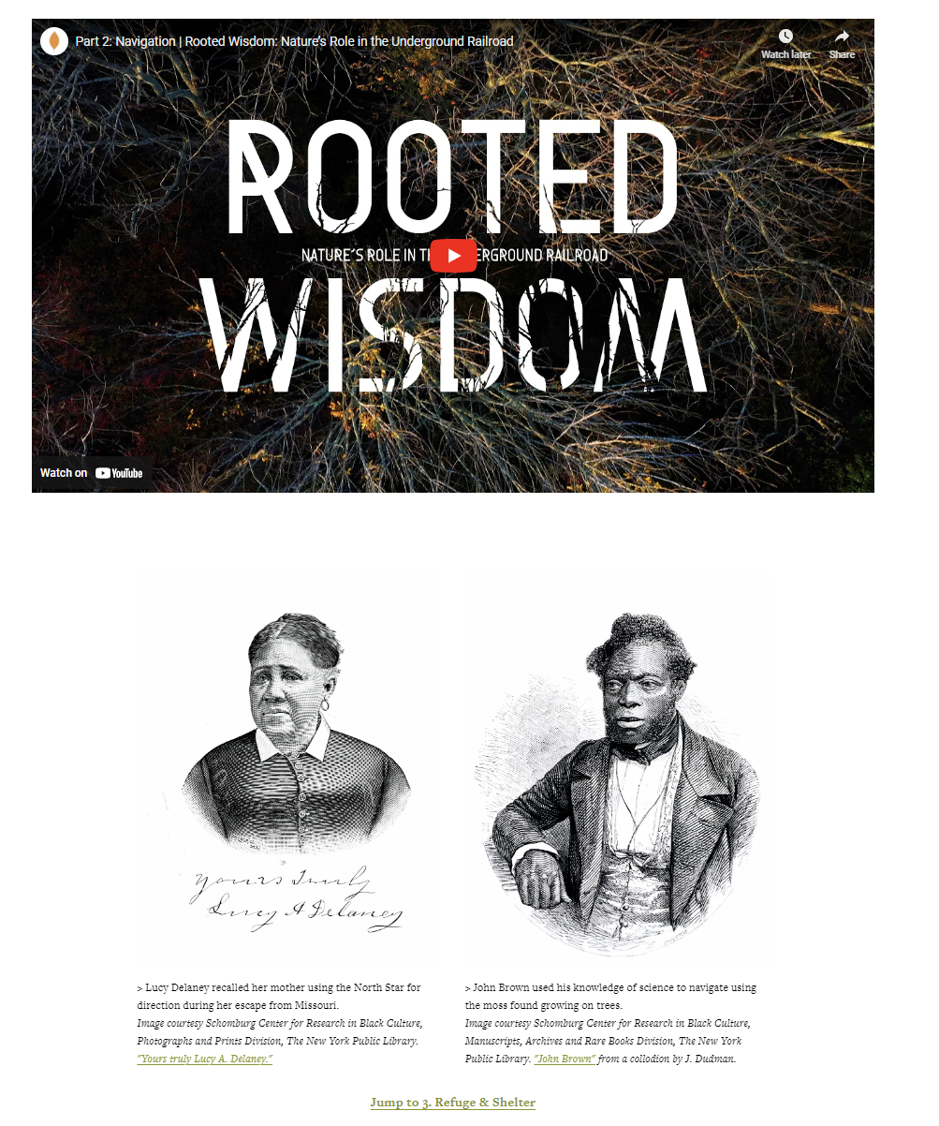
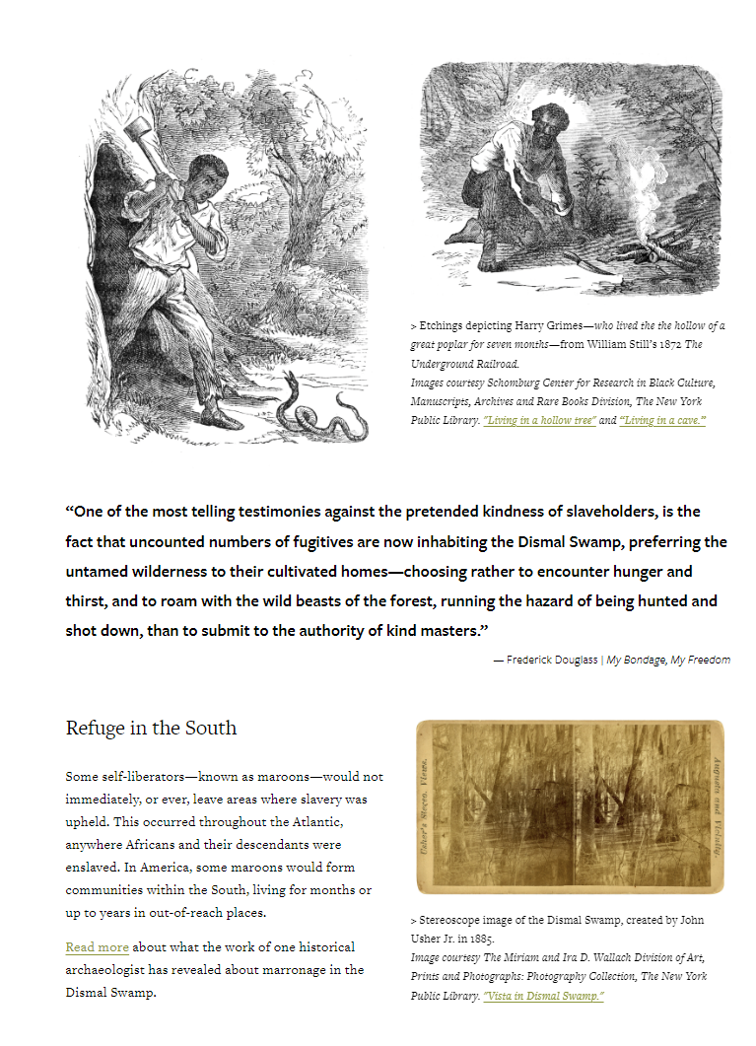
Bridging the Gap
Using Rooted Wisdom as a framework, we can build a website with images and different articles discussing African American cultures in the setting of the garden.
Rooted Wisdom is a great website with excellent narrative concepts. This website uses a variety of resources to tell its story. They used articles, films,pictures and YouTube videos, as seen in the images above. Furthermore, you just get a burst of information rather than a large amount of it.

Slide 6
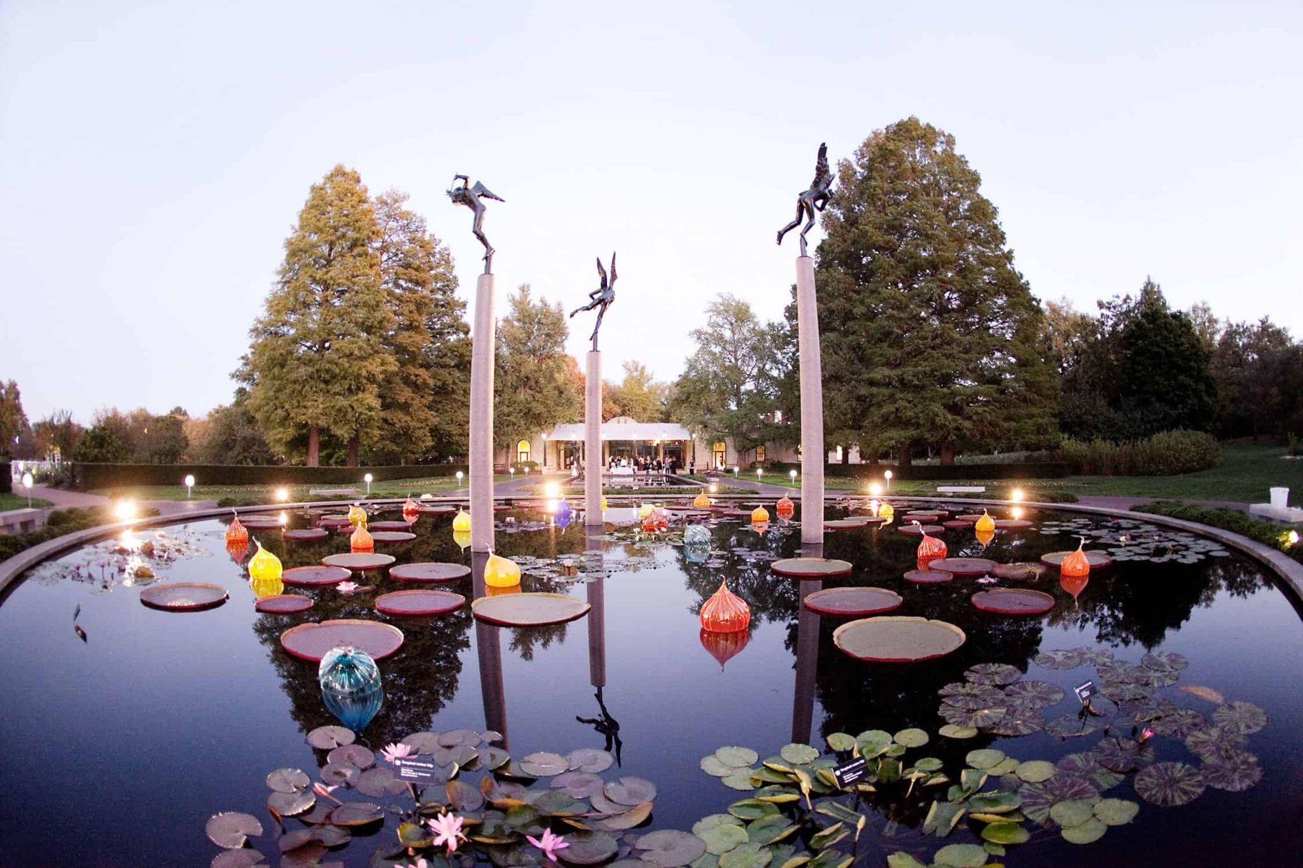
Conclusion
All things considered, during our time working with MOBOT, we learned that the Missouri Botanical Garden is home to one of the largest herbariums. Of course with such a great responsibility, it’s imperative they conduct their research with inclusivity in mind.We were able to pinpoint a few wicked problems. The most impactful wicked problem is the inequality in plant collection. The stories of the uncredited individuals who helped create and maintain the gardens are difficult for the MOBOT to correctly narrate. We want to make this easier to do in the future!

Slide 7
THANK YOU

