Slide 1
Performing Arts
Keith Hawkins
Aiden Martinez
Justin Richerson
Nadia Harris

Slide 2
Theatre Props

Slide 3
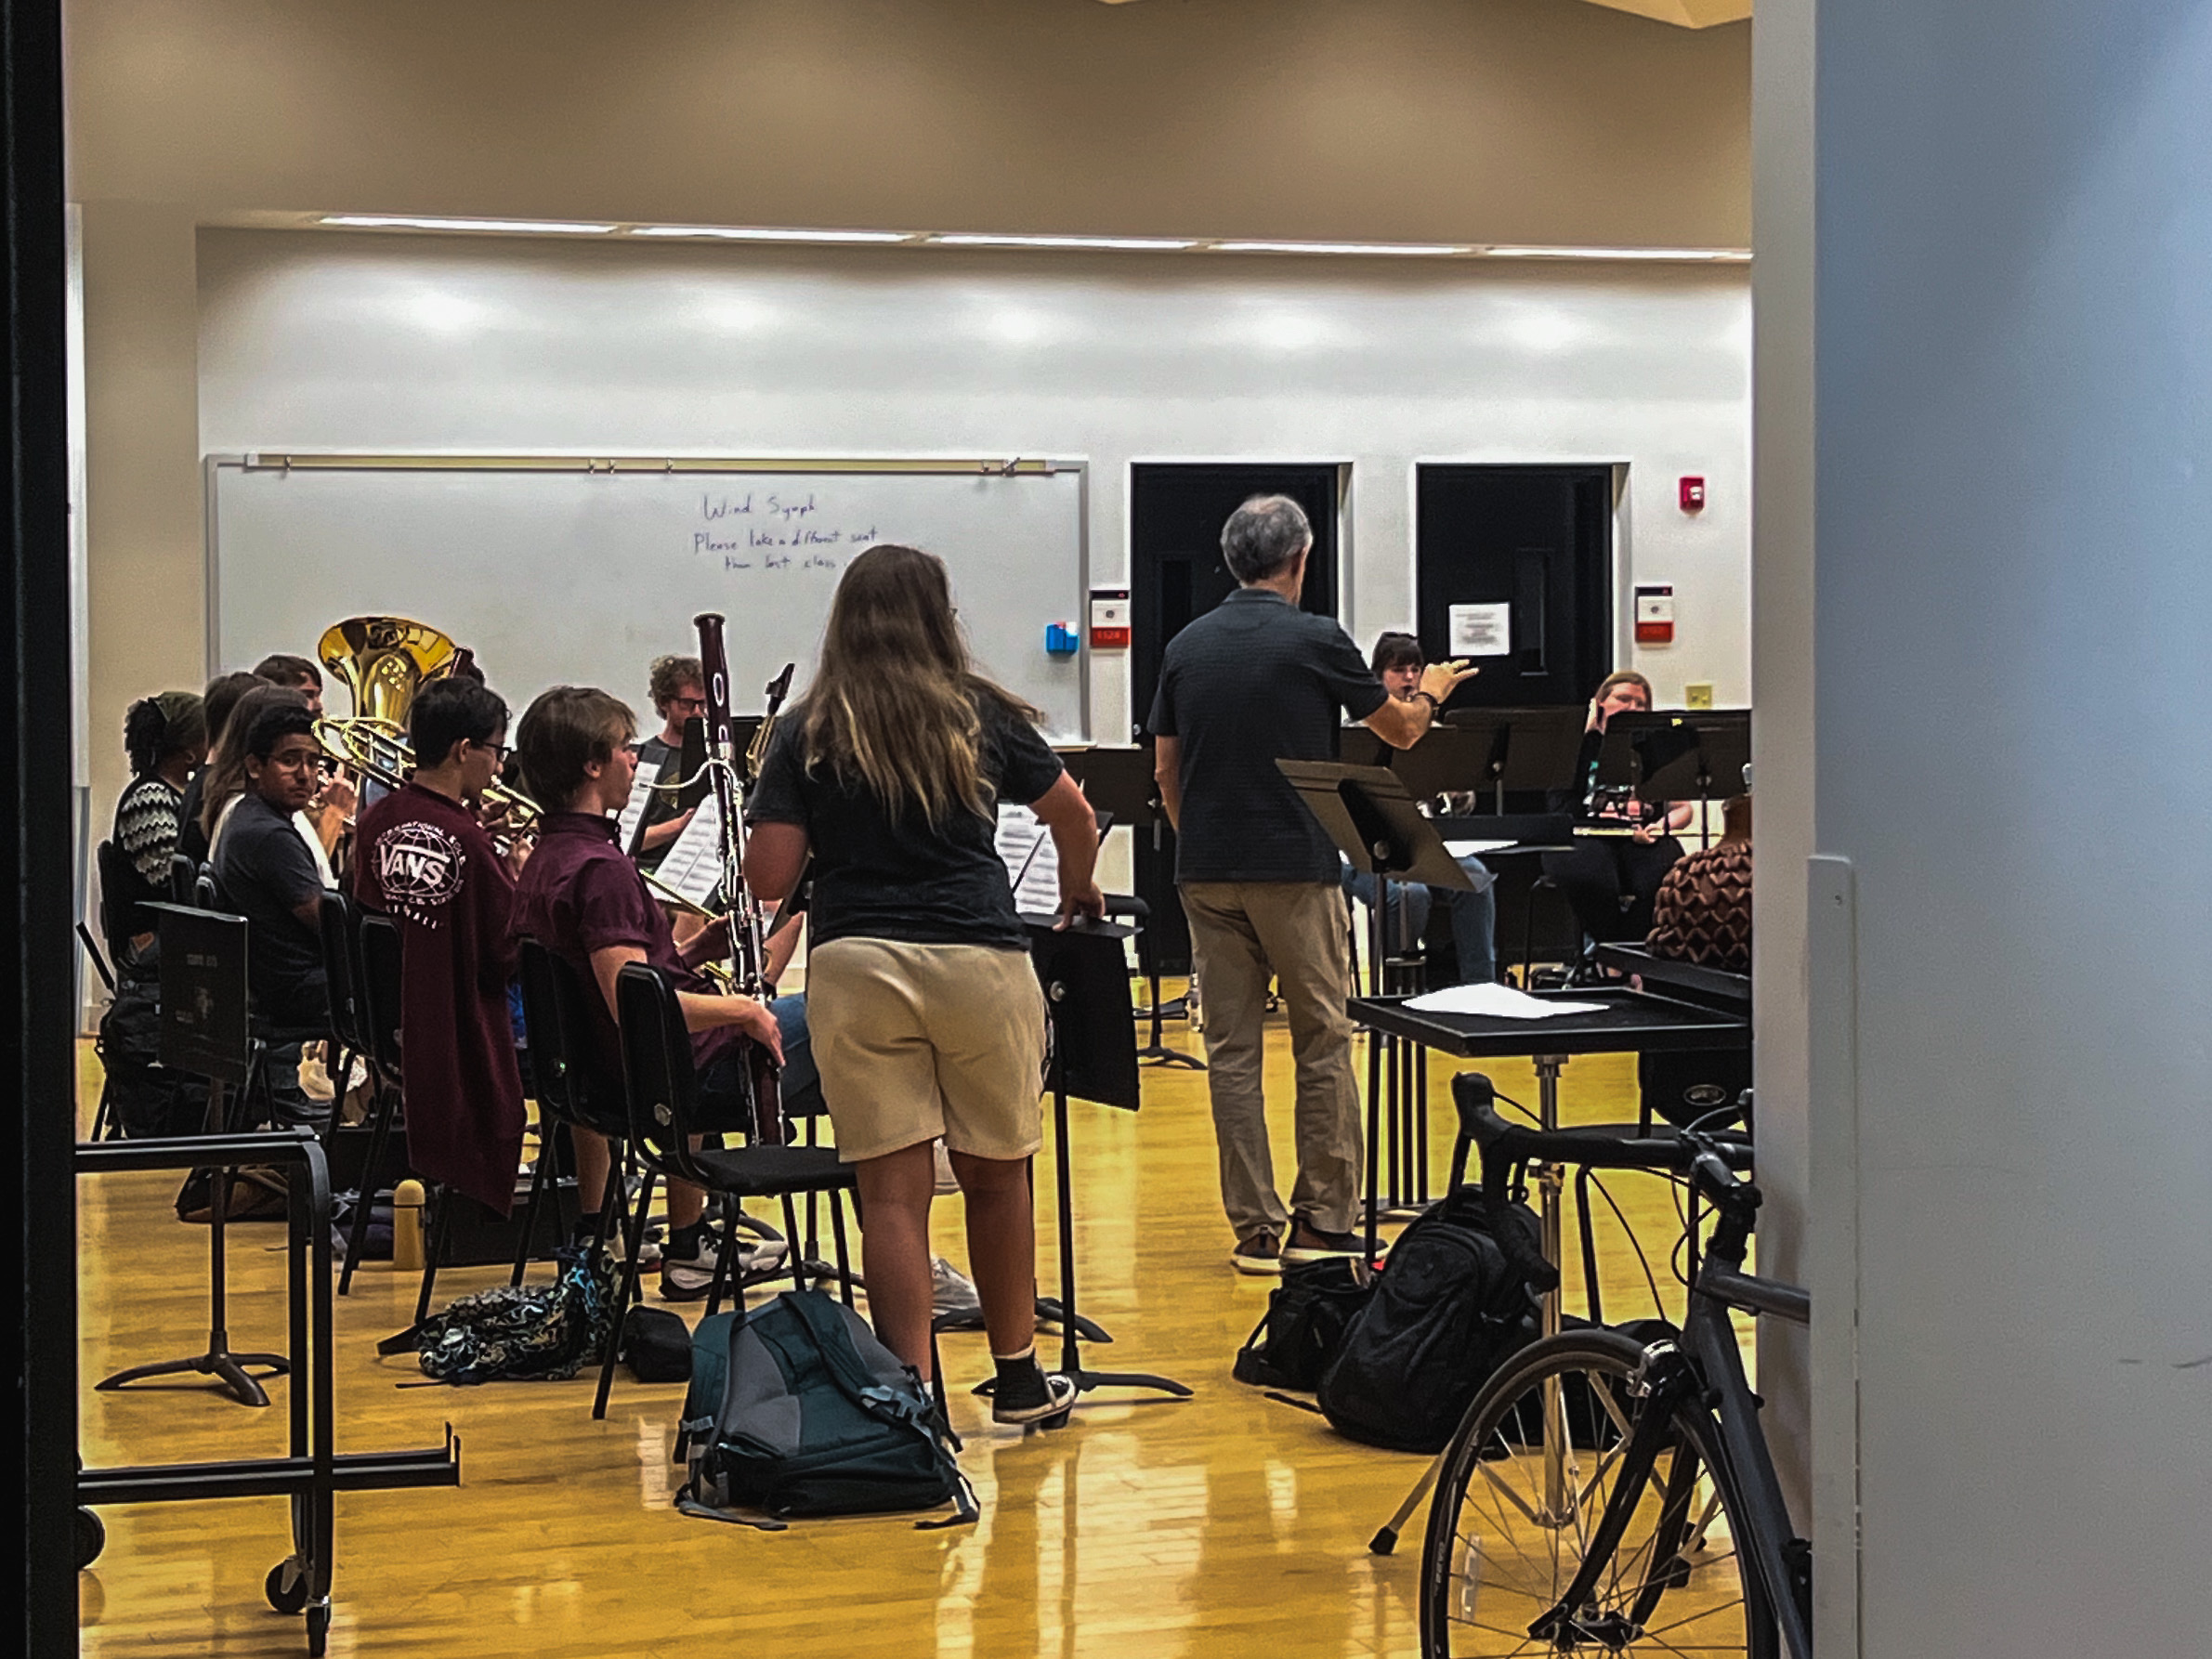
Band Rehearsal

Slide 5
Model Drawing

Slide 6
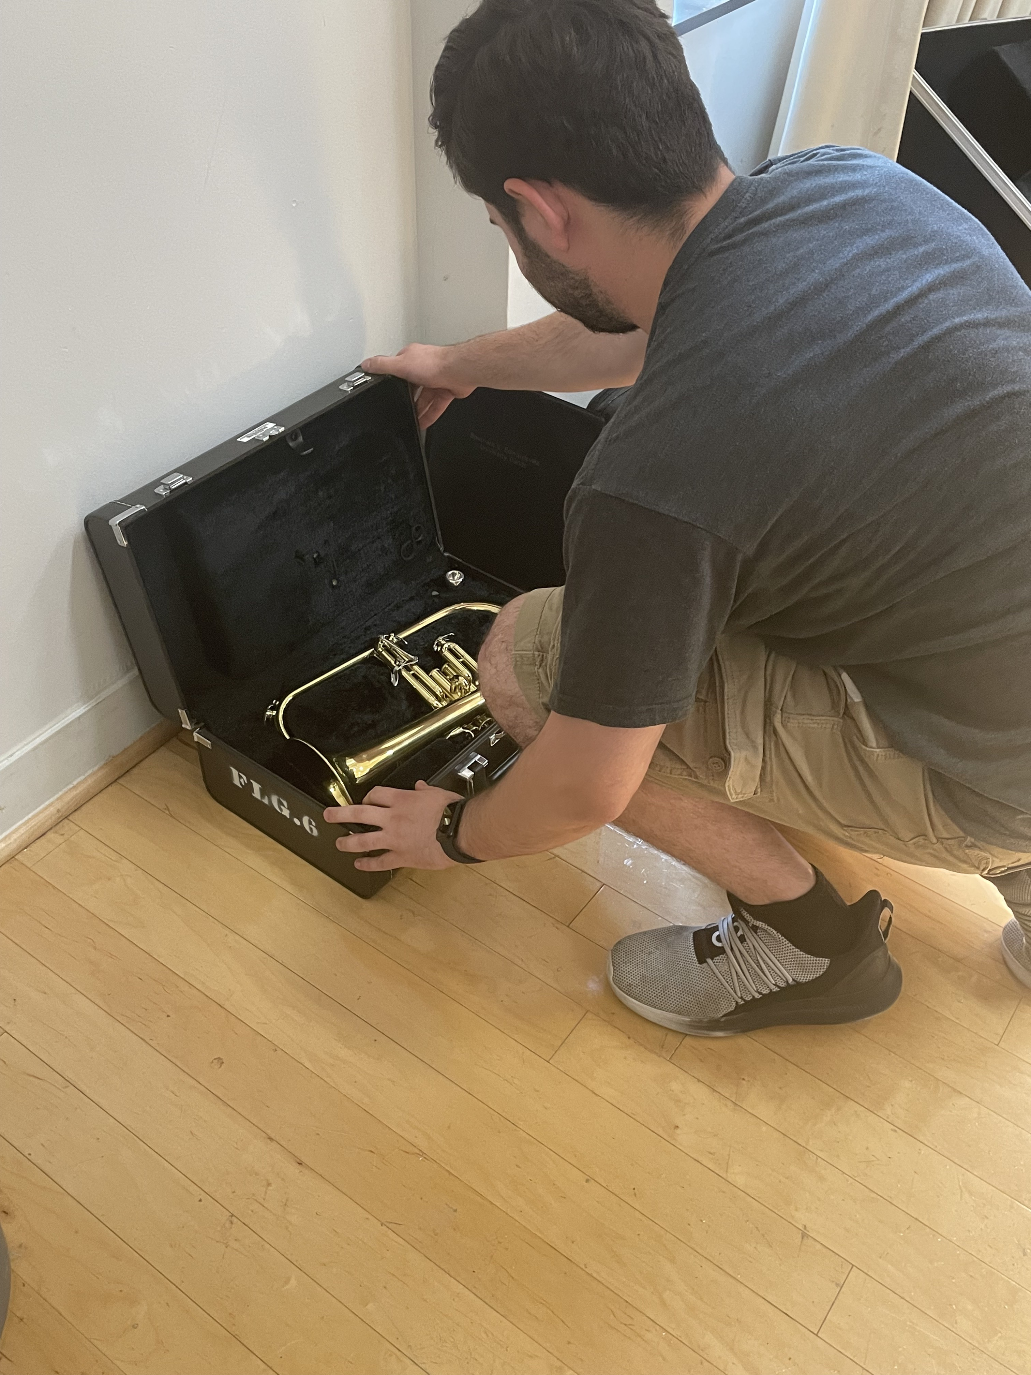
Instrument Cleaning

