Slide 1


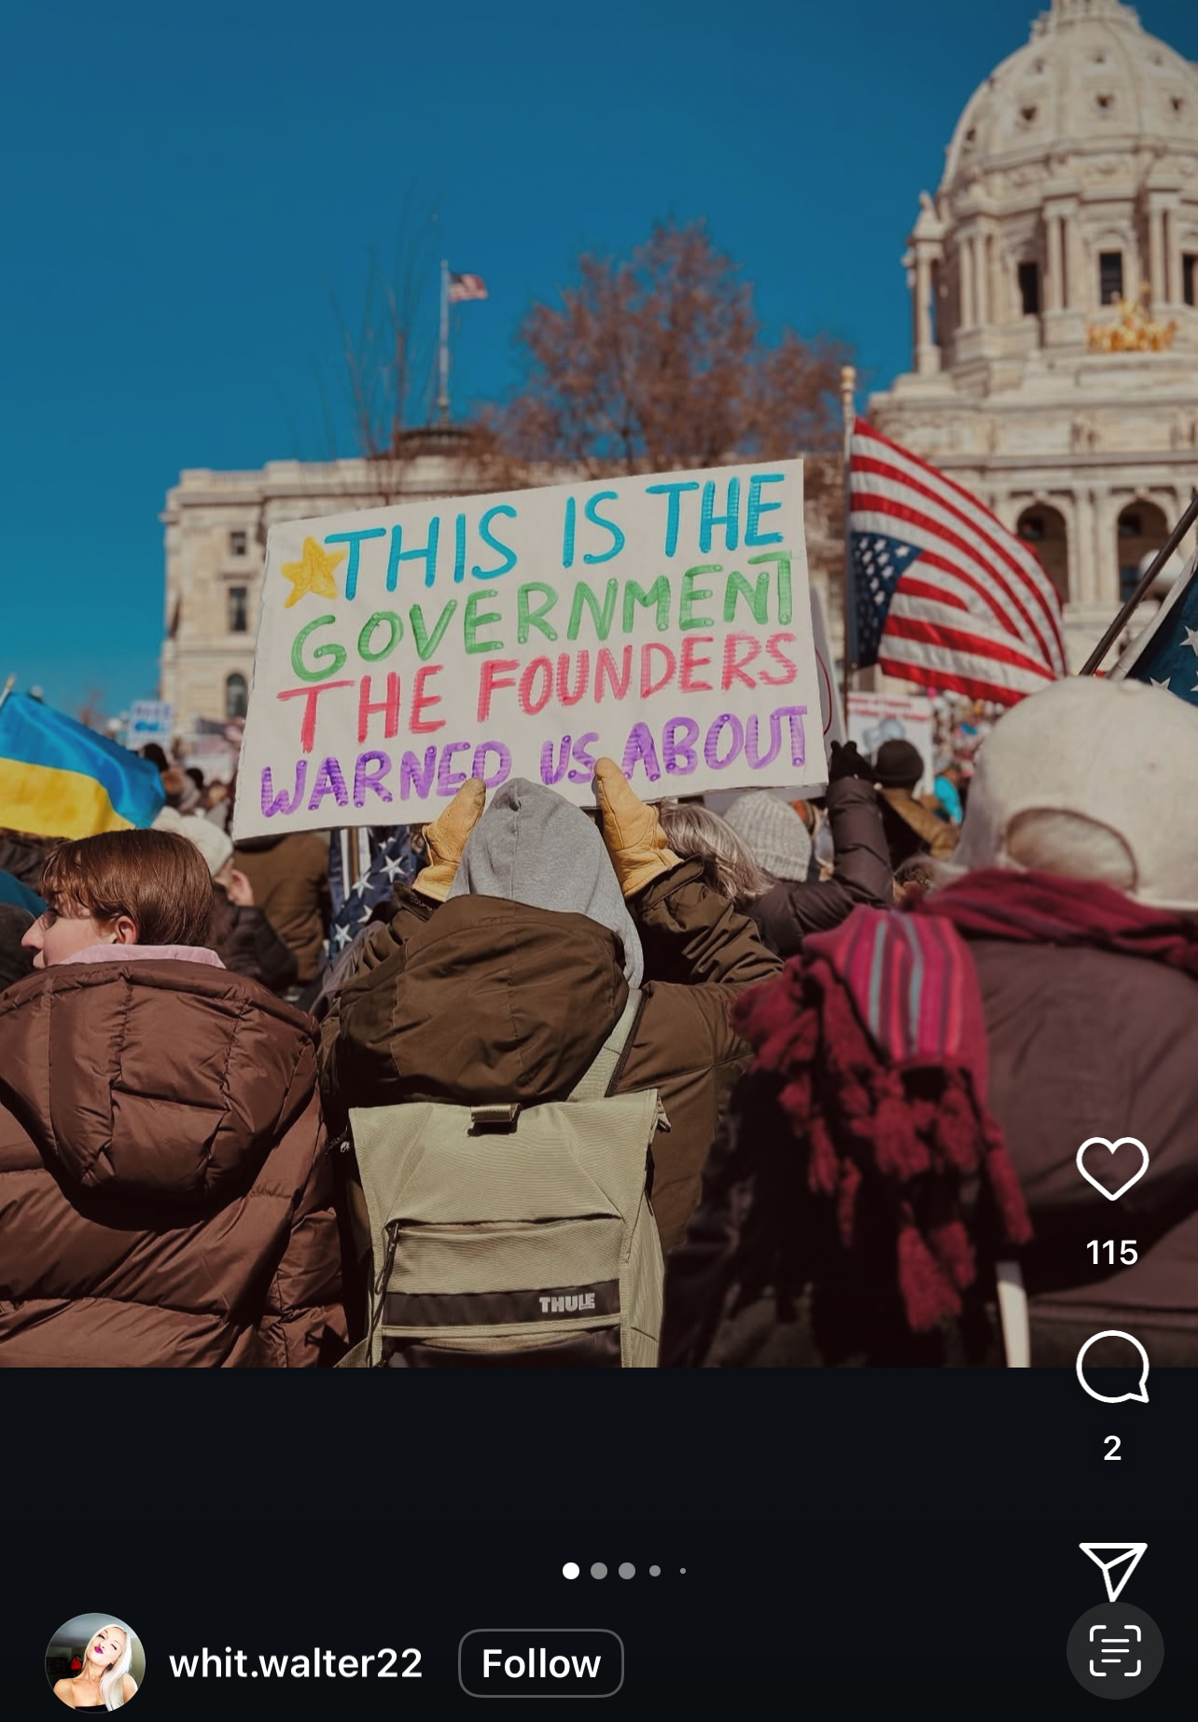
#HANDSOFF: A Thematic Analysis of the 2025 Trump/DOGE Protests
By Keith Hawkins, Aiden Martinez, Julez Hill, and Samuel Lee
CODES 123

Slide 2

Common themes
Disapproval of Trump's second administration
Disapproval of giving the top 1% control and power over the lower and middle class.

Slide 3
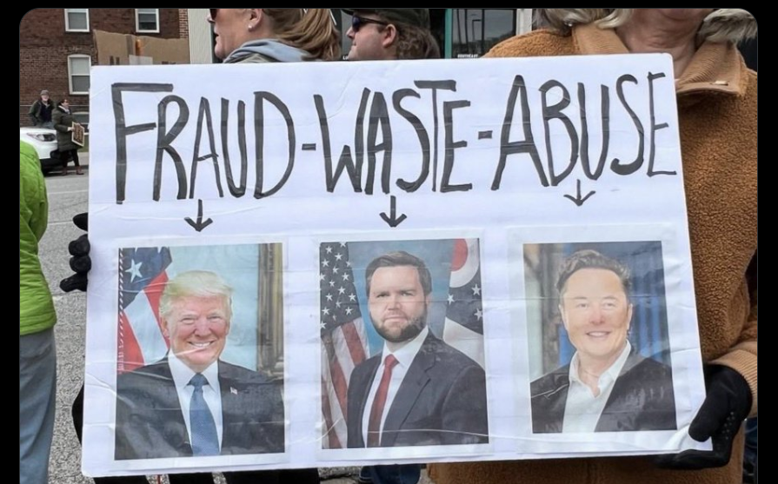
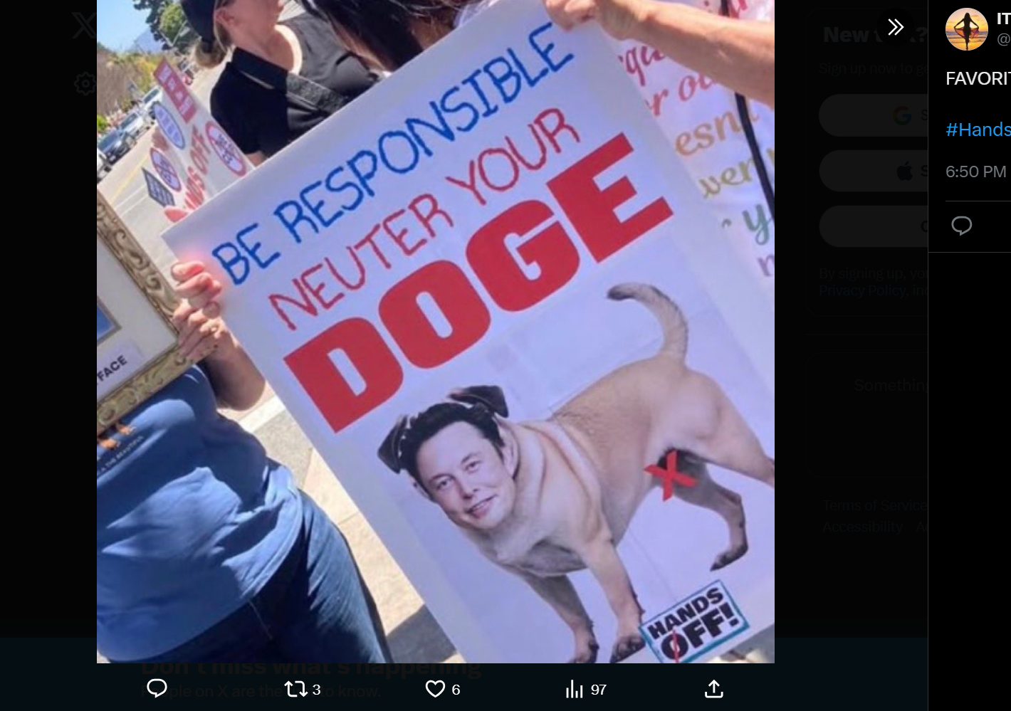
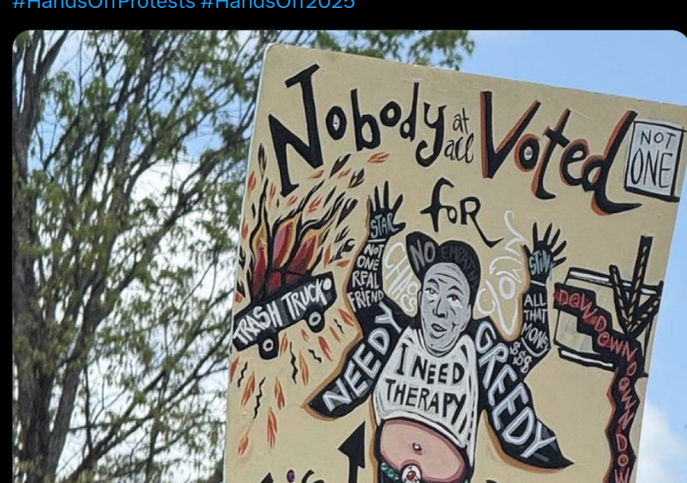
Quotes
"The Power of the People is greater than the people in power" -shopsocialgoods via Instagram
"We are watching! We are listing! Resist, persist, hands off!" -johannagoodman via Instagram
"This wasn't just a rally- it was a warning. We are organized. We are united. And we are just getting started."- voicesagainsttrump via Instagram

Slide 4
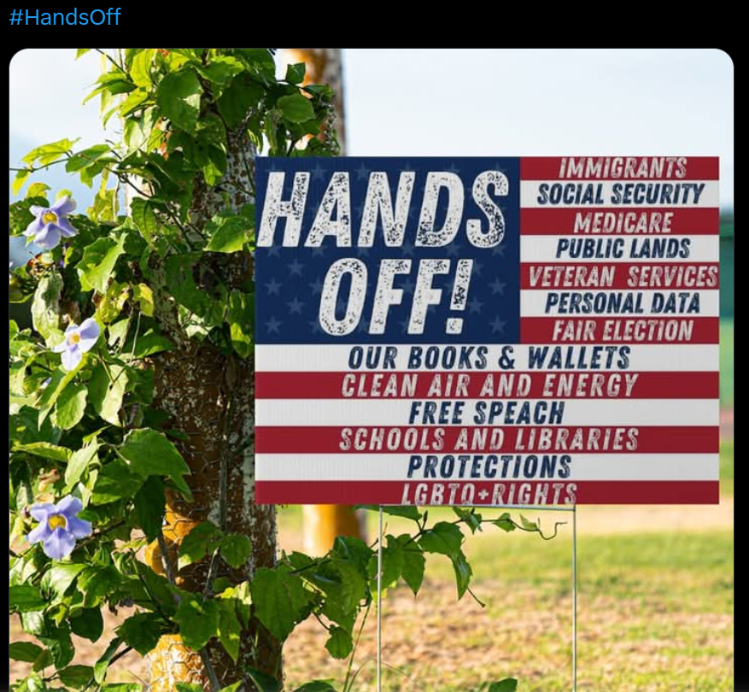
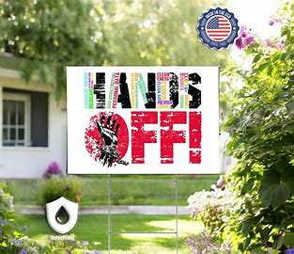
Focus and Purpose
This study explores the dominant themes present in discourse surrounding the hashtag #Handsoff.
Our focus is on the overwhelmingly negative response to the Trump and Elon musk's DOGE.
The purpose is to spread awareness and educate on the meanings behind the movement

Slide 5
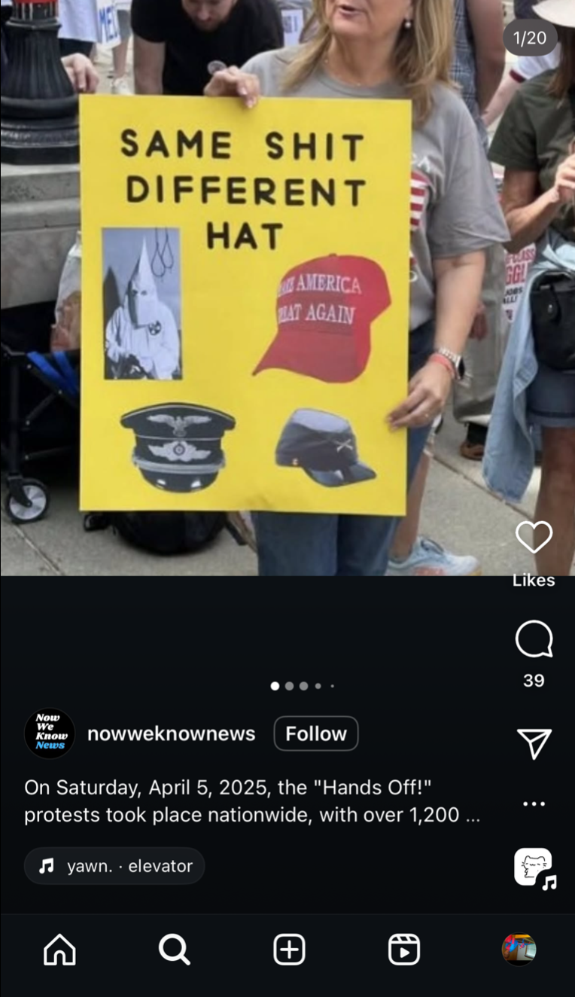
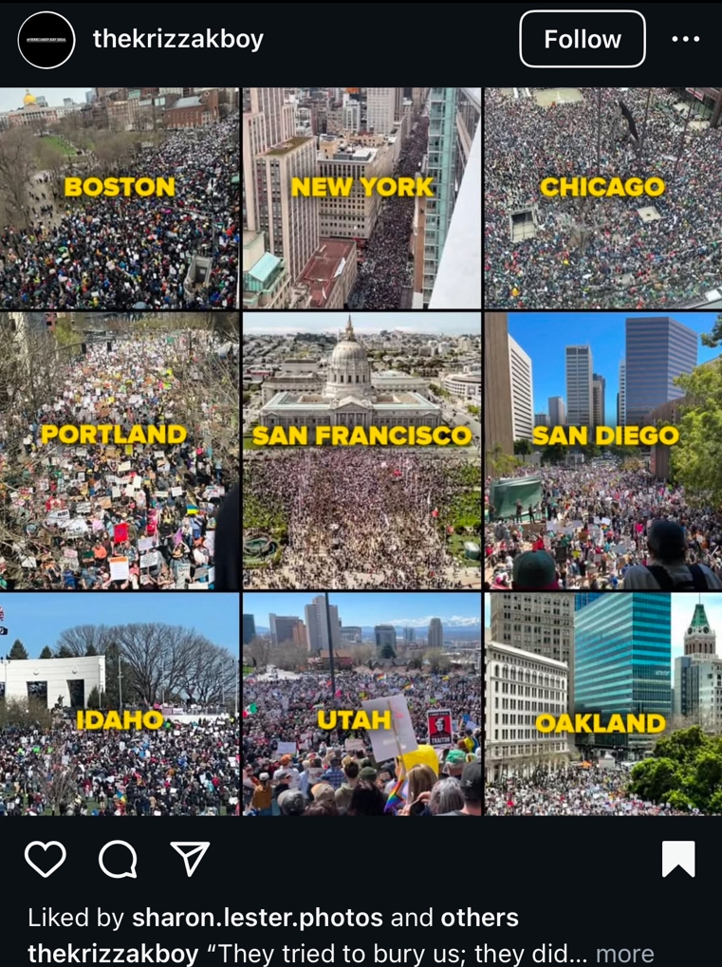
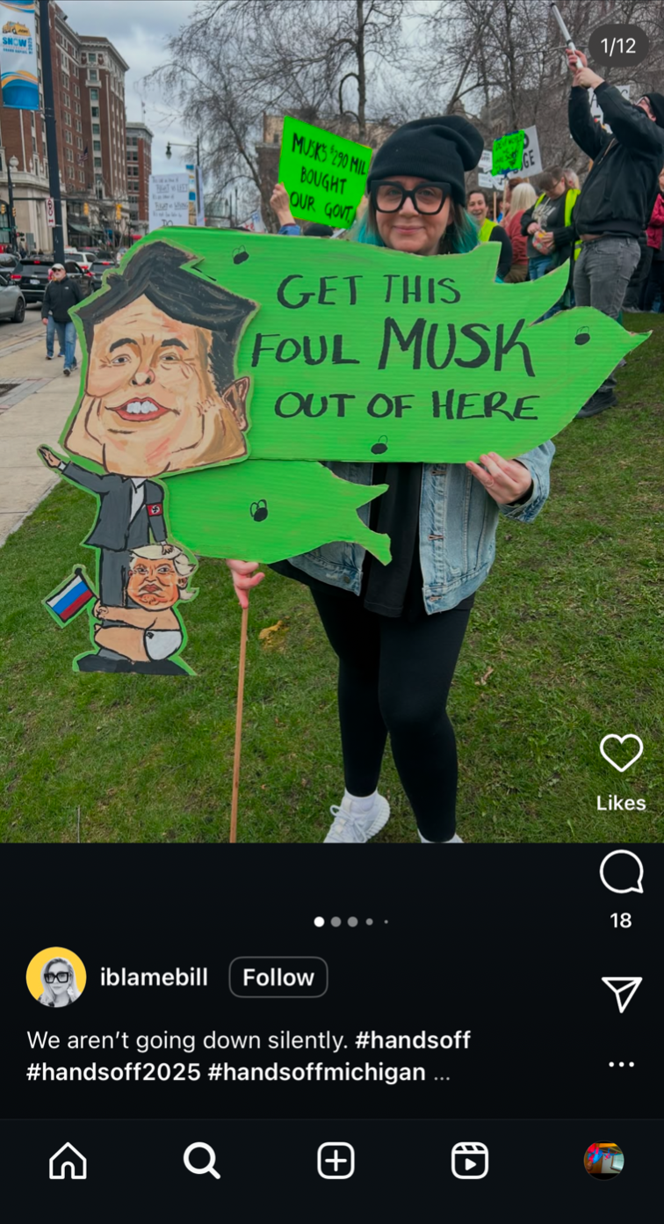
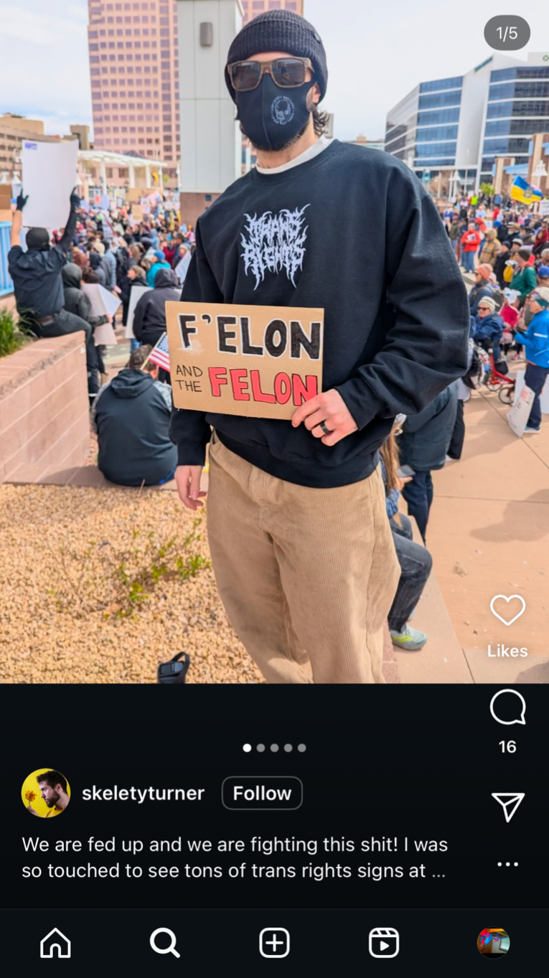
Methods
We chose this hashtag due to the relevance of the issue and it is an important local topic that should be discussed.
We collected our data from hashtags. We looked through different hashtags from various websites like instagram and twitter.
We looked through the captions of the post along with the content of the post to code and development themes.

Slide 6
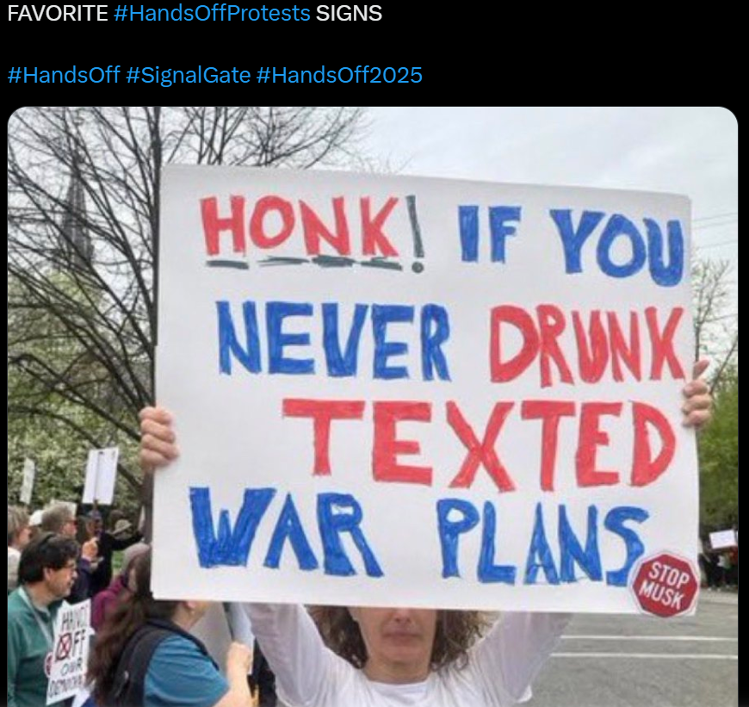
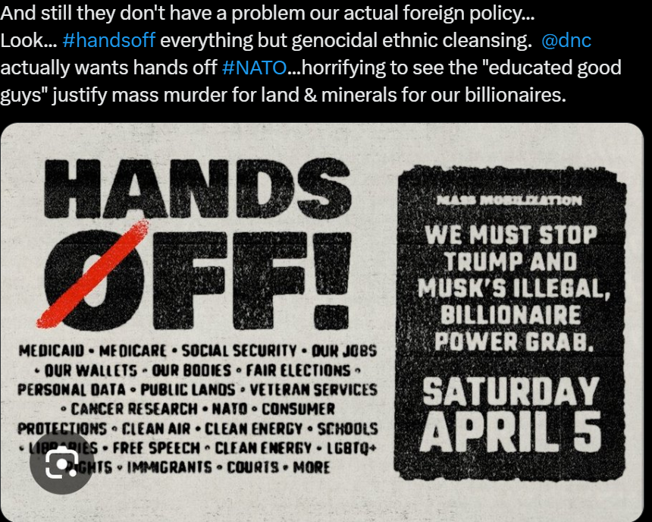
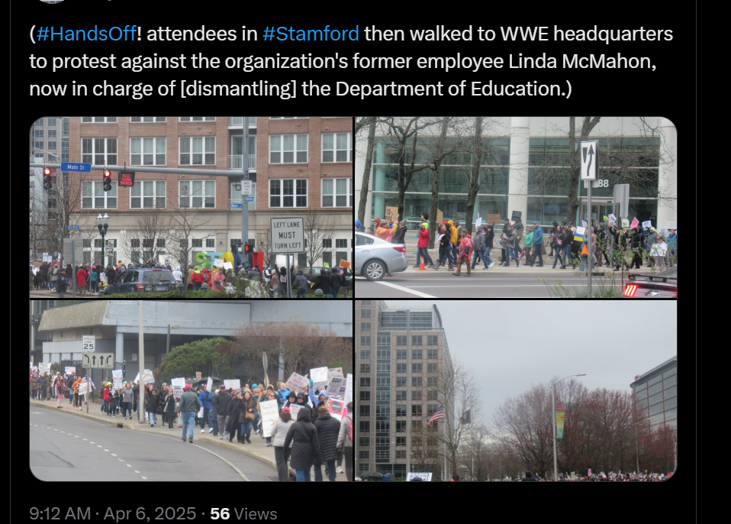

Slide 7
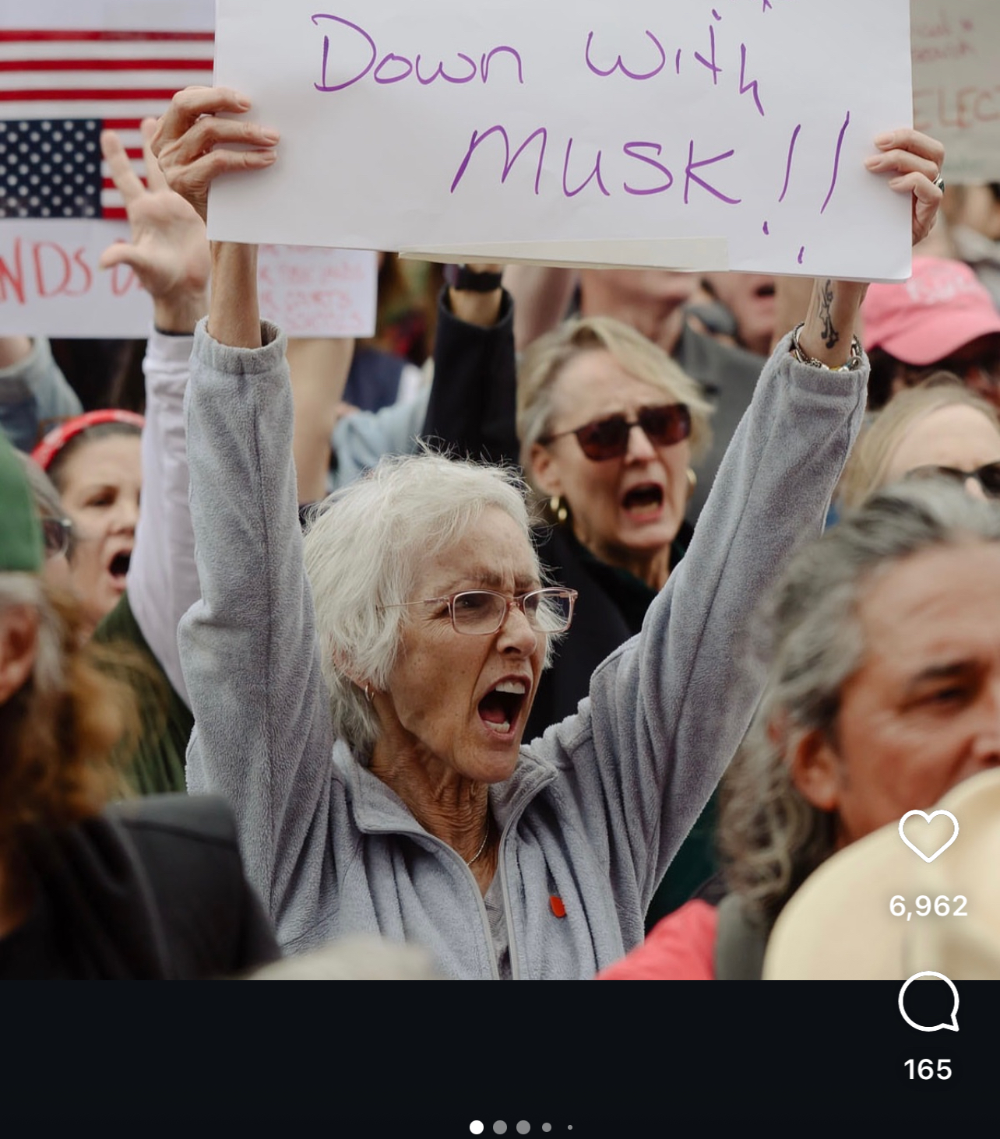
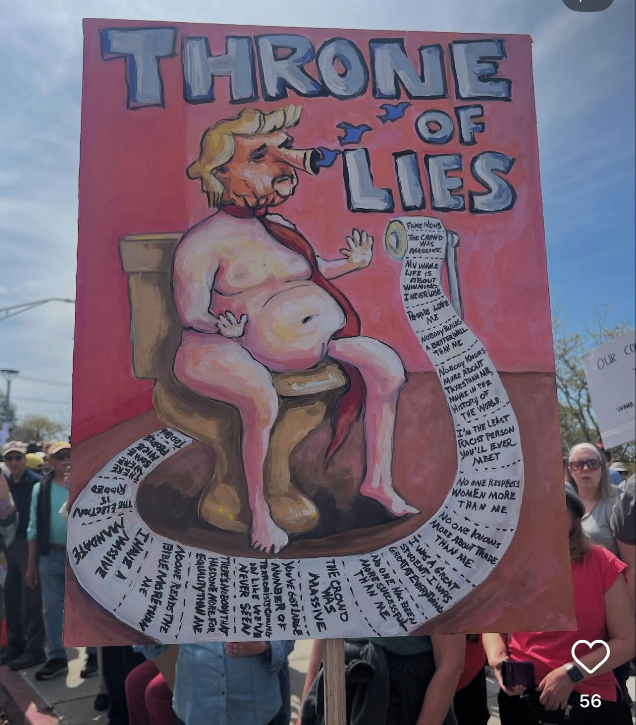
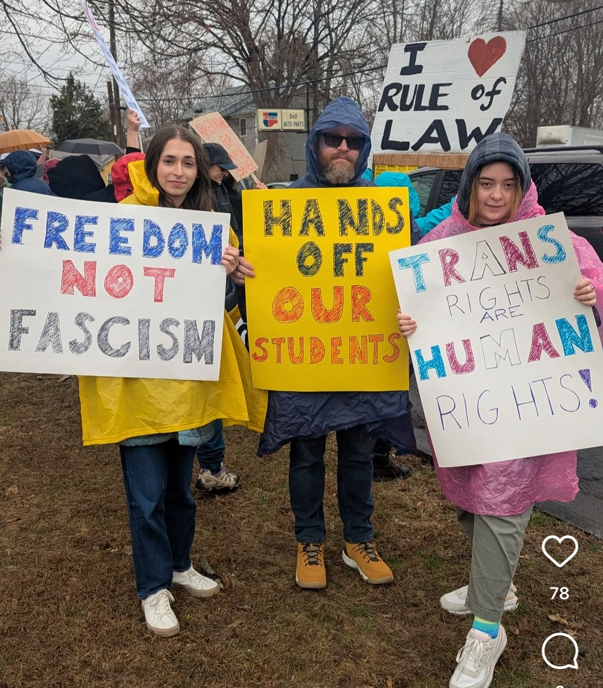

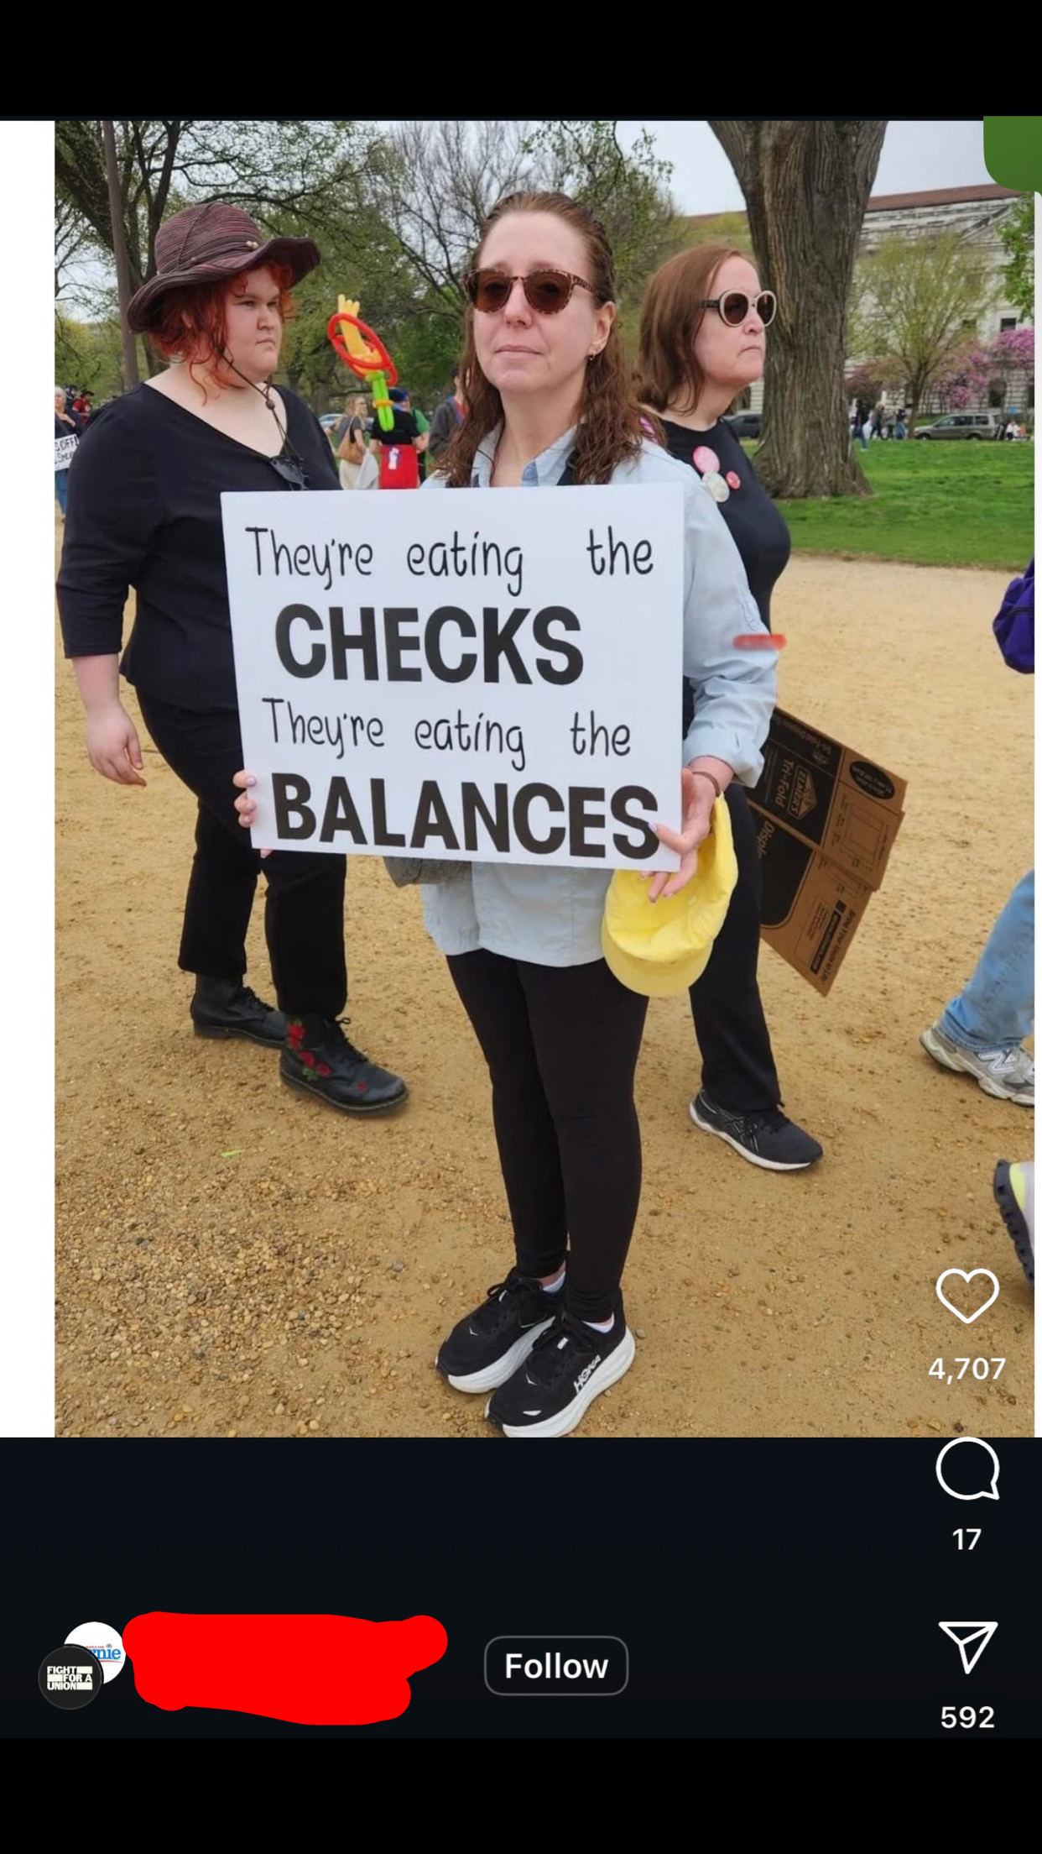
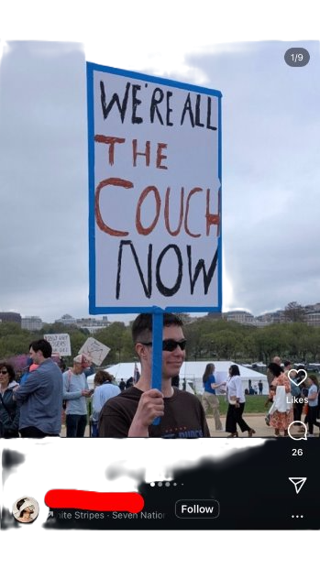

Slide 8
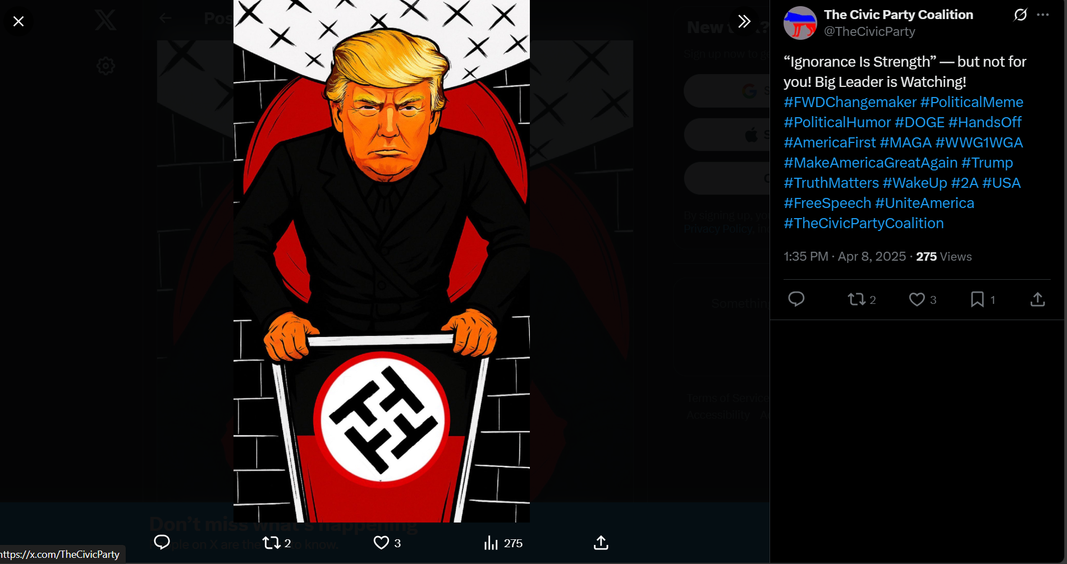
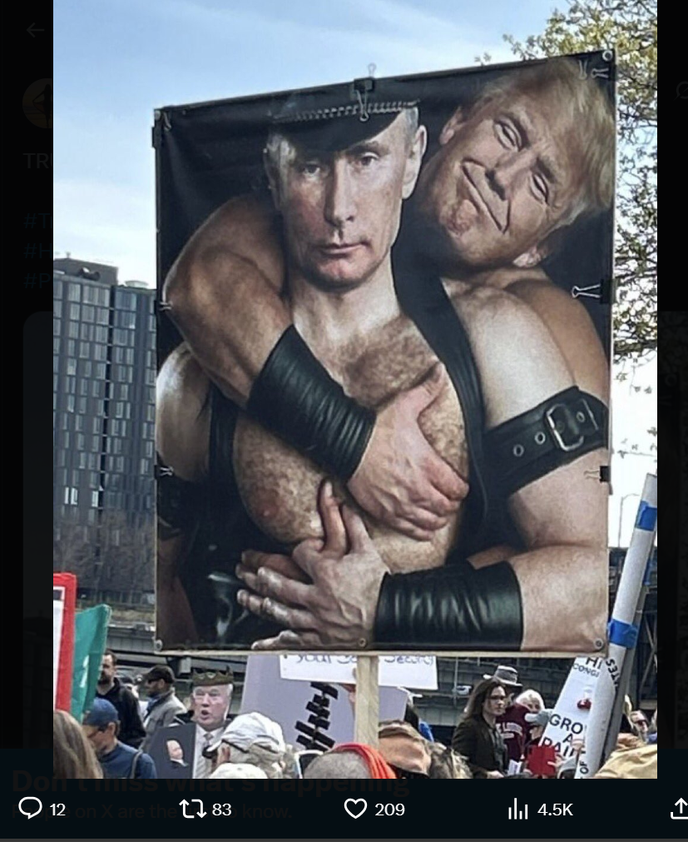

Slide 9
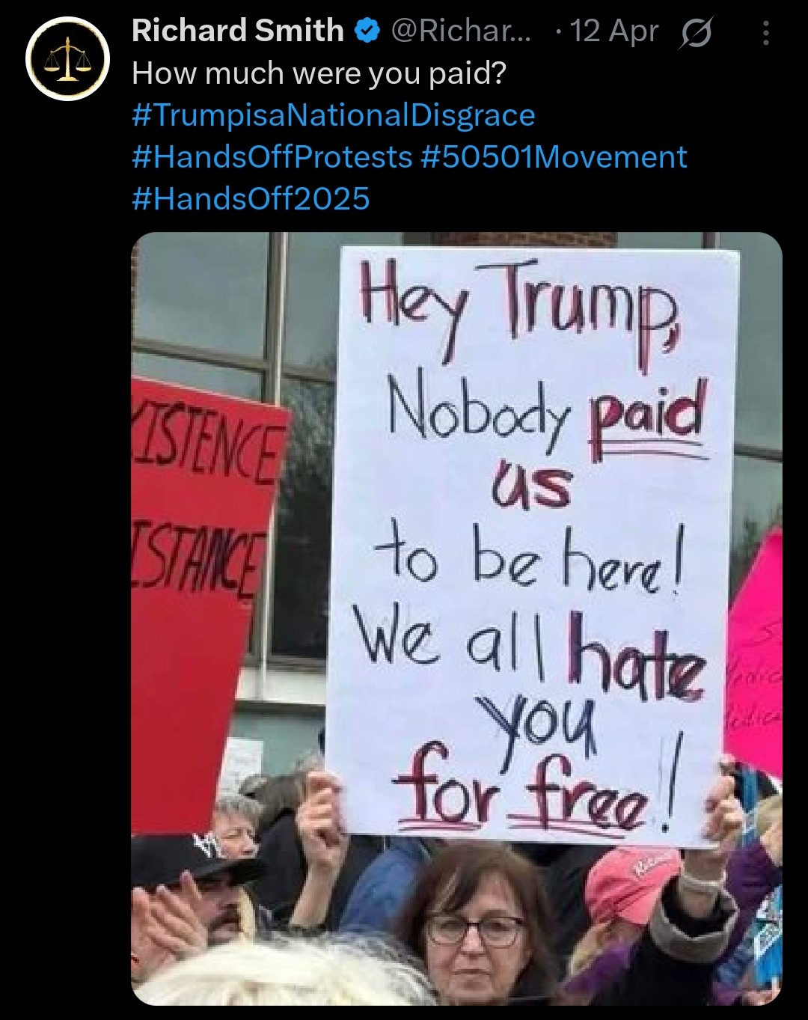
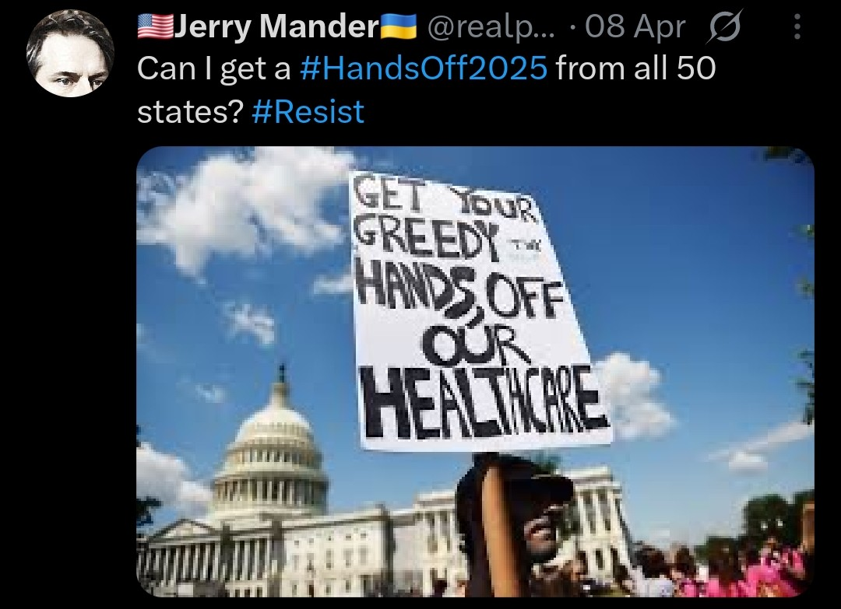
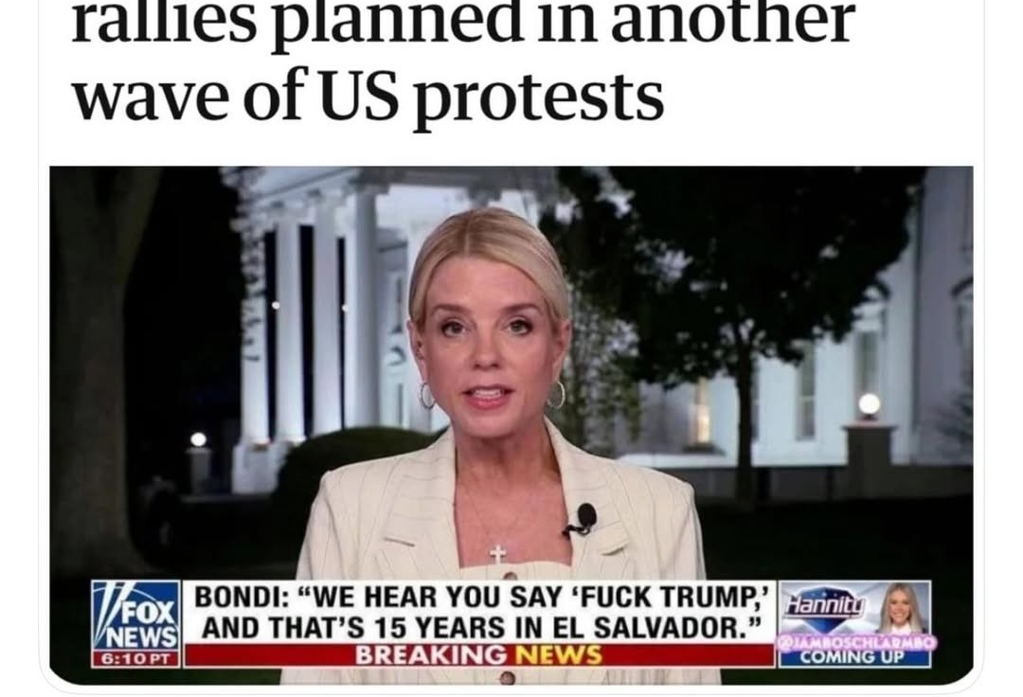
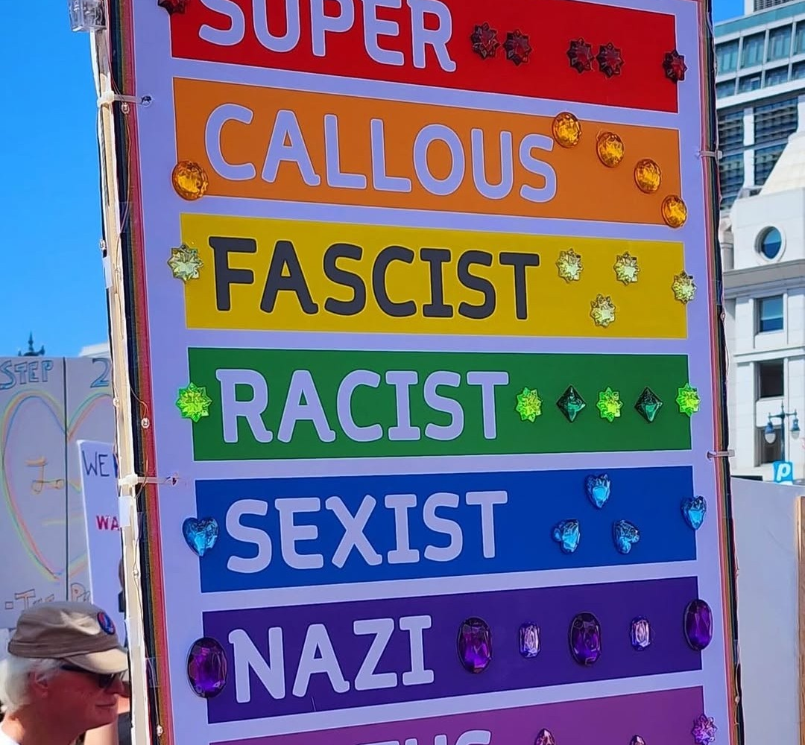
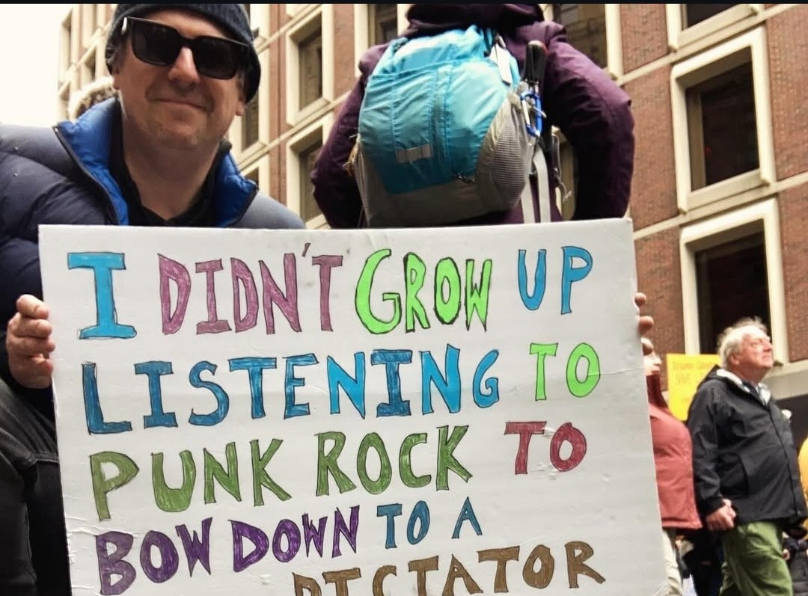
Significant Findings
Some of the most Significant finding is the age group around 20-37 particularly white people around major cities, such as San Francisco, Seattle and Portland, Oregon.
The hashtag peaked in relevance around march and different topics came up like immigration, DEI, and Education reform.
The overwhelming majority of the post under the hashtag were against the trump administration and support of the protesters. However, the comments under these post where people who supported the trump administration.

Slide 10
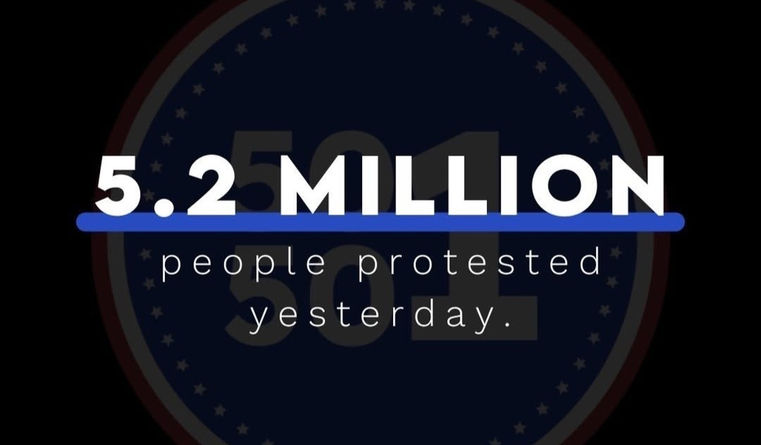
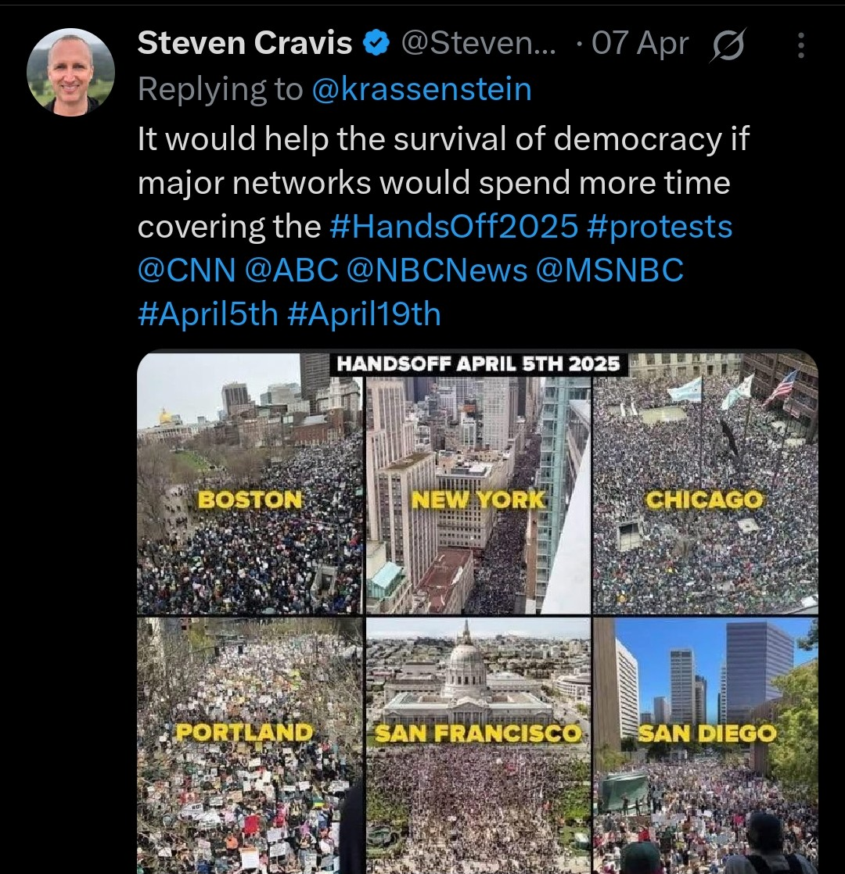
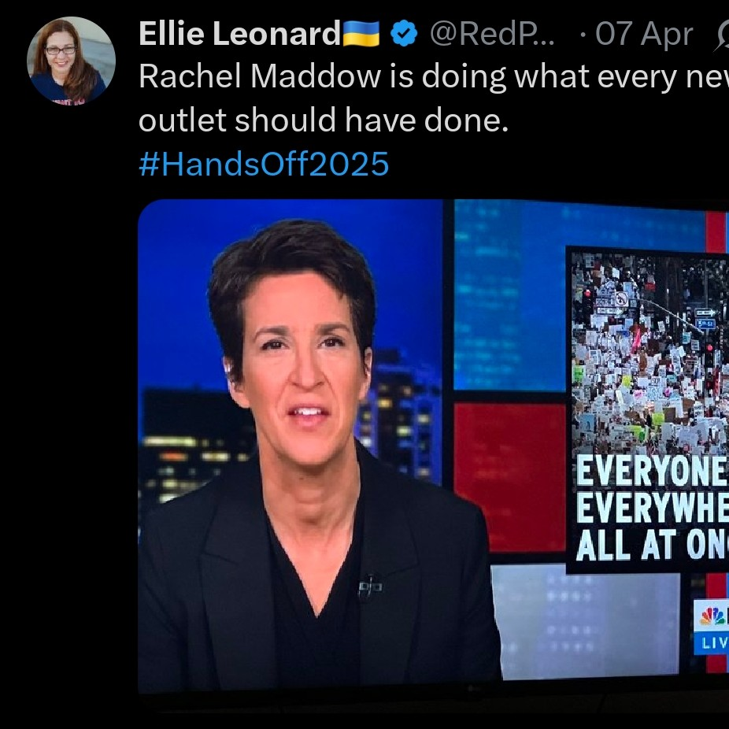
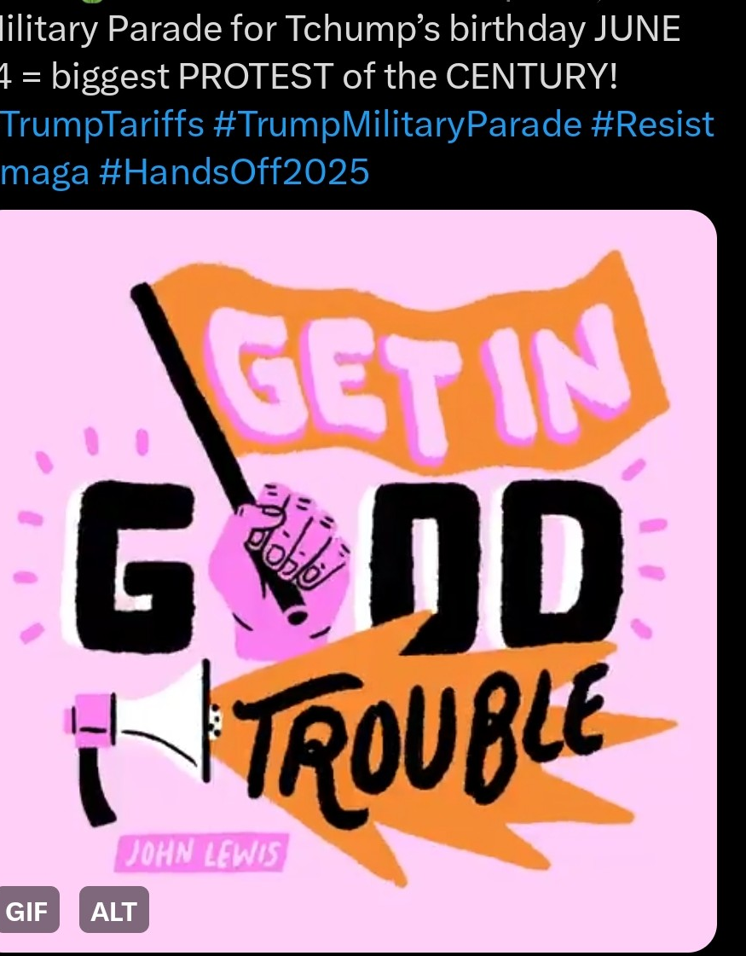
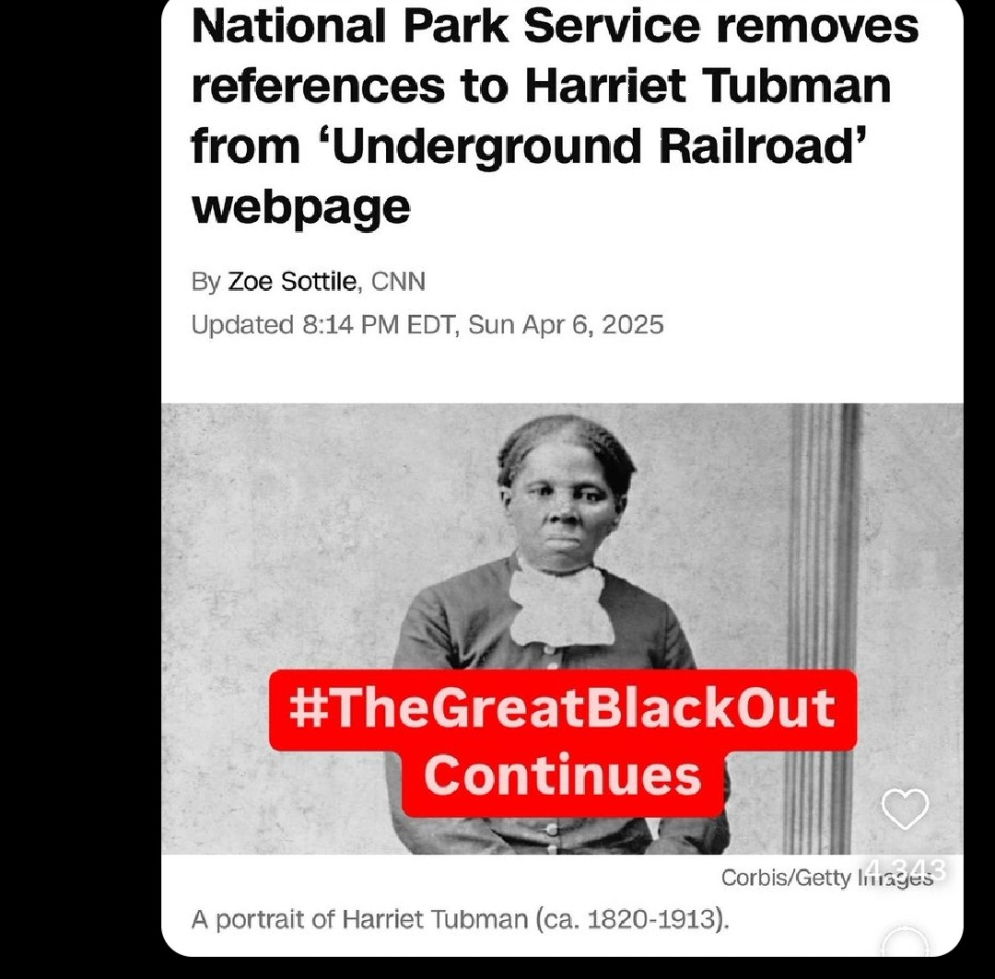

Slide 11
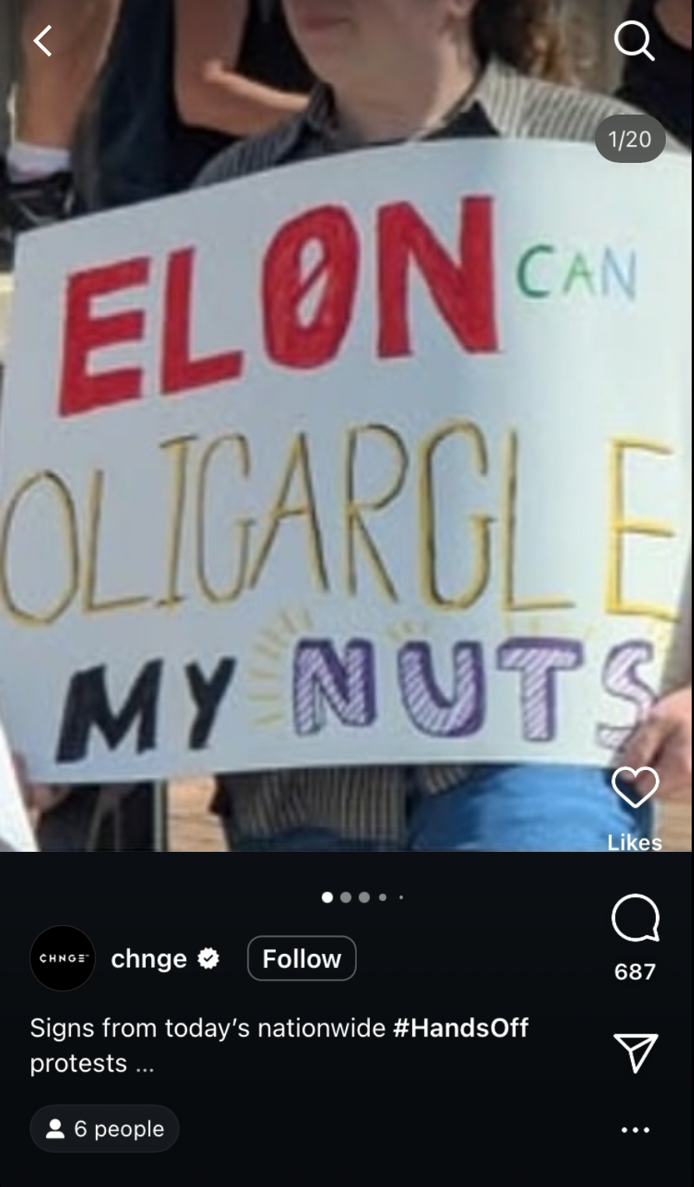
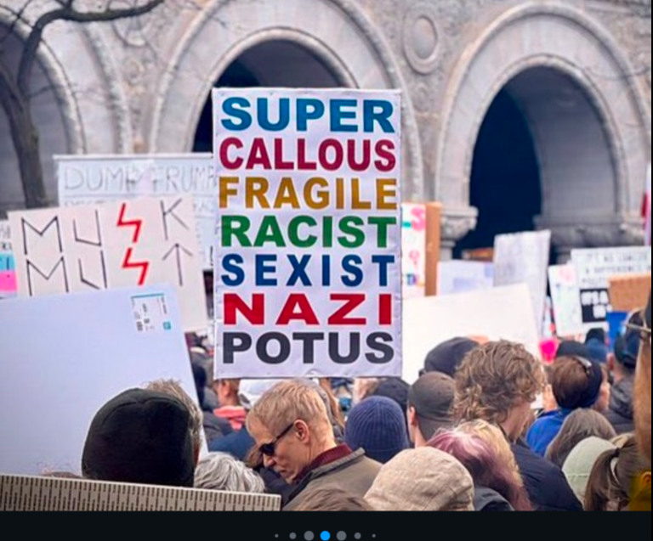
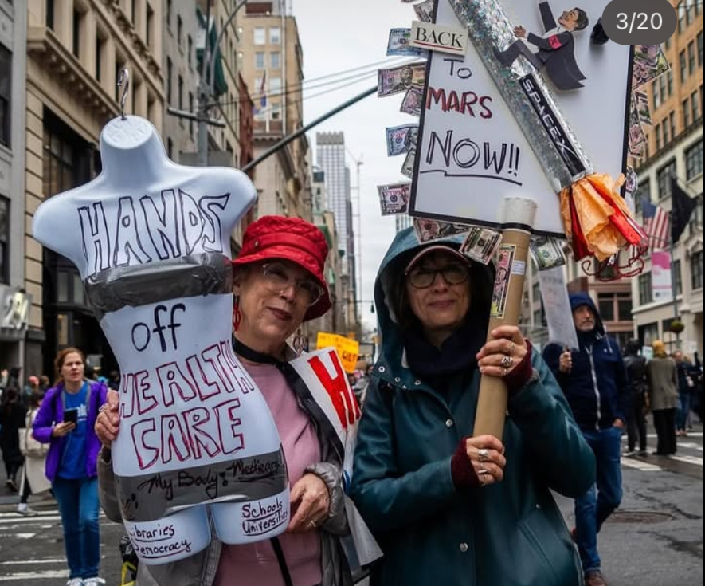
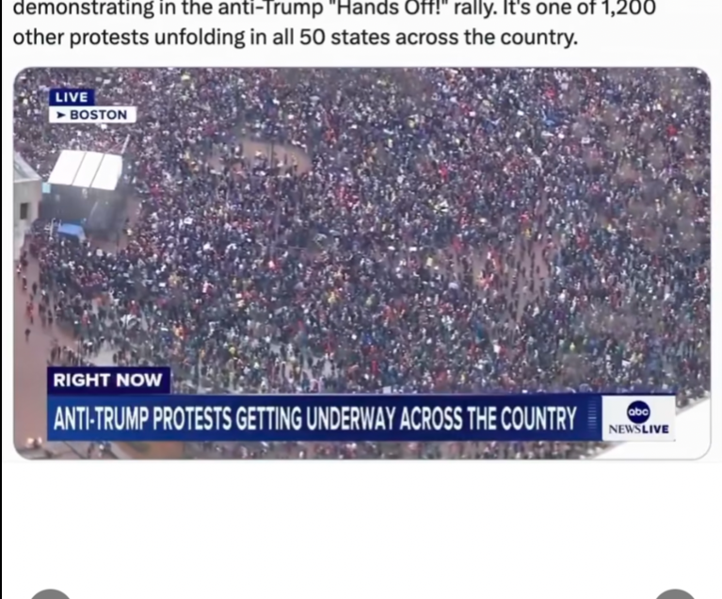
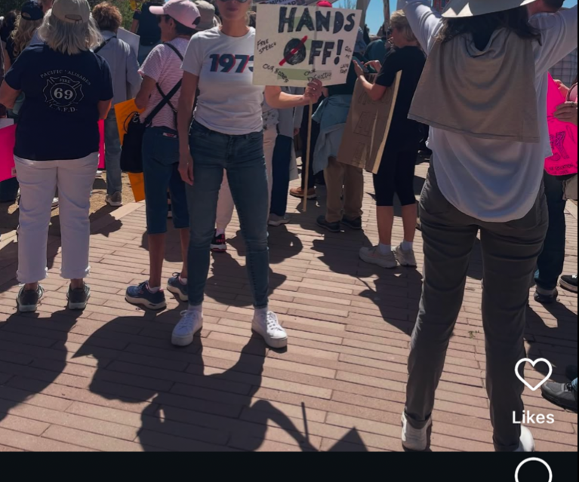

Slide 12
Reflection
The data cleaning was one of the most challenging part about this process. The correlation between the post and the meta data were difficult to clean because of the amount of content posted over a short period of time.
Our group found the number of negative comments under the hashtag. With the protests being so widespread, our group assumed the consensus on the topic to be more unitary as opposed to the division seen under the posts.
One of the key takeaways from our research was not only to protests themselves, understand the reasoning behind it. The data cleaning was harder than anticipated when it came to finding post relevant to today's topic. Even with this challenge, our group prevailed and was able to find information that will not only educate our group but others around us.

