Slide 1
StoryBoarding
By Abril

Slide 2
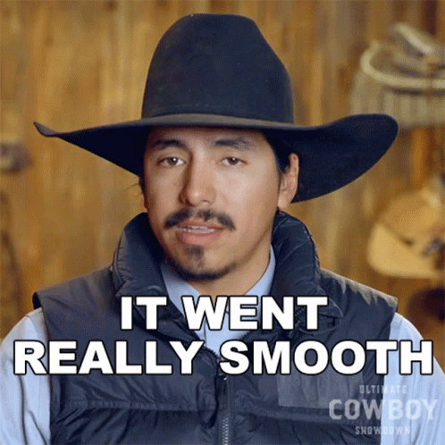
Immigrants succeeding
The American people are misinformed about the reality of the hardships they go through to be successful and have a better future for coming generation

Slide 3
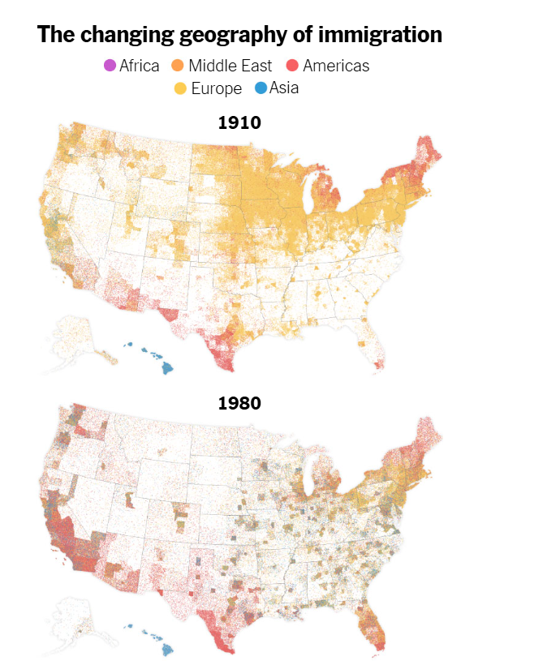
The change of immigrants over time and location
Immigrants moved to the united states for different reason with the same goal to live the american dream.

Slide 4
Over time there was more American immigrants coming to united states
American immigrants stayed more in the outskirts of the outer states and not the middle states over time those states developed a higher rate of american immigrants

Slide 5
Over time success and stability
The video shows that as the children of immigrants and US. born children grow through their lifespan, immigrants have a higher rate of overcoming poverty and building a stable home.

Slide 6
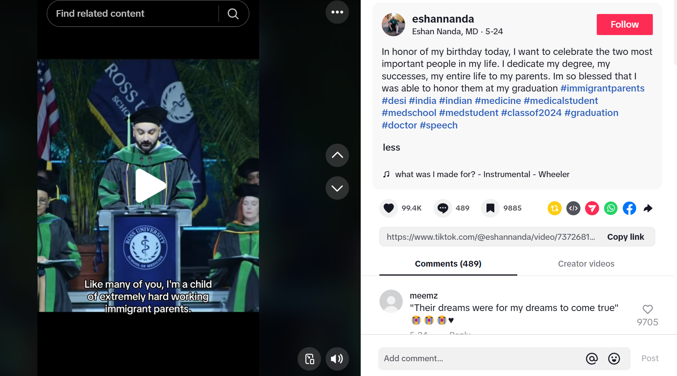
Tik Tok
Social Medial inspires people and tell the reality of their parents hard work and why they will become successful.

