Slide 1
The Future of Water Infrastructure Education
Name
Department Course Number Section Time Location
DATE
By: Marques Rutlin, Sonia Sheryr, Alexandra Guerrero, and Payton Plummer

Slide 2
Introduction+System
Name
Department Course Number Section Time Location
DATE
Ultimate Goal
Understanding
Complex/simple systems
Awareness
Complexity
Interactive Activities

Slide 3
Stakeholders
Name
Department Course Number Section Time Location
DATE
Government
Students
Parents
Internal stakeholder
Active Stakeholder
Secondary Stakeholder

Slide 4
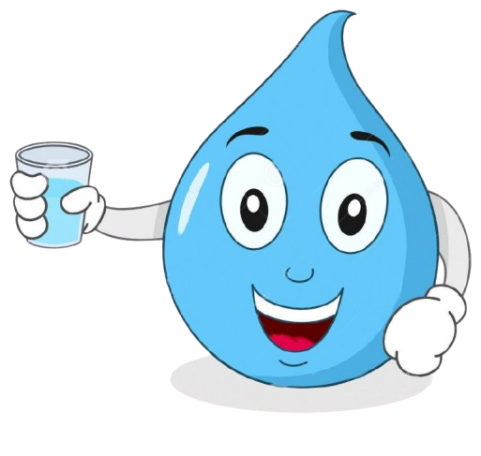
Stakeholder Participation
Name
Department Course Number Section Time Location
DATE
Stakeholder Participation is important because
Improved decision making
Greater project success
Deeper understanding of community needs

Slide 5
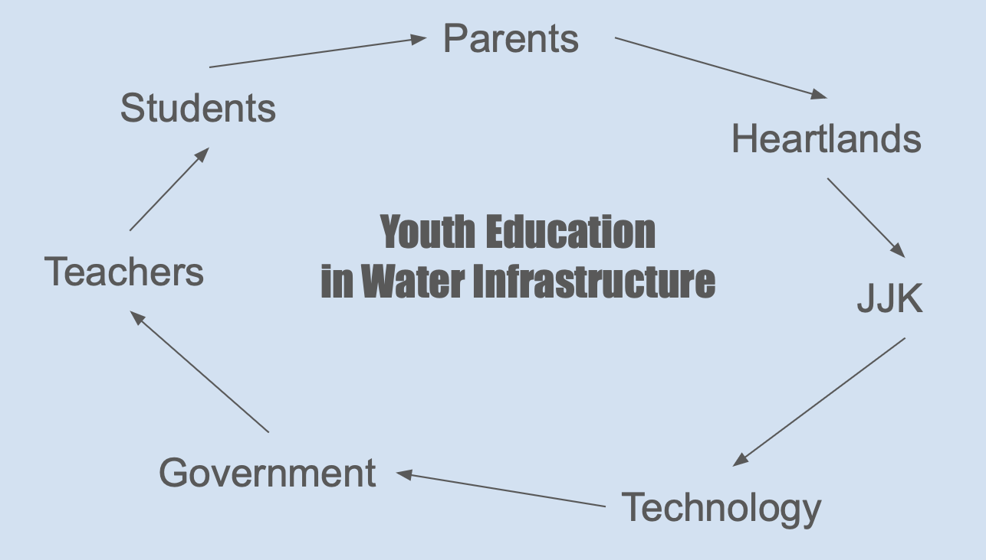
Problem Support
Exposing kids
Exposing children to places with natural bodies of water provides better knowledge and understanding of water infrastructure
For active learning, children can participate in projects and water conservation analysis. Letting the kids research water and engage in water science, they can develop solutions and problem-solving tactics, all of which will open new ways of learning.
Our plan of support
We use youth education to influence others. We aim to show the importance of water infrastructure and why teaching it to young kids can significantly impact the future.

Slide 6
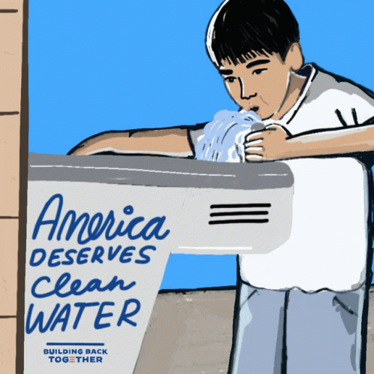
Problem Support
Name
Department Course Number Section Time Location
DATE
We are concentrating on elementary education and different aspects we can use to educate students of this age on the impact of learning about water infrastructure. By exposing them to knowledge of water's importance, they can pass this on to the next generation. Teachers should focus on three areas
Curriculum development
Collaboration with expert
Field trip
Hands on learning
Focus

Slide 7
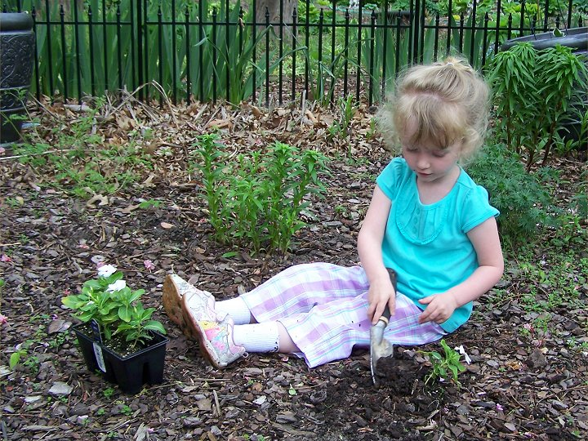
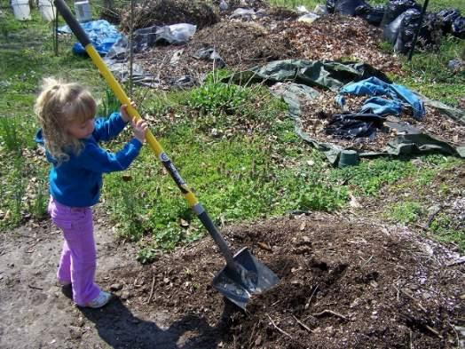
Name
Department Course Number Section Time Location
DATE
Next Steps
Research
What are other communities doing?
What is and isn’t working?
Technology integration
Social Media
Virtual Reality
Extracurriculars
JJK & Heartlands
Spring 2025 and Fall 2025

