Slide 1
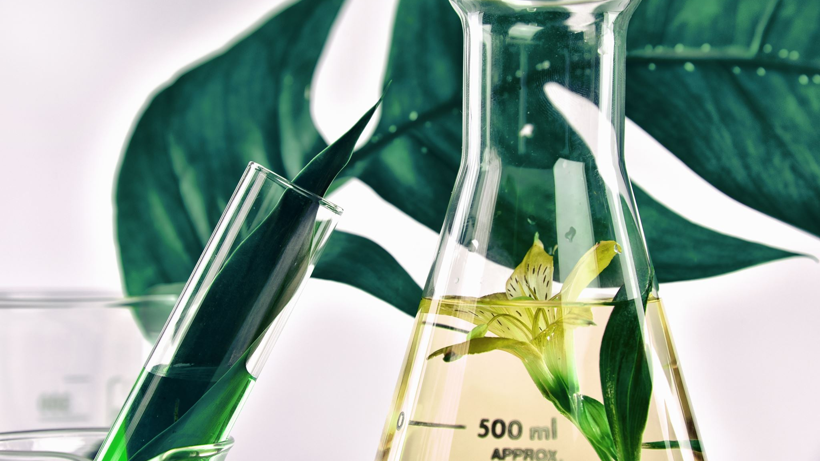
Indigenous Plant Knowledge vs Scientific Plant Knowledge
Evitt Nashed & Cullen Krieg

Slide 2
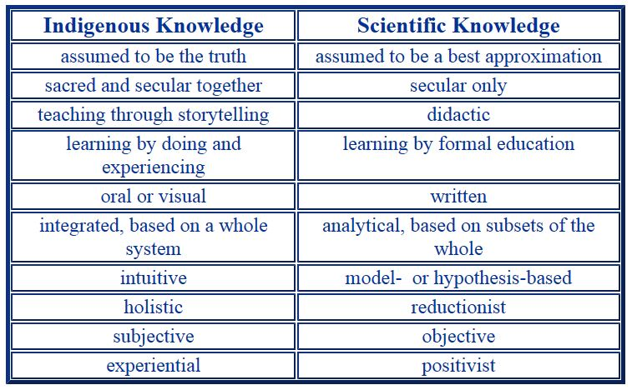
What does indigenous knowledge mean?
What Does Scientific Knowledge mean?
Indigenous knowledge is defined as traditions, practices, wisdom, and other experiences related to relationships with the land and ecosystem.
Scientific Knowledge is known as knowledge gained by observations, testing's, measurable facts, experiments, etc.
Notes:
Indigenous knowledge to us means holistic knowledge has been passed down through many generations that offers great alternatives to how we can care and use plants! Indigenous people have a great understanding of plants.
Scientific knowledge to us means things like experiments, observations and the use of scientific methods to test something. Scientific knowledge uses theories to predict future observations while indigenous people rely on generational traditions.

Slide 3
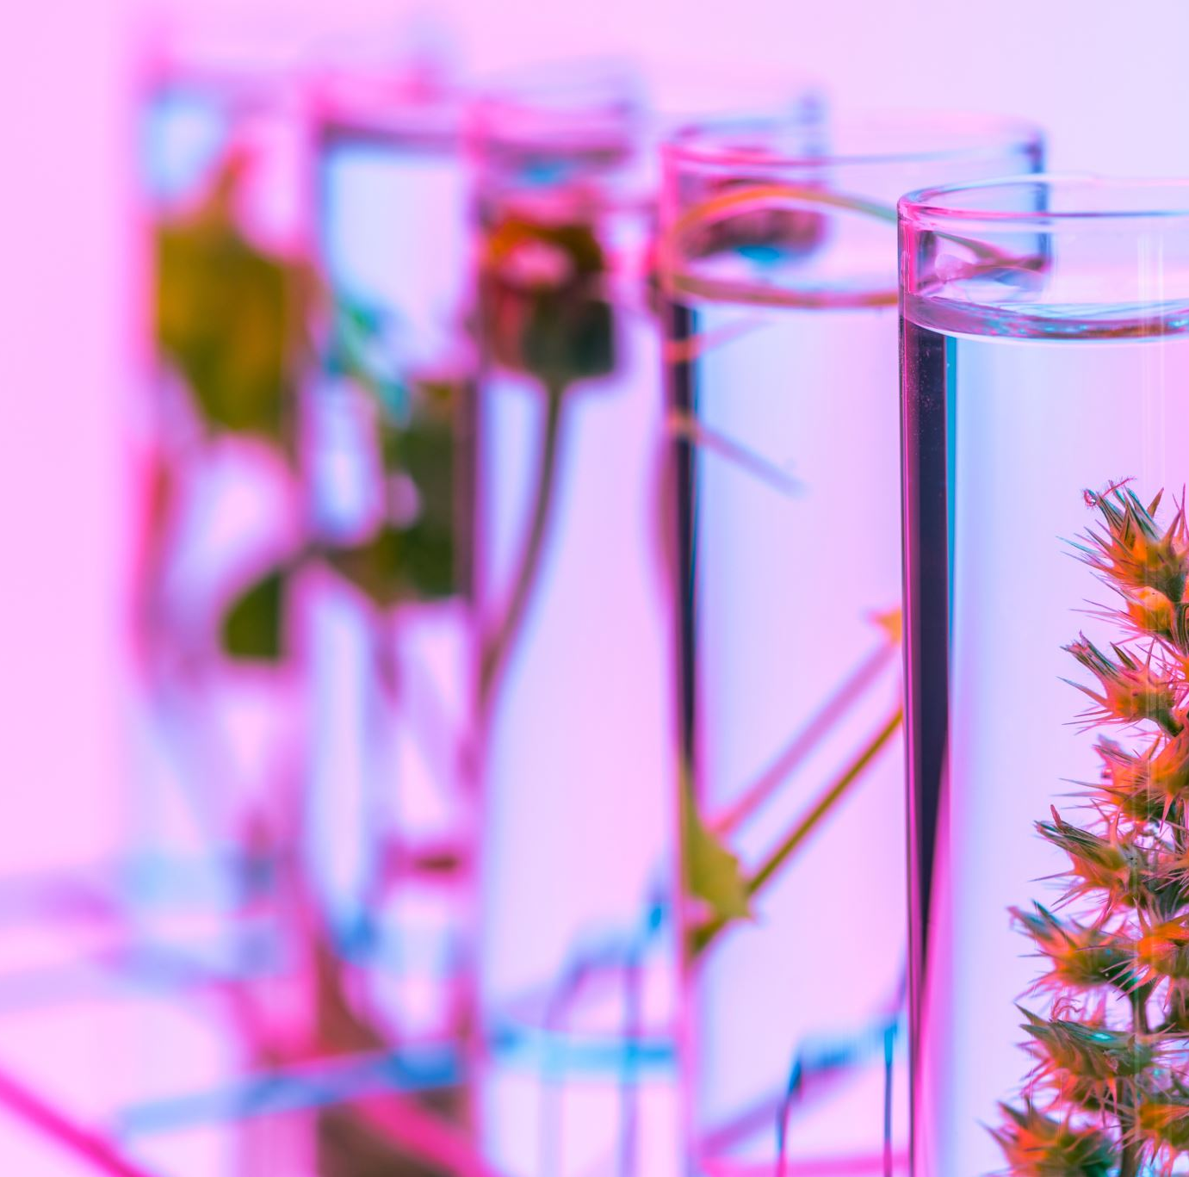
Research question
How did indigenous people care and cultivate for their plants compared to modern scientists?
Notes:
The research question was made to help us figure out how indigenous people work with the ecosystem and the way animals, land, humans are all interconnected. It is proven that biodiversity is big within indigenous knowledge with their conservation methods. The research found all relate to the significance of Indigenous Knowledge and how to care for the ecology. We hypothesize that Indigenous plant knowledge is better off than scientific plant knowledge because the Indigenous communities have thrived for many years with the knowledge that they have known.

Slide 4
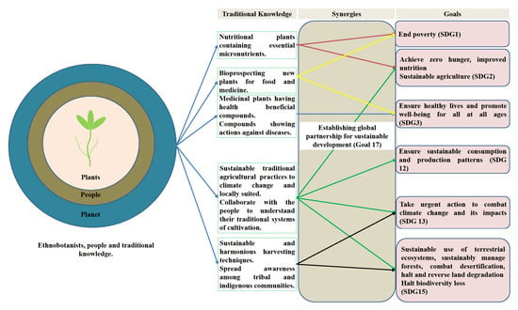
Summary of evidence
Review article
Role of Traditional Ethnobotanical Knowledge and Indigenous Communities in Achieving Sustainable Development Goals
This figure highlights the goals ethnobotanists developed to achieve a sustainable environment.
Notes:
This review article goes into detail about the vital role ethnobotanical knowledge and indigenous knowledge plays in achieving sustainable development goals. The way these indigenous communities develop this knowledge is by physical interactions with nature and the land they use. The author argues that if you apply traditional ethnobotanical knowledge to modern practices, then you will achieve a greater use of environmental sustainability. The article also talks about certain practices like crop diversification and soil fertility management that indigenous people use to help maintain the security of these plants.

Slide 5
Summary of evidence
USING TRADITIONAL ECOLOGICAL KNOWLEDGE IN SCIENCE: METHODS AND APPLICATIONS
In this research paper the authors’ area of research is exploring how Traditional Ecological Knowledge (TEK) can be implemented into current scientific research tactics.
Research article
Notes:
The author talks about trying to have a collaborative bond between indigenous individuals and scientists to implement better ecological understanding of a certain topic and the decisions that are made to conclude. The hypothesis made in the research paper is traditional ecological knowledge can enhance current scientific research. The use of collaborative research will allow both parties to get together to share ideas and work to find a shared conclusion or possibly create new ideas with the shared mindset.

Slide 6
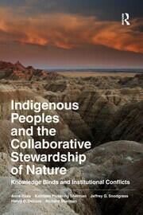
Summary of evidence
Science communication article
Indigenous Peoples and the Collaborative Stewardship of Nature
Notes:
This book goes into detail about indigenous communities and the way they manage their resources. The author describes that indigenous knowledge and modern knowledge can go hand in hand with some of their management practices. The author also argues that challenges could arise when collaborating with both indigenous communities and modern science. Both have different worldviews and practices they live by that could get in the way. The book goes through certain case studies to analyze the pros and cons of collaborating.

Slide 7
Proposed Experiment
Independent- Both modern scientists and Indigenous individuals
Dependent- Time spent taking care of plants
Control- The plants
Time spent weekly
Notes:
This graph shows that indigenous people put more effort and care into plants than modern scientists. This is because they live a holistic life to the environment compared to modern scientists. Indigenous people rely on the environment to live which makes them form a connection with nature. This holistic lifestyle fosters stewardship between the people and land.

Slide 8
Summary and reflection
To tie this all up, we found out that Indigenous people evolve their whole lives around nature and time plays a role in it.
Notes:
Indigenous people often rely on long term observations of these plants for them to understand their environment better.
Time is seen as a reciprocal relationship within indigenous people compared to scientists. The land plays a role in providing plants for indigenous people and they provide timely care for them in return. For example, harvesting plants at a certain time is a way of listening to the plant’s needs and respecting it. They don’t just see plants as something that grows from the land. Instead, they usually reflect on plants in a spiritual meaning. They listen to the needs of the plants.

Slide 9
Citations
Ross, Anne, et al. Indigenous Peoples and the Collaborative Stewardship of Nature: Knowledge Binds and Institutional Conflicts. Routledge, 2016, https://doi.org/10.4324/9781315426617.
Huntington, Henry P. “USING TRADITIONAL ECOLOGICAL KNOWLEDGE IN SCIENCE: METHODS AND APPLICATIONS.” Ecological Applications, vol. 10, no. 5, Oct. 2000, pp. 1270–74. DOI.org (Crossref), https://doi.org/10.1890/1051-0761(2000)010[1270:UTEKIS]2.0.CO;2.
Kumar, A., Kumar, S., Komal, Ramchiary, N., & Singh, P. (2021, March 11). Role of traditional ethnobotanical knowledge and indigenous communities in achieving Sustainable Development Goals. MDPI. https://www.mdpi.com/2071-1050/13/6/3062

