Slide 1
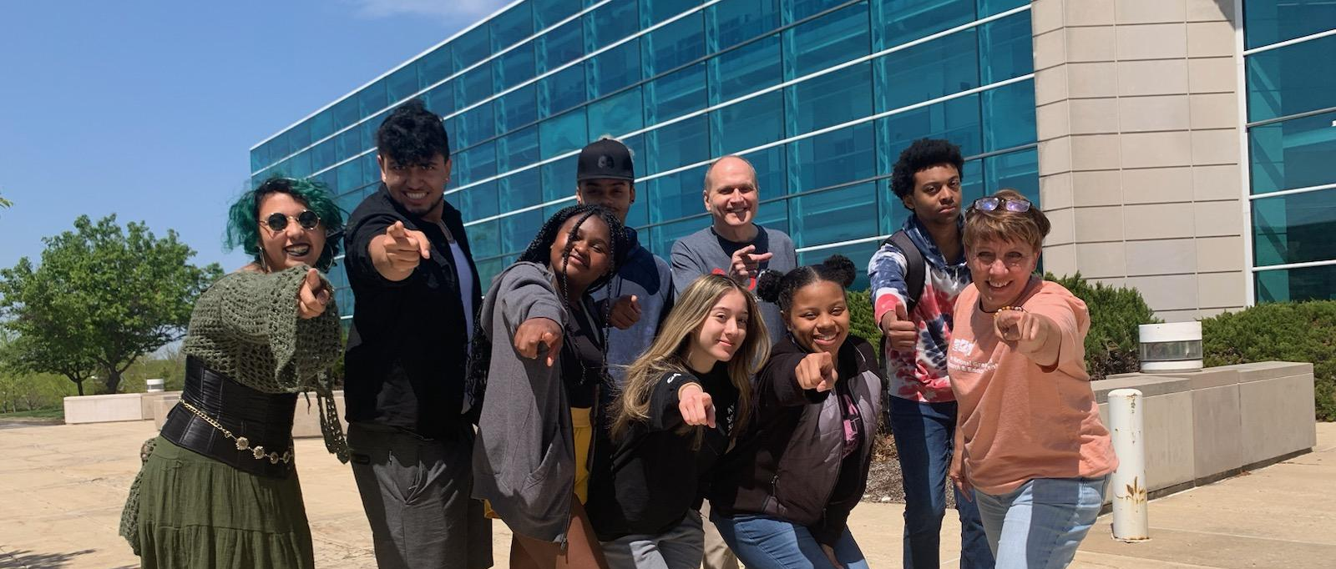
NGRREC Team
Community Oriented Digital Engagement Scholars
Kaz Isibue, Makhia Logan, Sean Brown, Danahe Villasenor, Derrick Newsome, Nick Fowler, Adam Gardner

Slide 2
NGRREC Spring Symposium
Notes:
Connie video about NGRREC

Slide 3
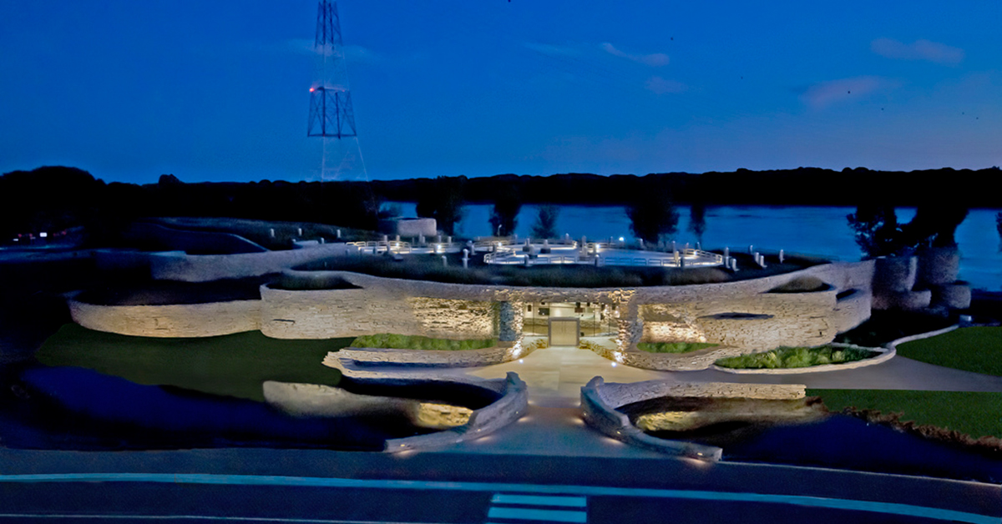
What is NGRREC and what they do?
NGRREC: National Great Rivers Research & Education Center
Mission:
Study the ecology of the big rivers
Study functions of watersheds that feed rivers
Study connections communities have with rivers
Notes:
Introducing NGRREC the mission is —-
Introducing the internship we are being offered
We will be talking about ____

Slide 4
Future Topics
Summer Initiatives
Wetlands Initiative
Plastics Cycle Initiative
Education and Outreach
Notes:
Focus areas/goals of summer internship

Slide 5
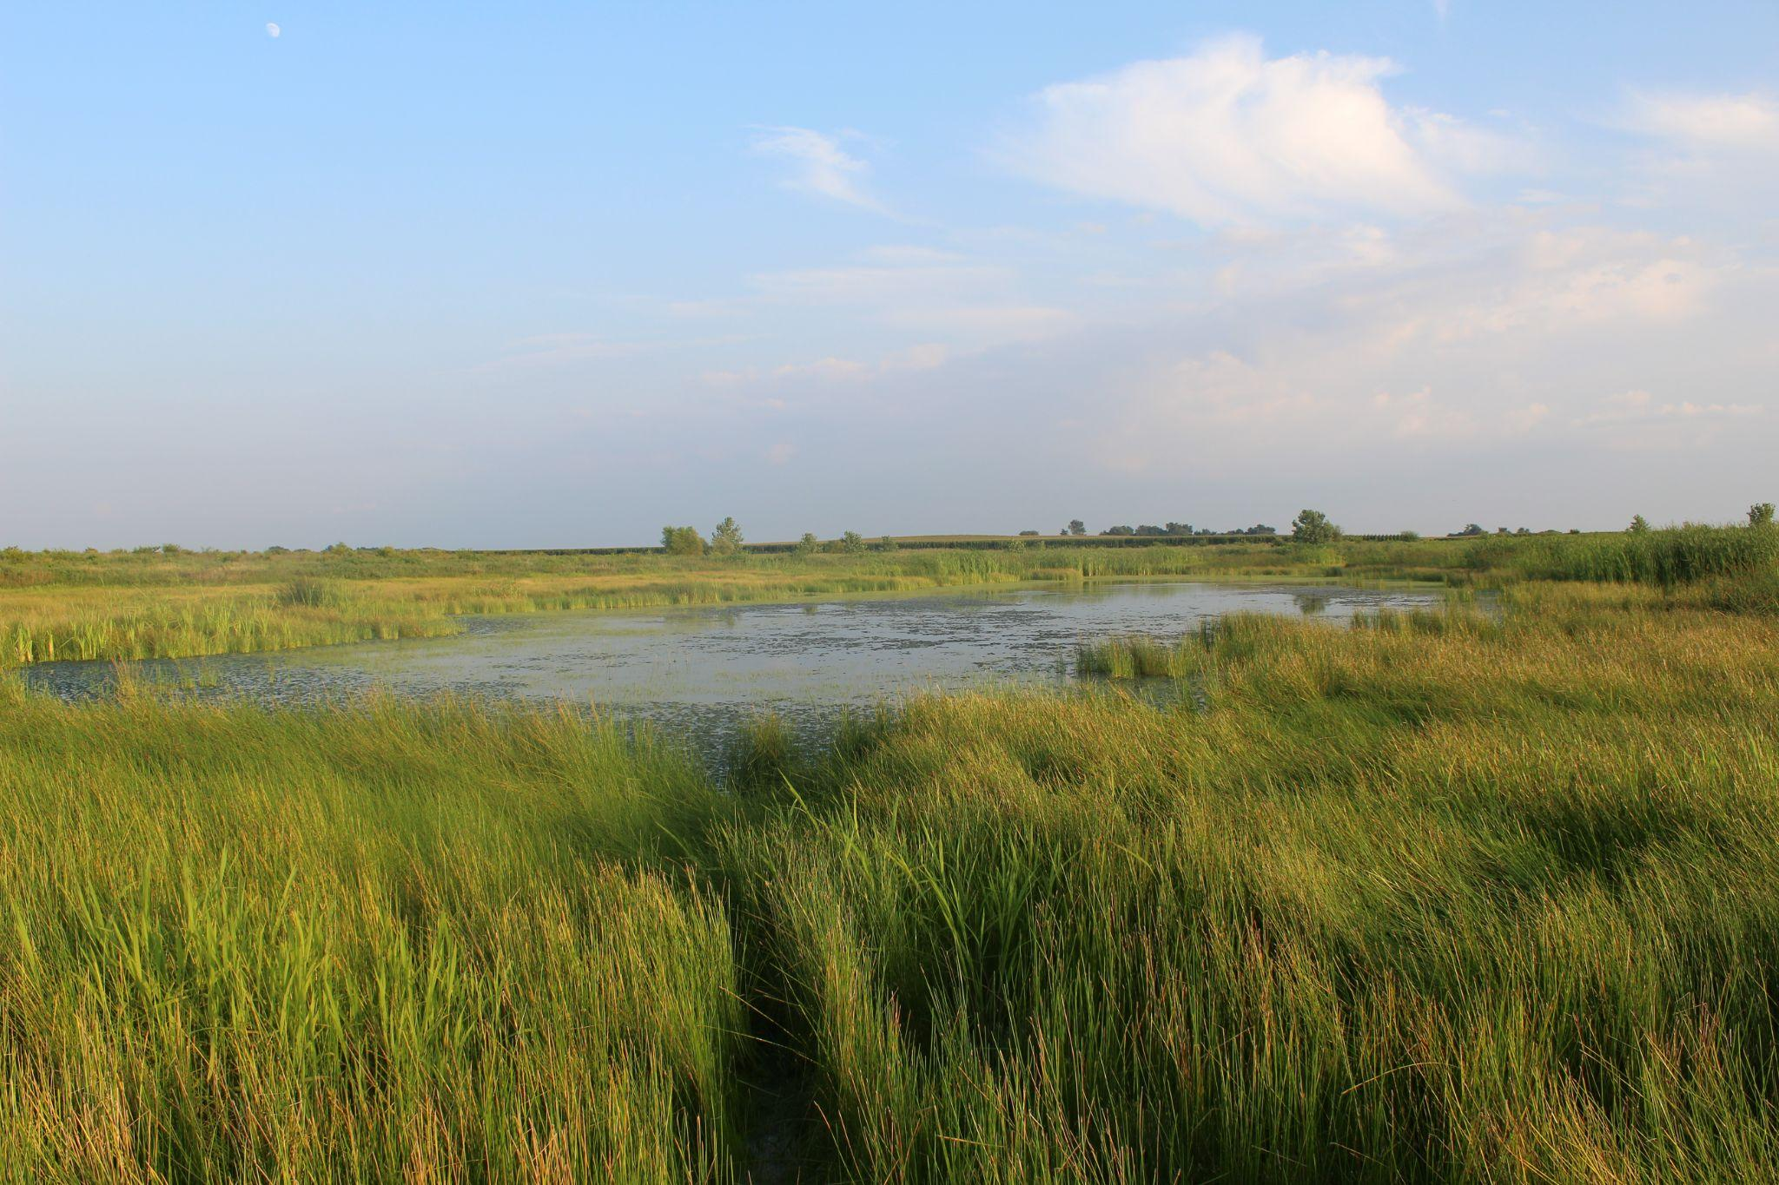
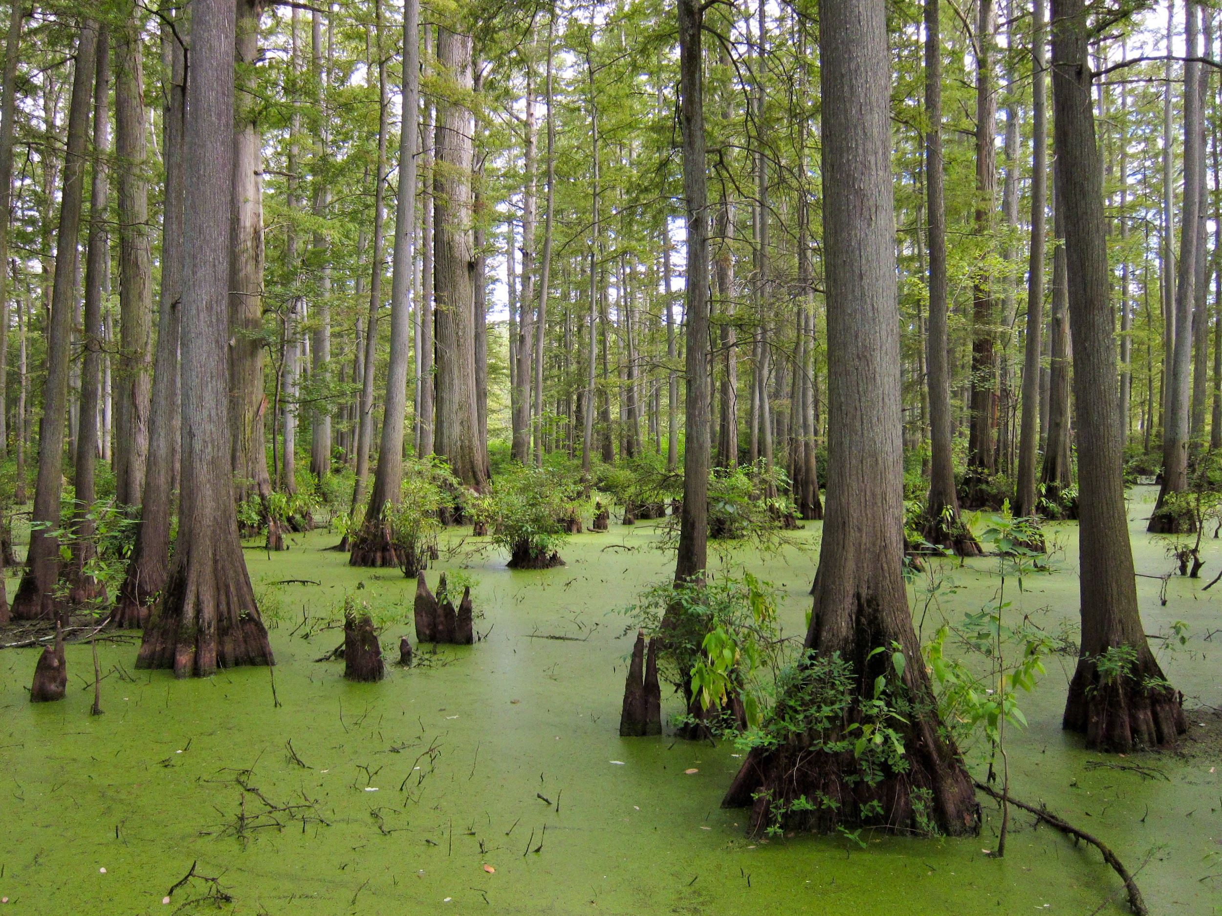
Wetland Initiative at NGRREC
What is a wetland?
Definition
Important to local ecology
Southern Illinois a hotspot for wetlands in the Mississippi River Basin
Southern Illinois Wetlands
Notes:
I’ll be talking about the Wetland Initiative
A Wetland is a
Why is it an important ecosystem?
Many species of aquatic and terrestrial plants and animals find habitat in wetlands
Wetlands are beneficial for many reason, including flood protection, improved water quality, reduced shoreline erosion, natural product production, recreation, and beauty
What Research is NGRREC doing to help Wetland initiative?
Creating an app or website that will help community scientist take their own data on the wetlands around them
Why is it needed?
As stated before the wetlands are an important aspect to the climate and animals
NGRREC can not always keep all eyes on every wetland so they’re opening the information up to the community to take part in the environment

Slide 6
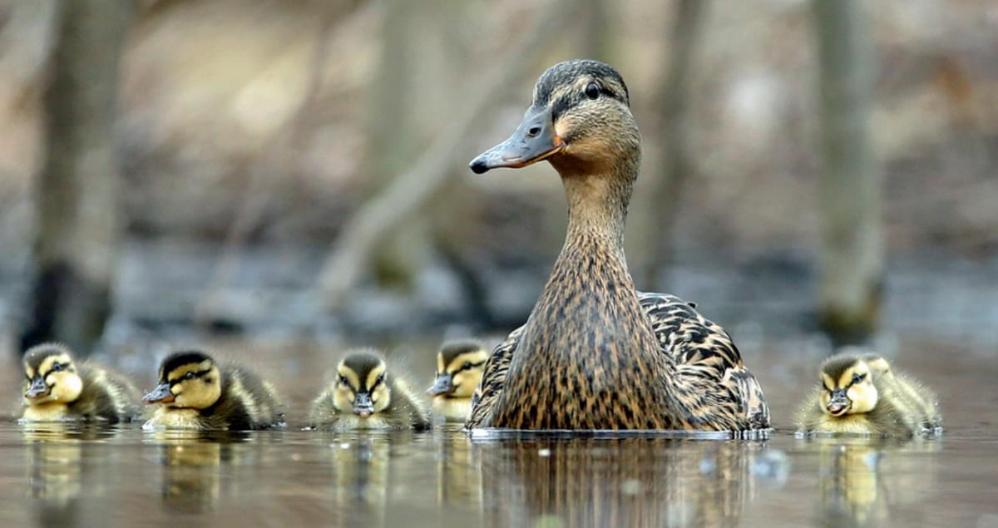
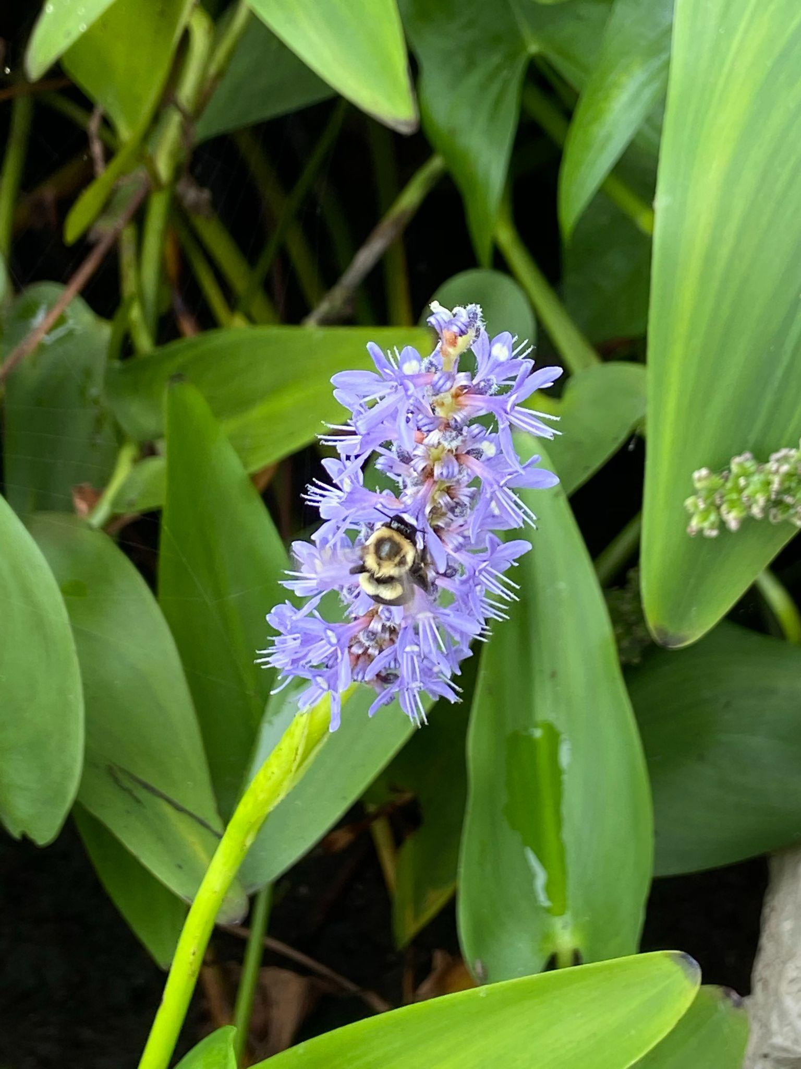
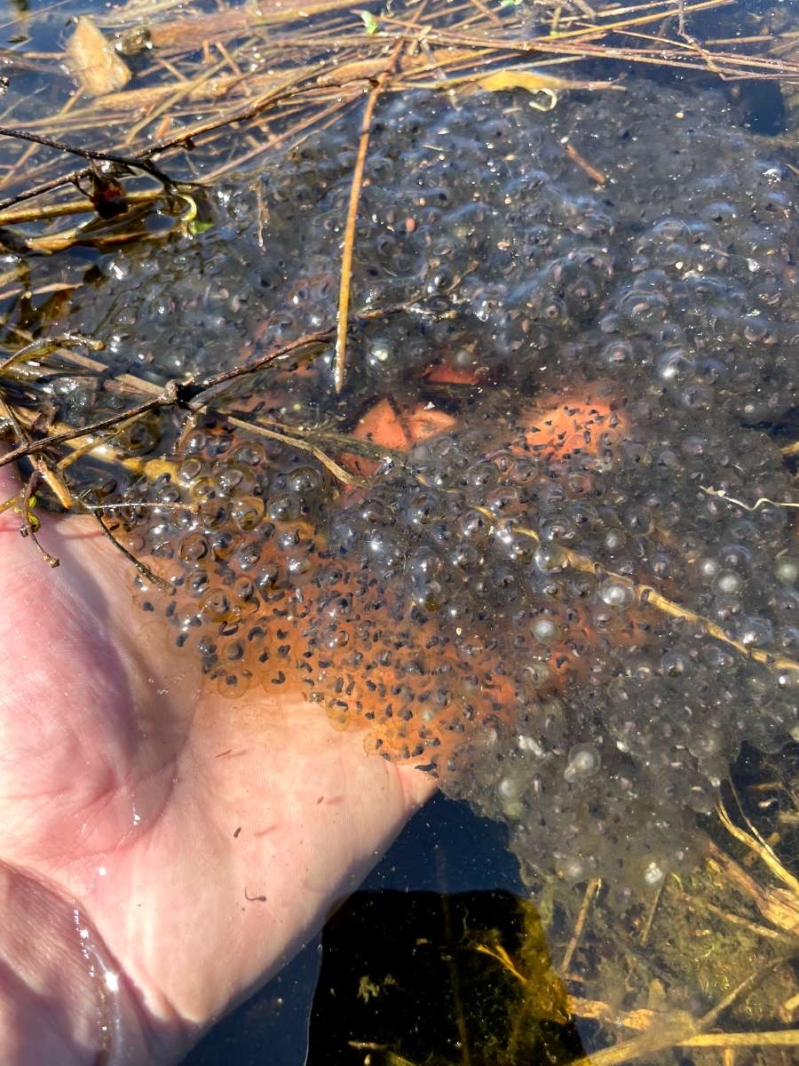
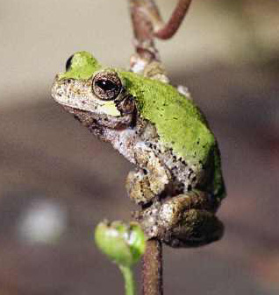
Why are wetlands important ecosystems?
Ecological hotbed: Plants and Wildlife

Slide 7
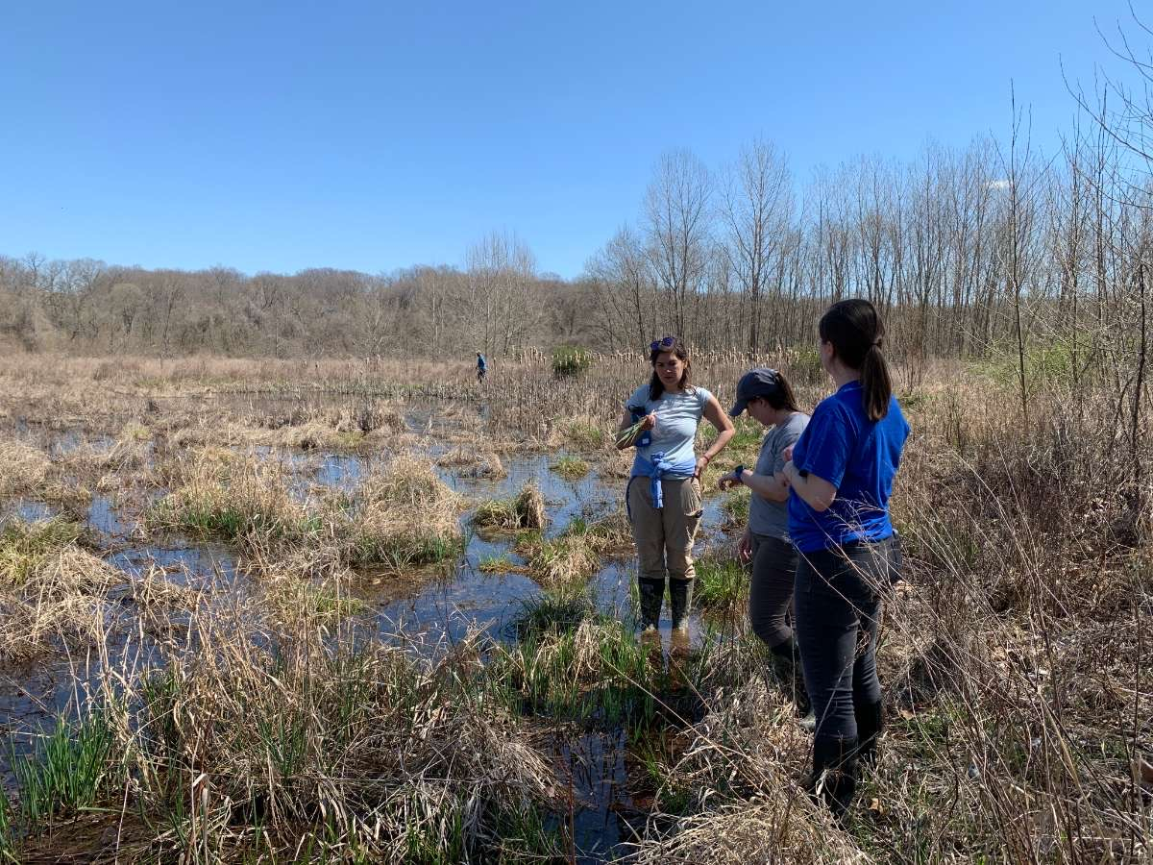
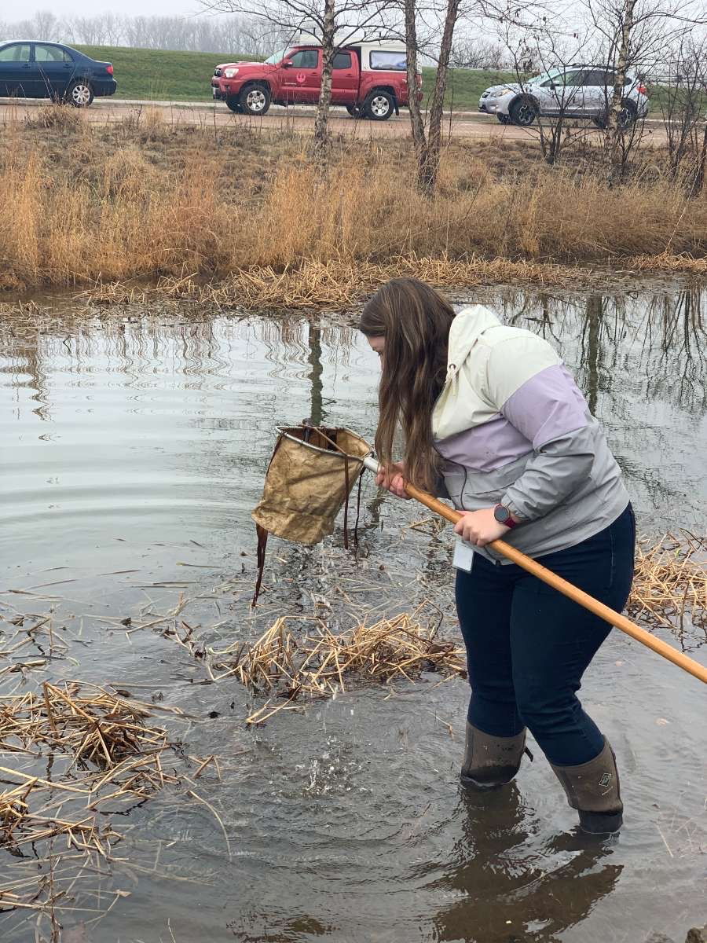
What research is NGRREC doing as part of the Wetlands Initiative?
Interns at NGRREC

Slide 8
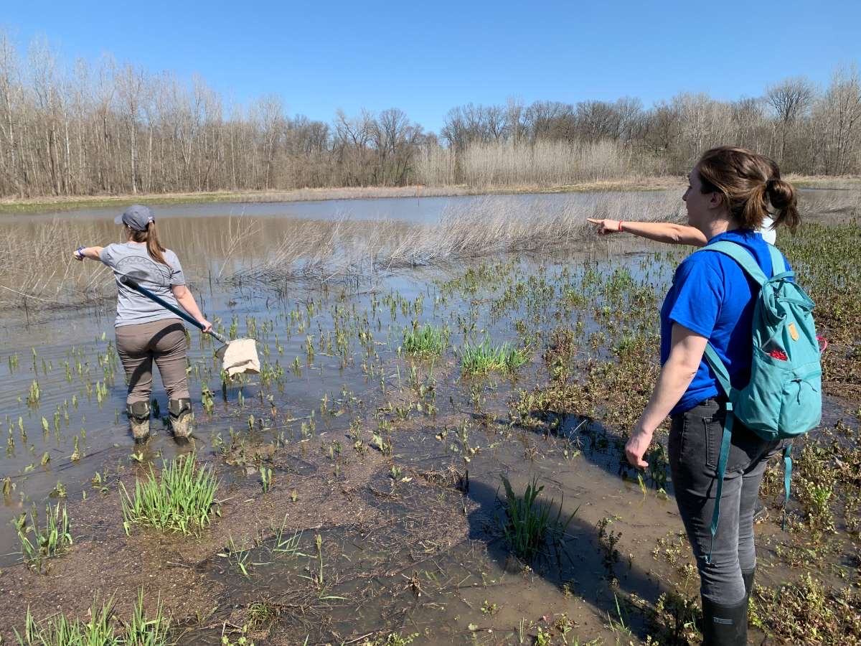
Why is it needed?

Slide 9
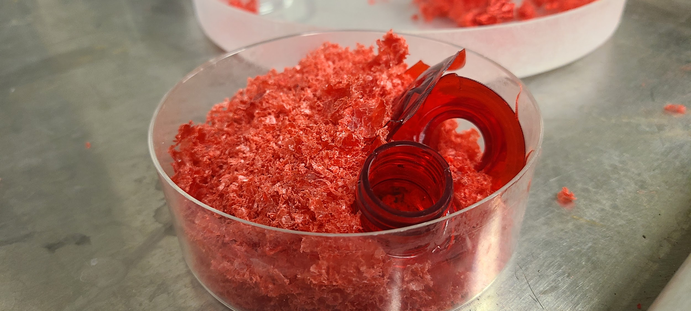
What are Microplastics?
Notes:
Im going to talk about the microplastics initiative
Microplastics are defined as plastic pieces less than five millimeters or 0.2 inches in diameter.
They are often created when very small plastic trash fragments released into the environment as a result of the destruction and disposal of industrial and consumer waste.
Microplastics are all around us, they have been found in our food, water, and every the air we breathe

Slide 10
What is the importance of microplastic research?
Microplastic research is lacking, as the issue has only come to public awareness in recent years
Effects of microplastics on the human body are unknown
Whether microplastics are affecting the ecosystem is also unknown
By researching these plastics we are able to bring the results to policy makers for real change
Notes:
So why should we care? What is the importance of Microplastic research
Microplastic research is lacking, as the issue has only come to public awareness in recent years very few studies have focused on the effects that micro plastics could have in day to day life or our survival as a planet.
Effects of microplastics on the human body ard are ecosystems is still unknown. But micro plastics are being found in more and more of the world around us.
By researching these plastics NGRREC is able to bring the results to policy makers and members of our community to advocate for real change

Slide 11
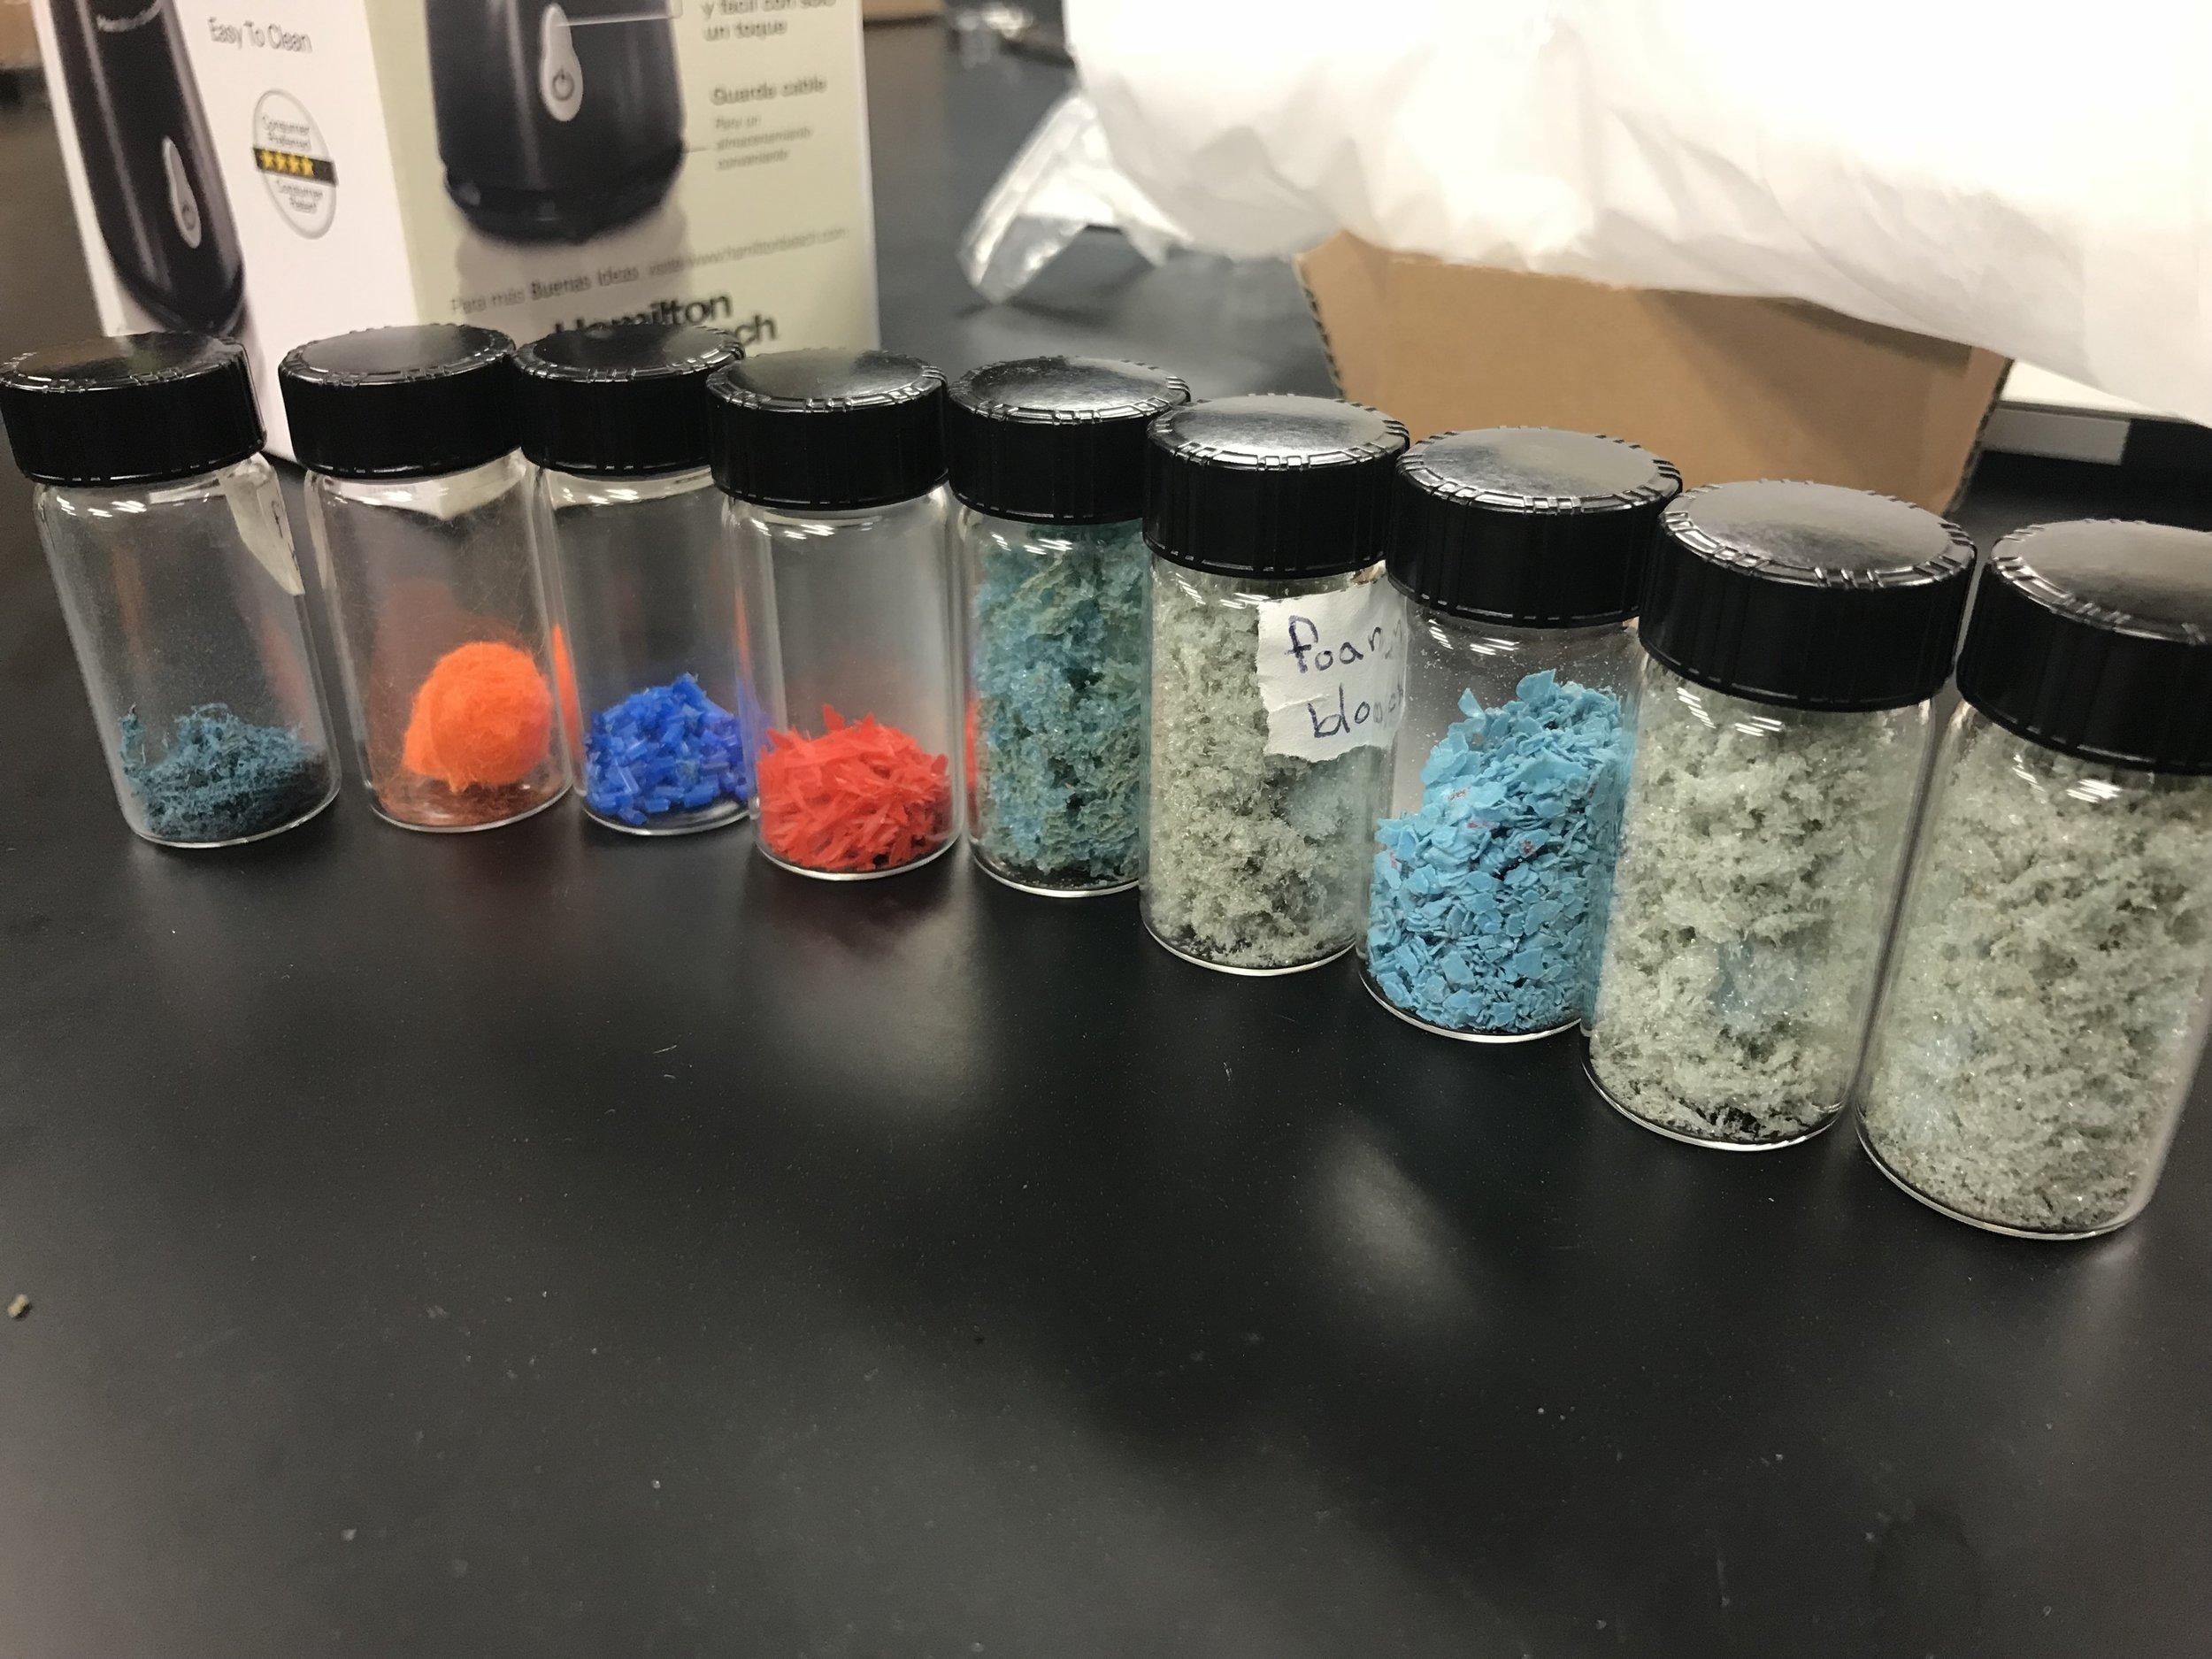
What is the Microplastics Initiative at NGRREC?
Emerging Contaminants Initiative
Mississippi River Basin Plastic Pollution (MRBPP) Collaborative
5 Main Themes
Extent of Plastic Pollution
Ecosystems and Biodiversity
Human Dimension
Education and Outreach
Policy
Notes:
Goals Mississippi River Plastic Pollution (MRPP) Consortium
Research
What does the plastic cycle look like in the Mississippi River watershed?
What (if any) are the ecological effects?
How is this affecting ecosystem services?
Education/Outreach
General public
LCCC students
Public health
There are five main themes to the initiative
Plastic across the Mississippi Basin
Plastic pollution and biodiversity
The human dimensions of plastic pollution
Education and Outreach
Policy - engage with policy-makers and provide scientific evidence needed to make informed decisions related to the mitigation of plastic pollution across the Mississippi basin.

Slide 12
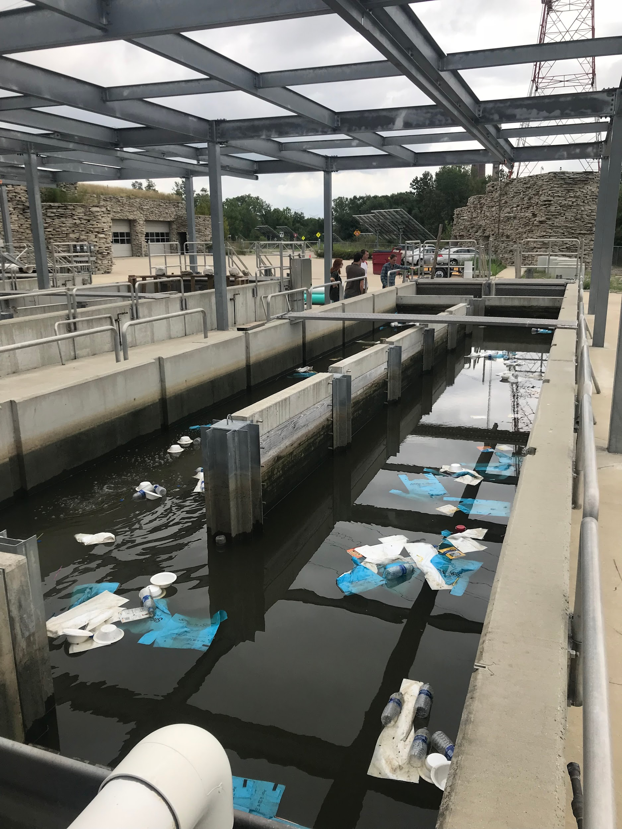
What research is NGRREC doing to understand microplastics?
Notes:
Phase one
Understanding plastics
How long does plastic last?
Phase I: Plastic degradation in rivers
Pilot study complete
Full study to commence in several weeks
Phase II: The plastic cycle in the Mississippi basin
Where is plastic distributed throughout the catchment?
Is it being integrated by all the microbes, plants, animals?
What are the ecological effects?
Phase III: Citizen Science
According to the MRPP “What is most needed is immediate and targeted scientific analysis of the problem.”

Slide 13
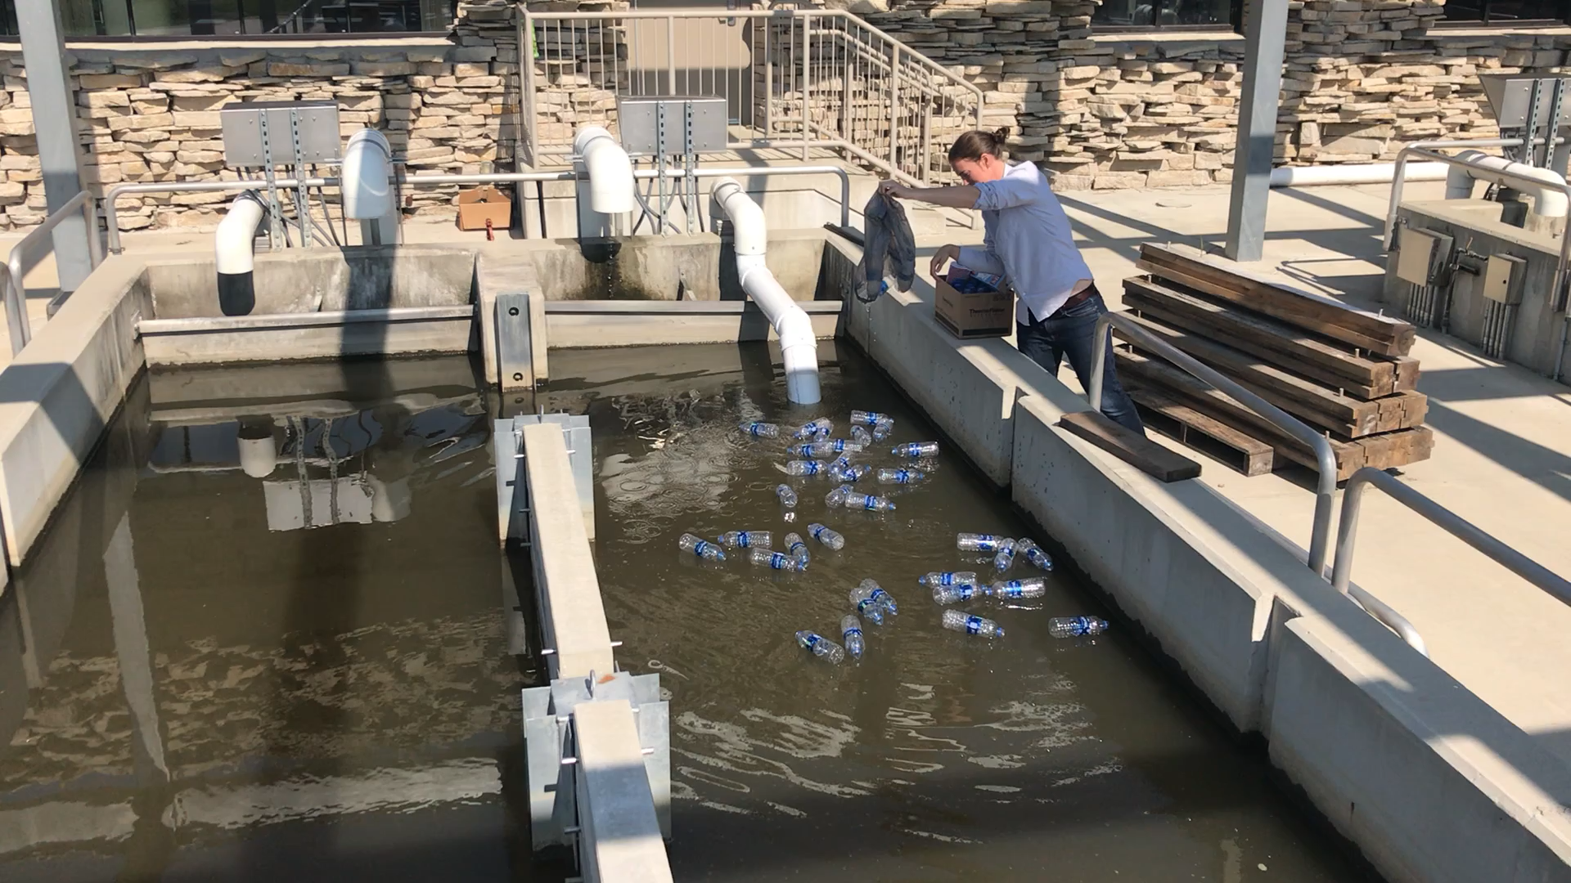
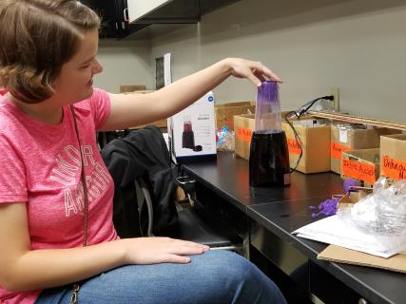
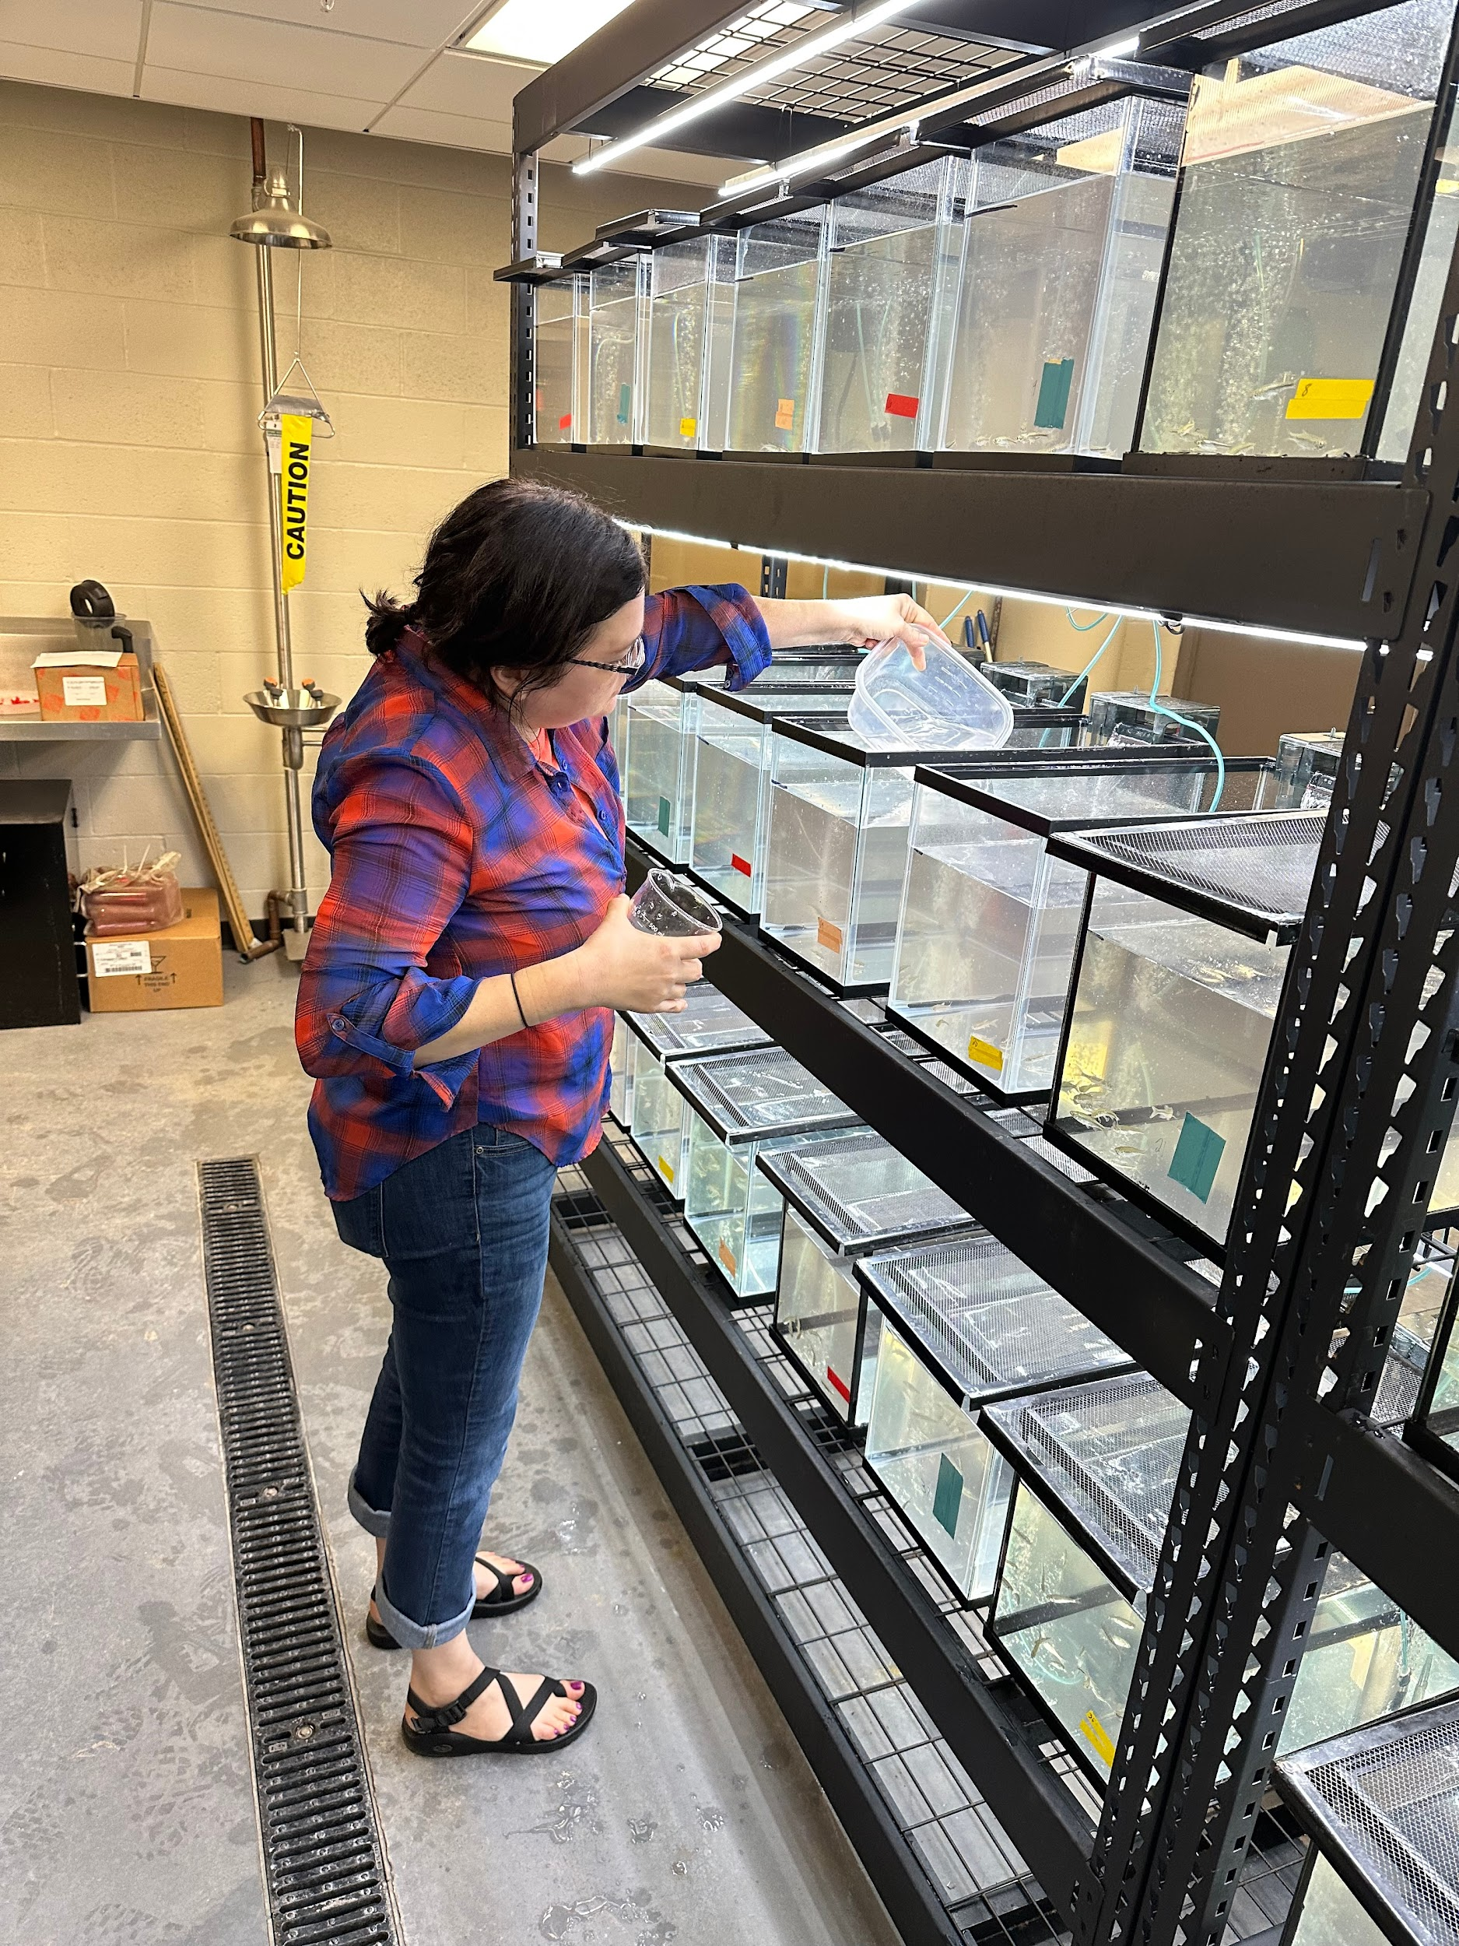
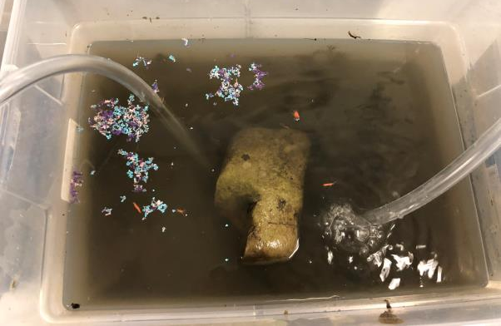
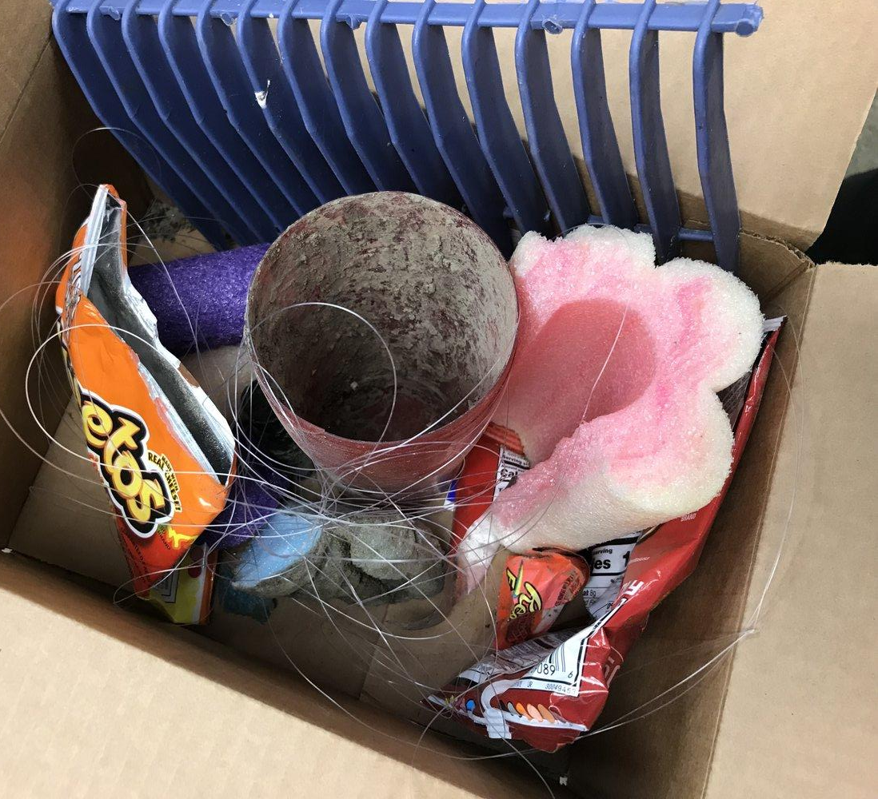

Slide 14
Education Program
What does the education program look like at NGRREC?
What is the educational mission?
What are some programs that the education initiative has to offer?
Notes:
What does the education initiative look like at NGRREC? The center has a full-time educational staff that comes up with and develops ideas for K-12 and college students. The center also tries to inform the general public.
What is the educational mission?
“NGRREC staff, educators, and associates believe that becoming a well-informed citizen and decision maker will aid in protecting and improving the quality, health, and understanding of great rivers for generations.”
What are some programs that the NGRREC education division has to offer? NGRREC offers a variety of programs and workshops. From working with adolescents over the summer to hosting teacher workshops. The education at NGRREC doesn’t just want you to learn but also have fun while doing it.

Slide 15
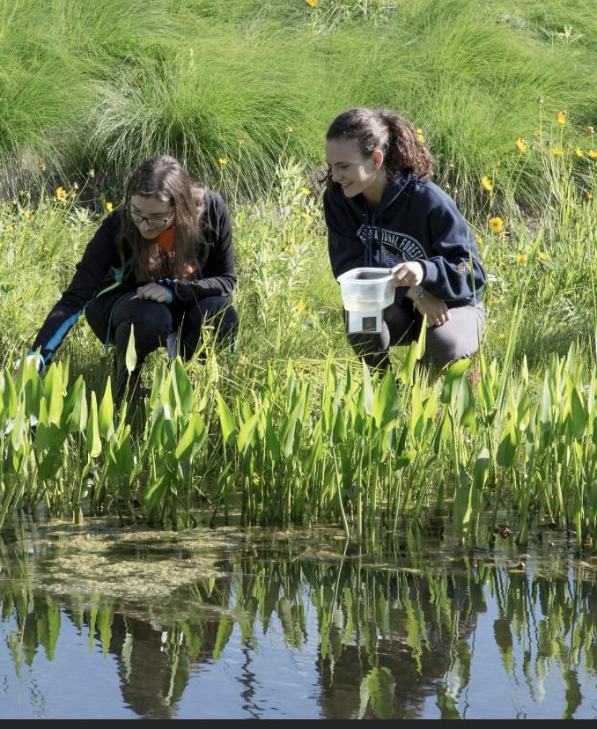
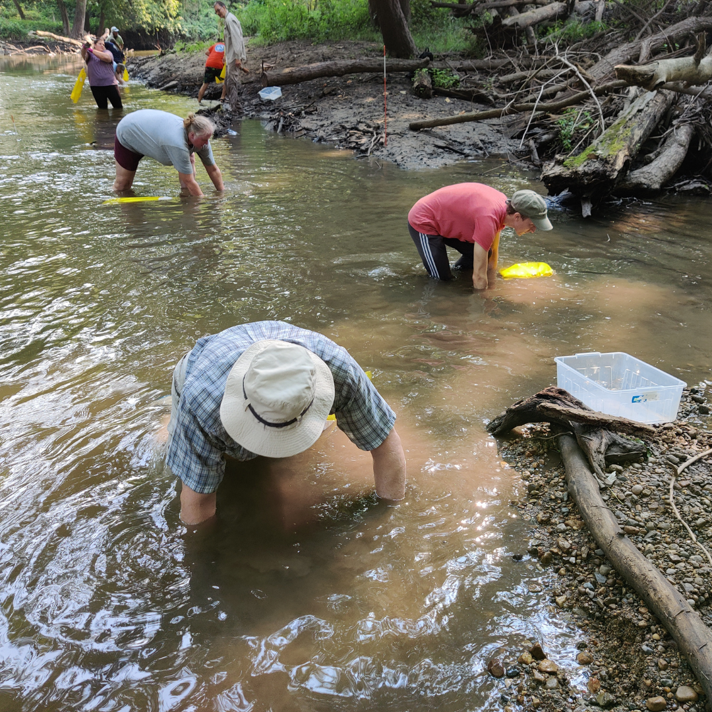
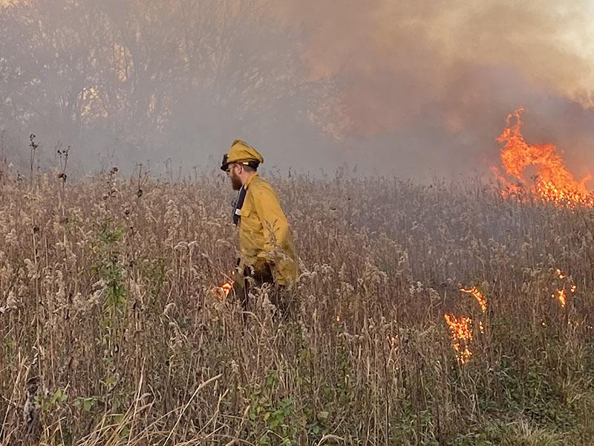
Outreach
What is Outreach at NGRREC?
What is Riverwatch?
Notes:
What is Outreach at NGRREC?
The Outreach program is are based on fundamental research and rivers ecology etc. The Outreach program aims to inform and identify environmental challenges.
Riverwatch:
A volunteer program coordinated by NGRREC that provides hands on opportunities to become involved with our local waterways by observing stream habitat and water quality in the area.
The only statewide biological monitoring program
Established in 1995 with over 200 volunteers annually
Helps educate the community about our Illinois water resources
These participants train in workshops to become what they call “citizen scientists”

Slide 16
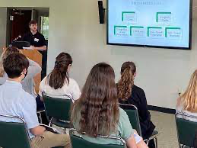
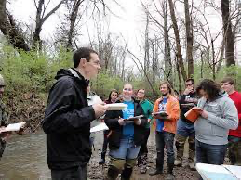
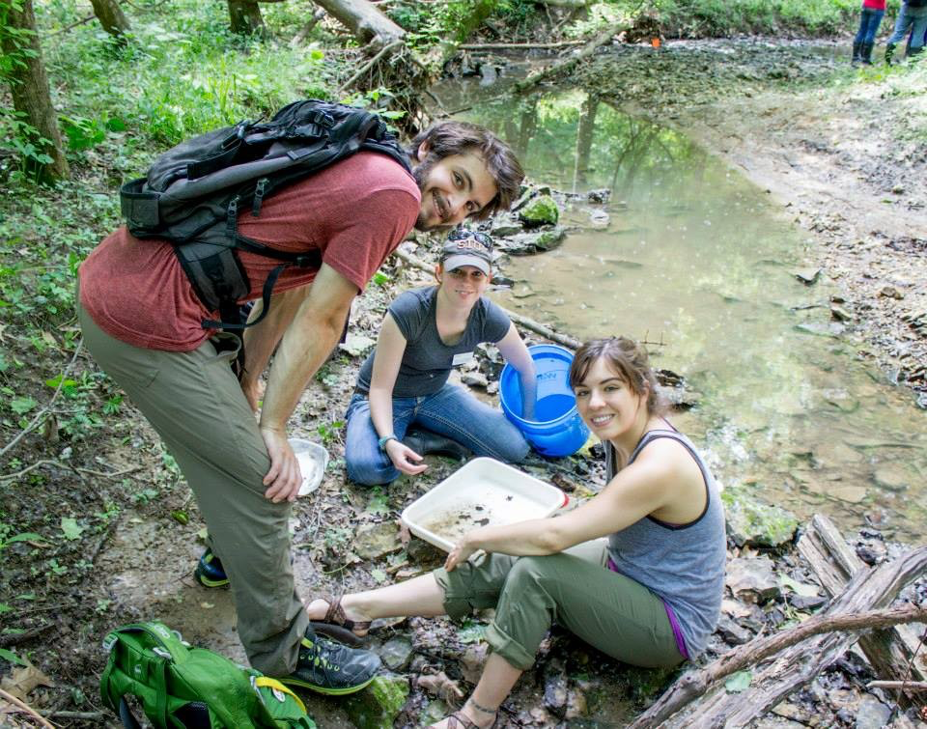
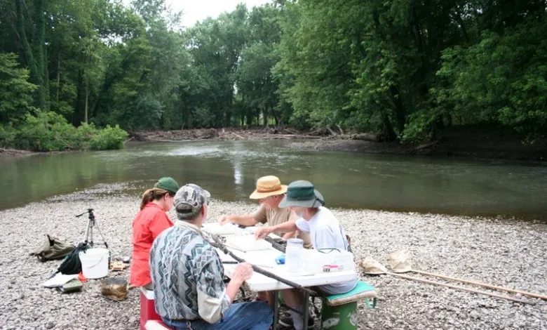
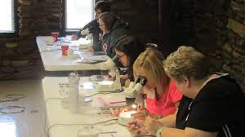
Photos from our Education/Outreach Lesson

Slide 17
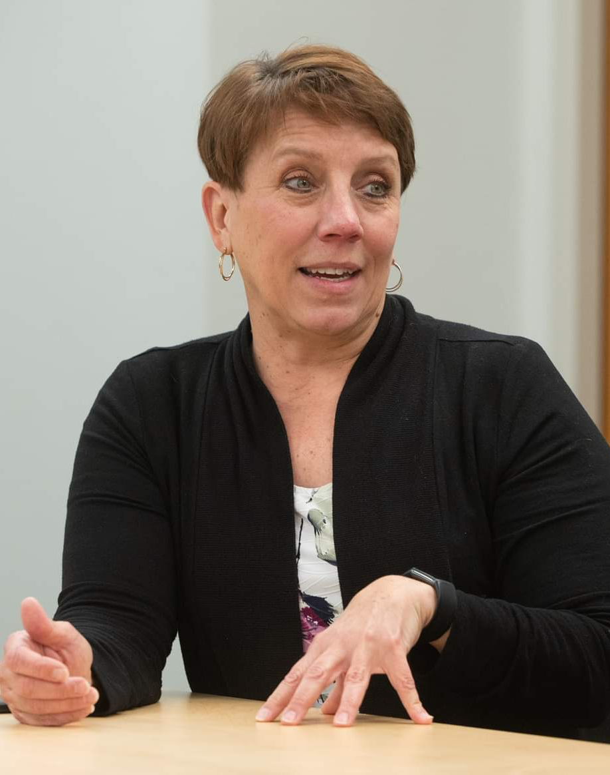
Looking Forward
Summer Goals
Understanding NGRREC
What does that mean?
Broad range of experiences
Participate in field research
Shadow summer camps, teacher workshops
Observe summer science convenings
Develop a digital library of summer activities and experiences
Photo: Dr. Paige Mettler-Cherry
Notes:
Looking forward
Over the summer we have big plans with NGRREC.
Through our internship we hope to gain an understanding NGRREC through an immersive summer experience. By the end of the summer we hope to be able to answer “what does ngrrec mean to us”
Broad range of experiences
Participate in field research
Shadow summer camps, teacher workshops
Observe summer science conveenings
Develop a digital library of summer activities and experiences
Interns will participate in a broad range of activities throughout the summer
By the end of summer identify and develop digital projects

Slide 18
Looking Forward
Next Steps
Identify and develop digital projects
Community Science apps
Websites
Self guided tour for the roof native garden
Outreach with high schools
Community service programs
Introduce to career opportunities in natural resources
Volunteer opportunities for students
Notes:
We are enceited to
Y
Community Science apps (Wetlands, plastic cycle, riverwatch)
Websites (Wetlands and Plastics)
Self guided tour for the roof native garden
QR codes for the plants

Slide 19
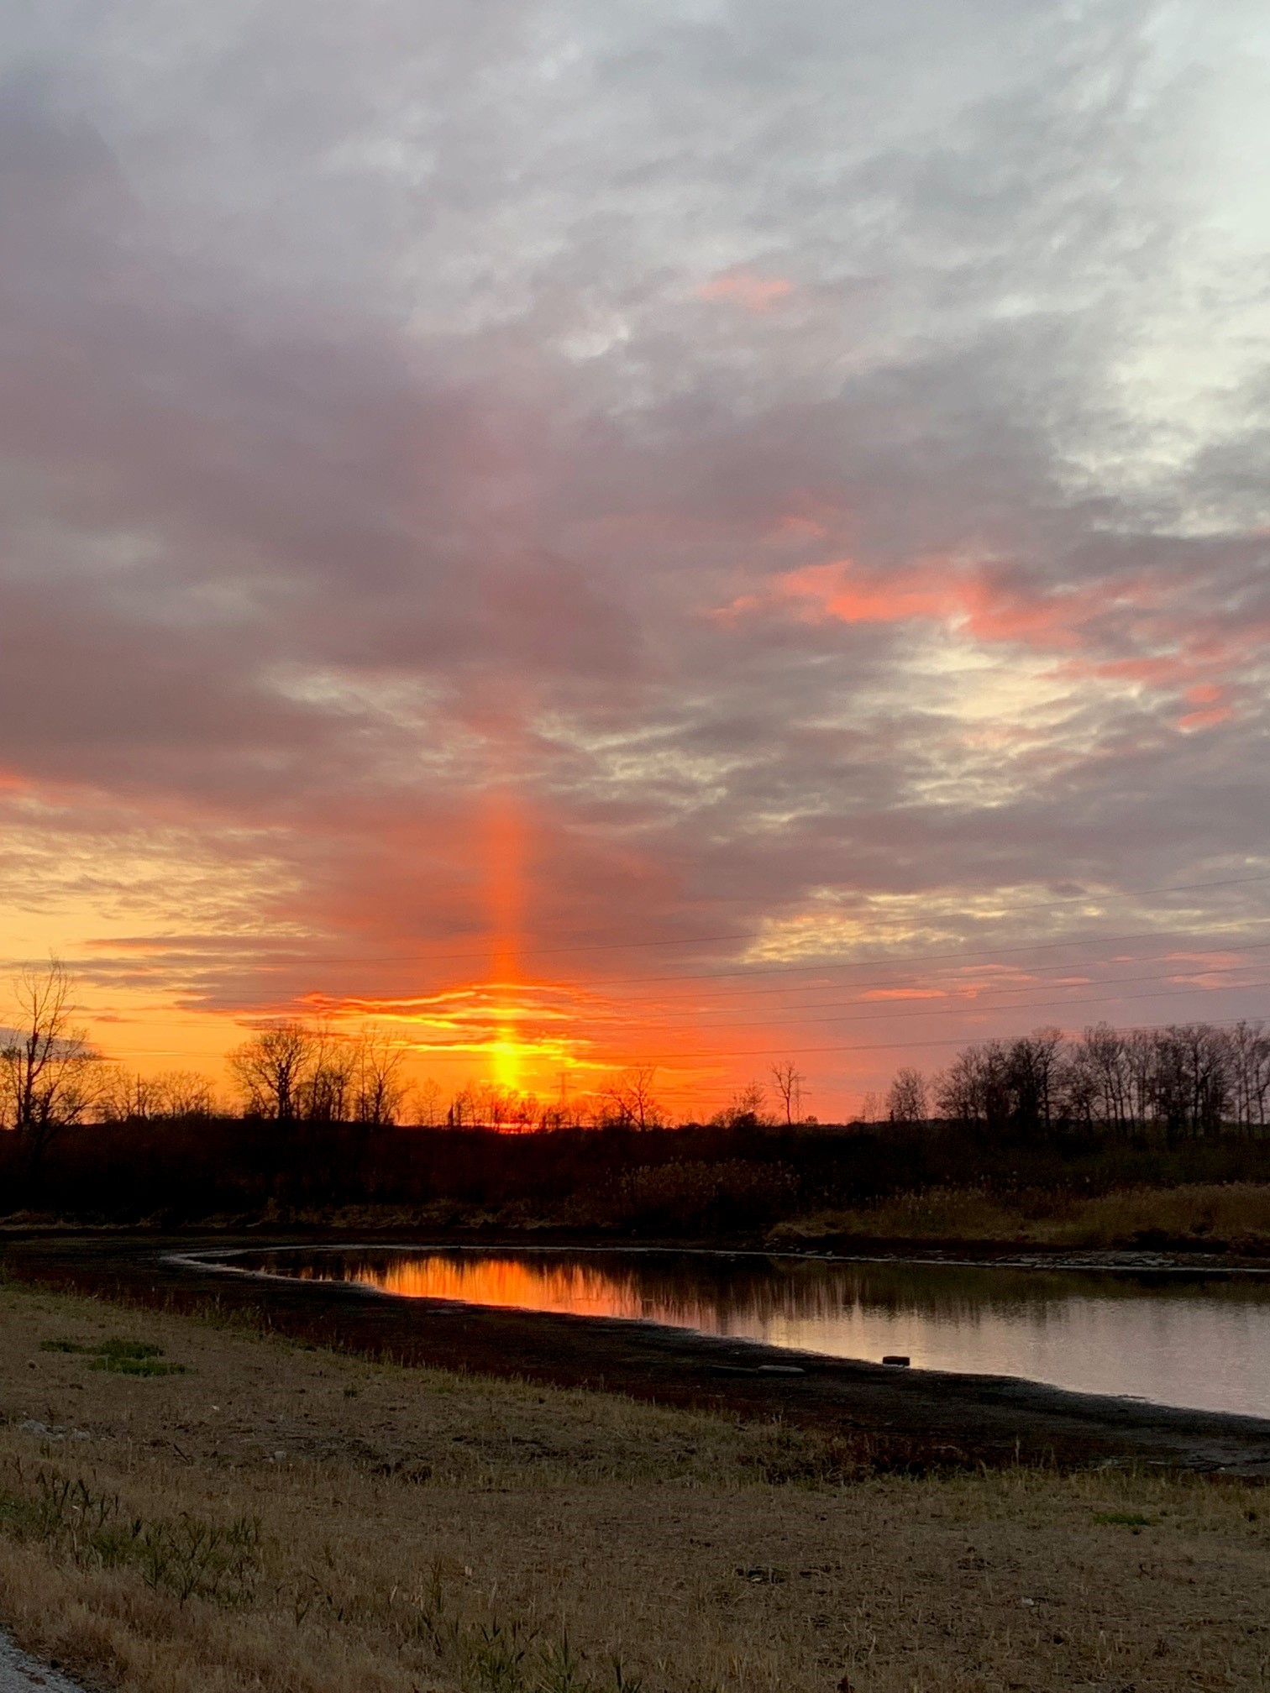
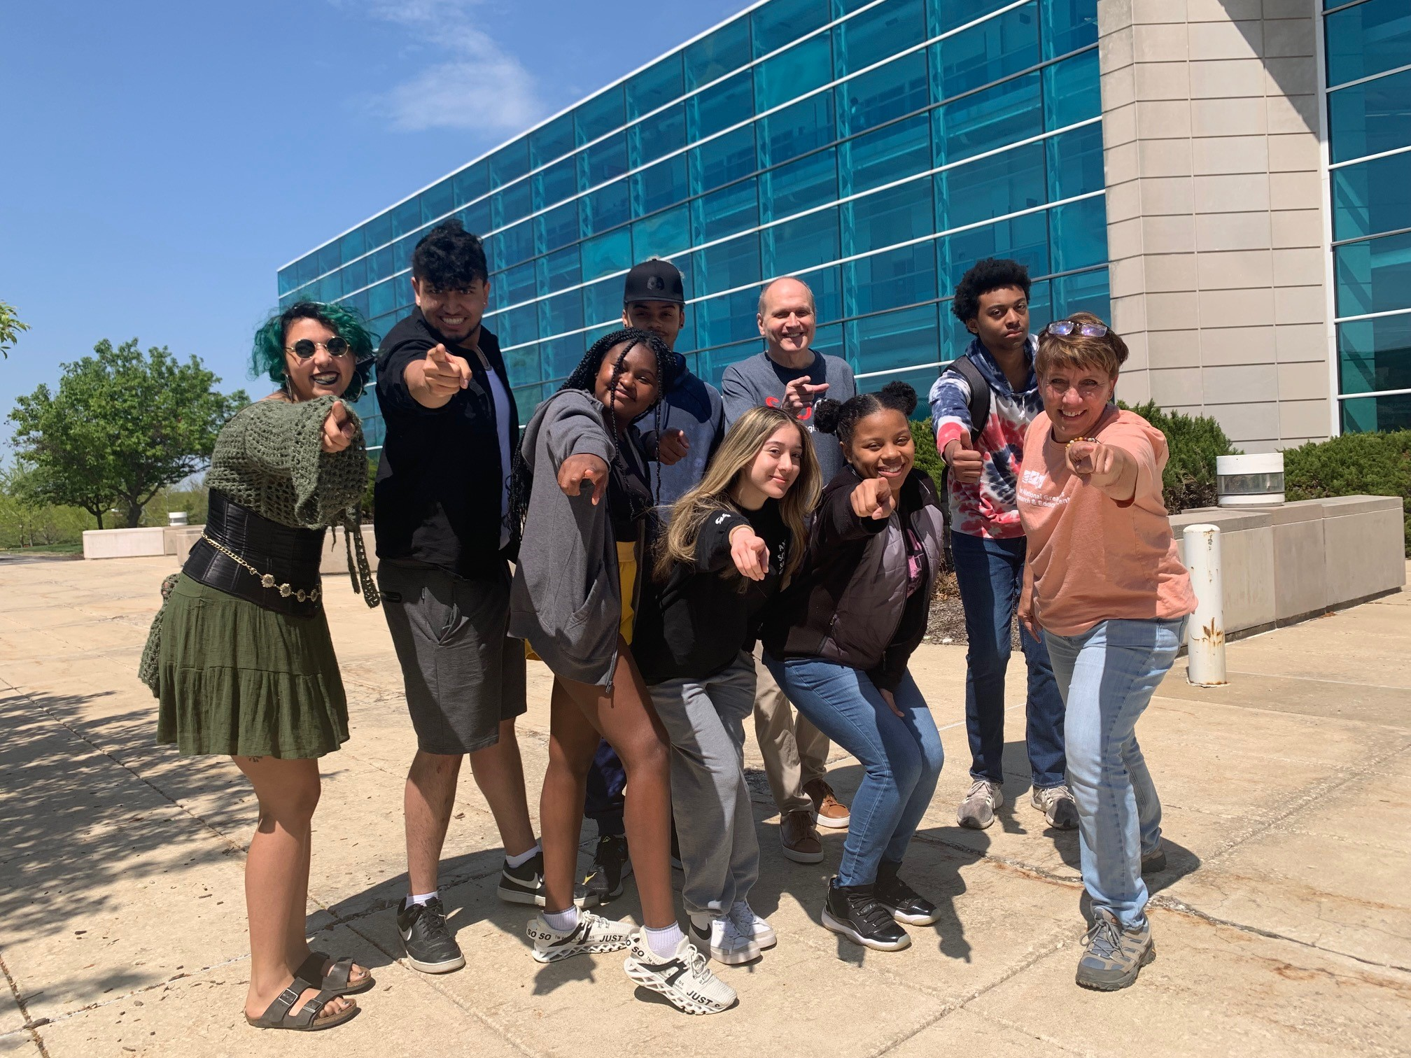
Thank You!
With Love from the NGRREC Team

