Slide 1

Holistic Construction: Building Better Landscapes from the Perspective of Zoopsycology
Martinez, L. Blout, E. Johnson

Slide 2
Background
As human settlements grow and expand, animal populations face new challenges due to habitat disruption from urban development.
By approaching construction practices through the lense of human-animal cohabitation, urban growth can be achieved while limiting the physical impact on wildlife.

Slide 3
Research Question
What is the relationship between native animal populations and urban architecture with respect to animal behavioral patterns?

Slide 4
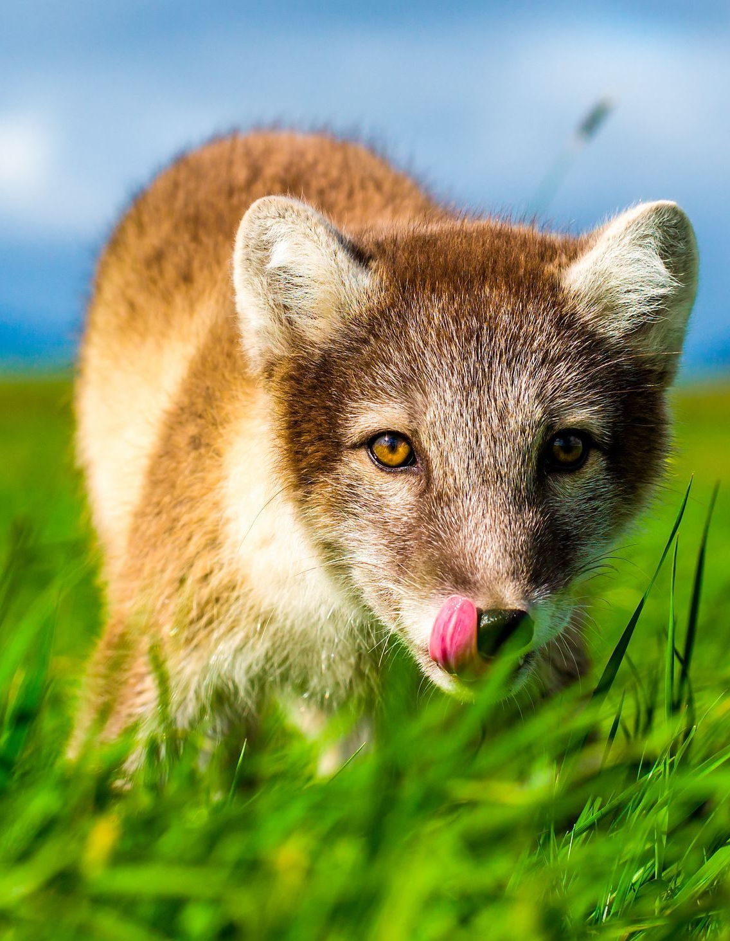
Evidence
Urban populations' views on animals are greatly determined by exposure, preferring commonly seen animals such as raccoons and opossums over less seen species like coyotes. (Aronson et al., 2023)
Forests found within urban centers such as parks, nature preserves, and backyards often struggle with biodiversity and nonnative species intrusion more so than untouched or rural forests. (Schmit et al., 2025)
Using bio inclusive design practices such as nature bridges, human-animal cohabitation can be achieved without significant impact on either group. (Niesner et al., 2021)

Slide 5
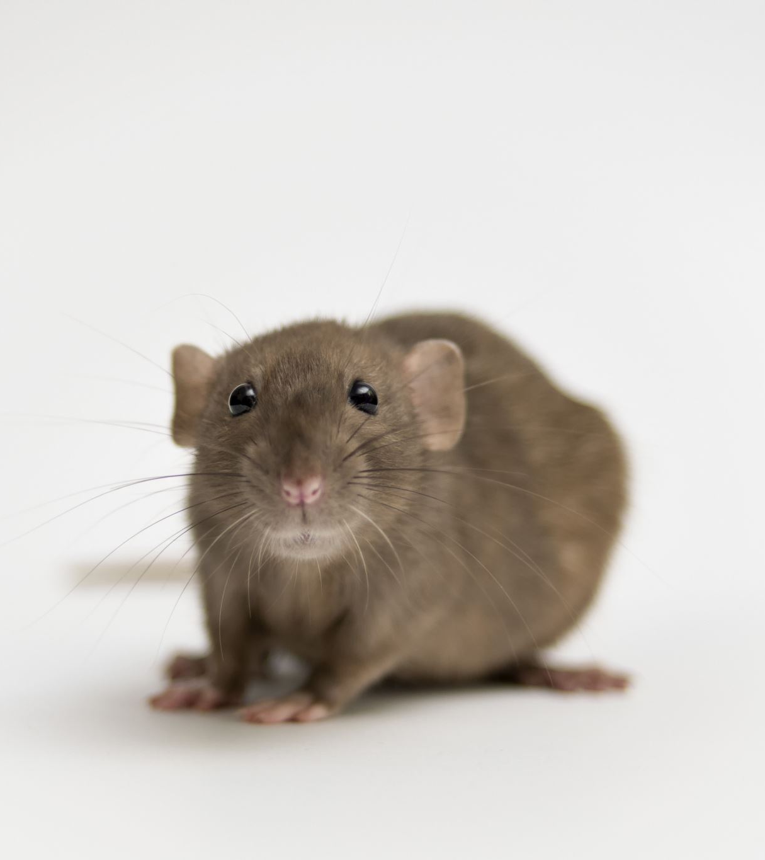
Evidence
Mamal populations are greatly affected by local environments, as larger mammals and predator species require greater amounts of biomass to be successful. (Hansen et. al.)
Pollutants, including air, water, soil, and thermal pollution sources, greatly effect the biodiversity of urban habitats. Rodent populations can adapt to these stressors, but other less resilient species cannot. (Yasmine et. al., 2025)

Slide 6
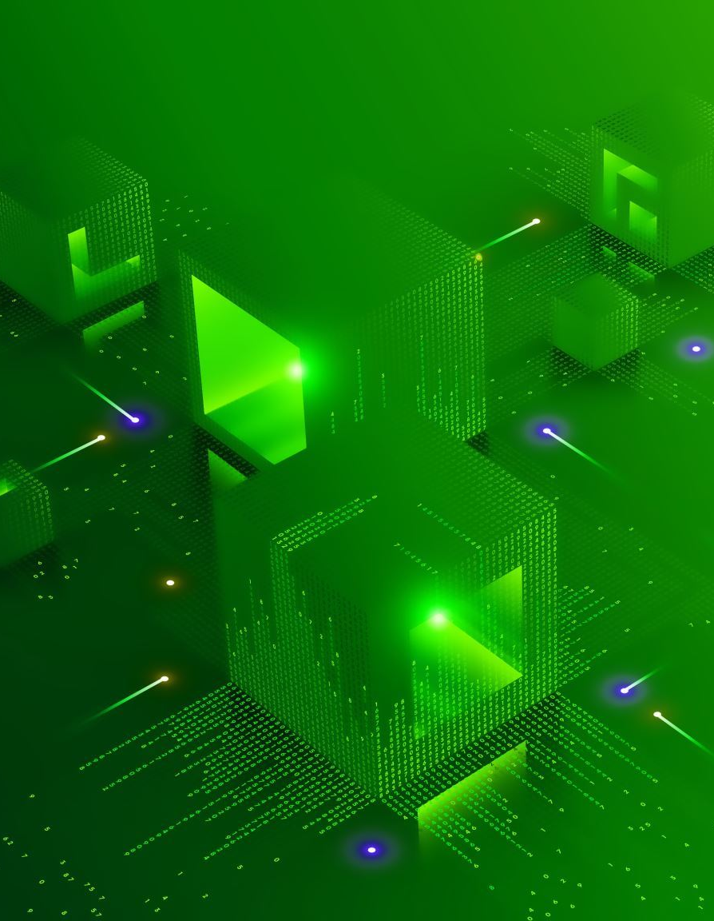
Evidence
Human settlement patterns have a direct relationship to the evolutionary changes seen in animal populations. Scavenging animals such as rats and crows have adapted to and succeed based on human interference (Gallo & Fidino, 2019)
Green spaces within cities provide an enclave for animals to retreat to and reproduce within. Green space is essential for animals to live within urban centers such as New York. (Bullard, 2019)

Slide 7
Summary of evidence
Animal-human relationships are a complex topic that vary incredibly by species, public opinion, and the conditions said animals need in order to be successful. Despite this, all animal species benefit from bio inclusive construction, such as green spaces and wildlife bridges.
A balance of human and animal inclusivity is crucial to providing a livable habitat that is unintrusive on human life. Through a holistic approach, both populations can support each other and maintain ecological stability.

Slide 8
Summary of evidence
To achieve the greatest levels of success, architects, biologists, and both human and animal behavioral experts must work together; providing expertise within their respective domain to development projects.
Public perception on animal species must be accounted for when constructing urban habitats. Although species such as vultures and coyotes are incredibly important to biodiversity, these animals may be fighting to some people.

Slide 9
Experimental Draft
1. Independent Variable
The independent variable in this proposed experiment is the level of green-space connectivity in urban architecture. This includes how connected parks, native plant patches, and habitat corridors are within an urban area. Sites would be grouped into low, medium, or high connectivity.
2. Dependent Variable
The dependent variable is native animal response, measured through: • Species richness • Relative abundance • Behavioral patterns such as foraging activity and nocturnal vs. diurnal behavior
These are the outcomes expected to change in response to different levels of connectivity.
3. Control
A natural peri-urban site (or the lowest-connectivity urban sites) serves as the control. These areas represent minimal architectural influence and provide a baseline for what native wildlife behavior looks like without strong urban modification.
4. Proposed Results Figure
The graph you see in the next slide represents hypothesized results, not real experimental data. The expected trend is that species richness increases from low to medium to high connectivity. This visual predicts that more connected green space allows native animals to move more easily, maintain natural behaviors, and persist in higher numbers.

Slide 10
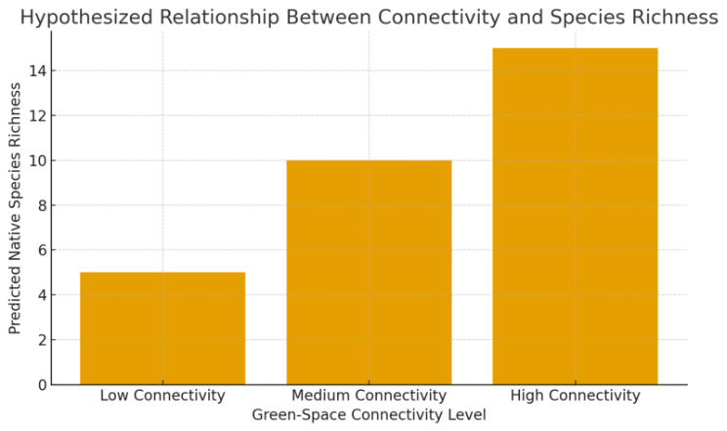
Hypothesized Data

Slide 11
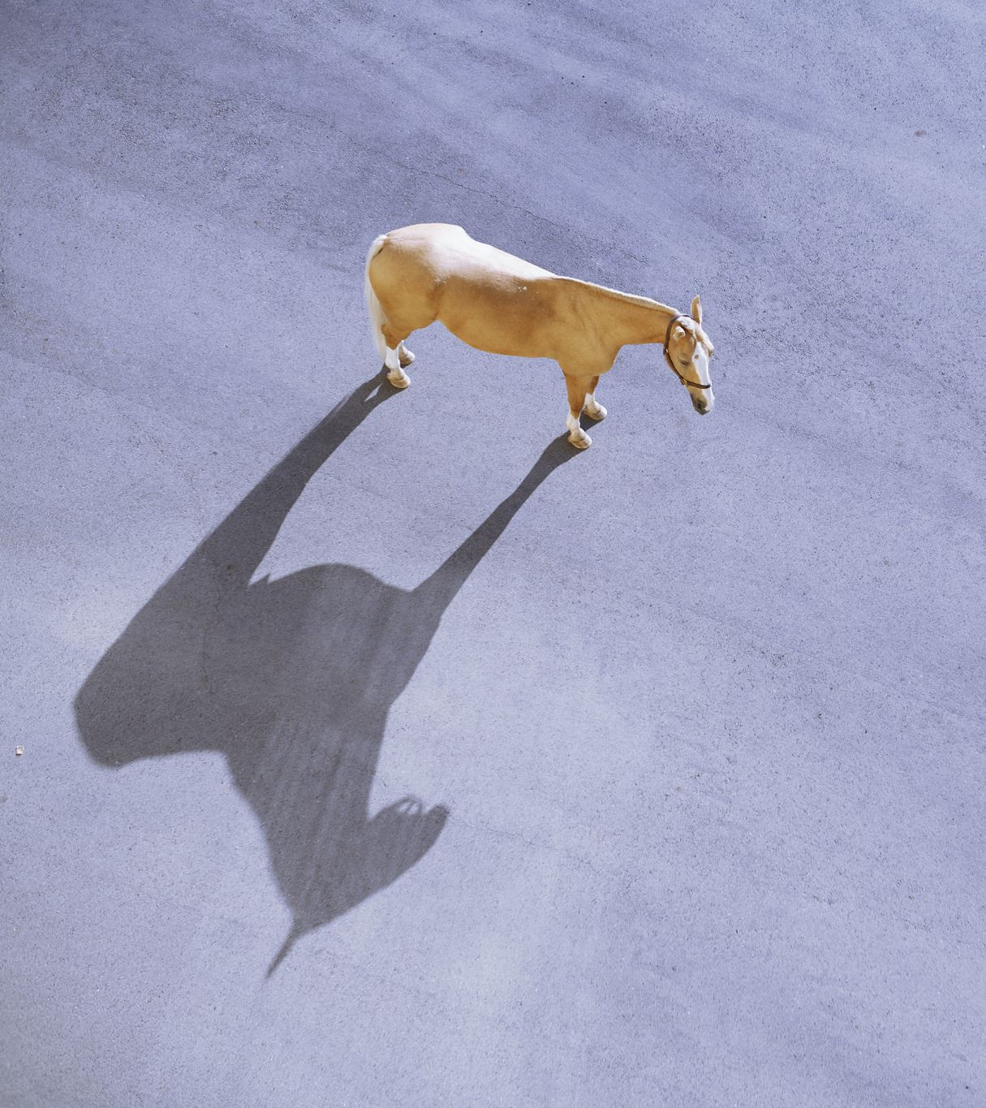
Summary
To realize the topic of human-animal urban design strategies, a multifaceted and interdisciplinary approach must be taken. By focusing exclusively on one aspect of design is to oversight another, leading to a failed project.
Animals have a right to live and coexist with humans and by limiting our effect we have on their habitats, humanity can grow and develop without harming animal populations.

Slide 12
Works Cited
Aronson, M. F. J., Lepczyk, C. A., Evans, K. L., Goddard, M. A., Lerman, S. B., MacIvor, J. S., Nilon, C. H., Spotswood, E. N., & Warren, P. S. (2023). Urban biodiversity and ecological networks: Perspectives and tools for understanding cities as ecological systems. People and Nature, 5(4), 1010–1025. https://doi.org/10.1002/pan3.10604
Lerman, S. B., Narango, D. L., Andrade, R., Warren, P. S., Grade, A. M., and Straley, K. (2021). Wildlife in the city: human drivers and human consequences. In P. Barbosa (Ed.), Urban Ecology: Its Nature and Challenges (pp. 37–66). CABI Publishing.
Schmit, J. P., Johnson, L. R., Baker, M., Darling, L., Fahey, R., Locke, D. H., Morzillo, A. T., Sonti, N. F., Trammell, T. L. E., Aronson, M. F. J., & Johnson, M. L. (2025). The influence of urban and agricultural landscape contexts on forest diversity and structure across ecoregions.
Mark J. Jordan , Robert A, Long , Rachel Mueller, Katie Remine , Laura R Prugh Yeserin Yildirim, Chaz Hyseni, Frank Johansson & Christopher J. Schell “Landscape Connectivity and Genetic Structure of Animal Populations in Urban Ponds.”
Hentati, Yasmine, Charles O. Estien, Zachary Hawn, Maria L. Garcia, and Thomas K. Nguyen. “Environmental Contamination Predicts Mammal Diversity and Mesocarnivore Activity in the Seattle-Tacoma Metro Area.” 2025.
Niesner, C. A., Blakey, R., Blumstein, D. T., & Abelson, E. S. (2021). Wildlife affordances of urban infrastructure: A framework to understand human–wildlife space use. Frontiers in Conservation Science, 2, 774137 https://www.frontiersin.org/journals/conservation-science/articles/10.3389/fcosc.2021.774137/full
Hansen, Christopher P., Roland Kays, and Joshua J. Millspaugh. “From Backyard to Backcountry: Changes in Mammal Communities Across an Urbanization Gradient.”
Making wildlife welcome in urban areas” by Travis Gallo and Mason Fidino, published in eLife Digest in 2019. The citation is: Gallo, T., and Fidino, M. (2019). Making wildlife welcome in urban areas. eLife Digest. https://elifesciences.org/articles/41348?utm_source.
Bullard, G. (2016, April 20). Animals like green space in cities and that’s a problem. National Geographic. Retrieved from https://www.nationalgeographic.com/animals/article/160420-green-cities-design-animals-architecture-urban0?utm_source

