Slide 1

Cahokia Heights Resources
By: Jada Parker, Sa'Dae Cooper, Keith Hawkins, Julez Hill, Nadia Harris, & Lindell Blount​

Slide 2

Introduction
Over the past three semesters, we have been conducting work with Heartlands Conservancy and the Cahokia Heights Library to research the water equity crisis in the Cahokia Heights area. Throughout our project, we engaged in archival research, site visits, oral histories, and surveys. This research has deepened our understanding of the ongoing water issues and provided us with firsthand accounts of the residents' experiences. In this presentation, we will cover different key topics, including the history of the area, local bussinesses, and the role of mutual aid. Together, these topics will offer insight into the work we have been doing and what we have learned.

Slide 3
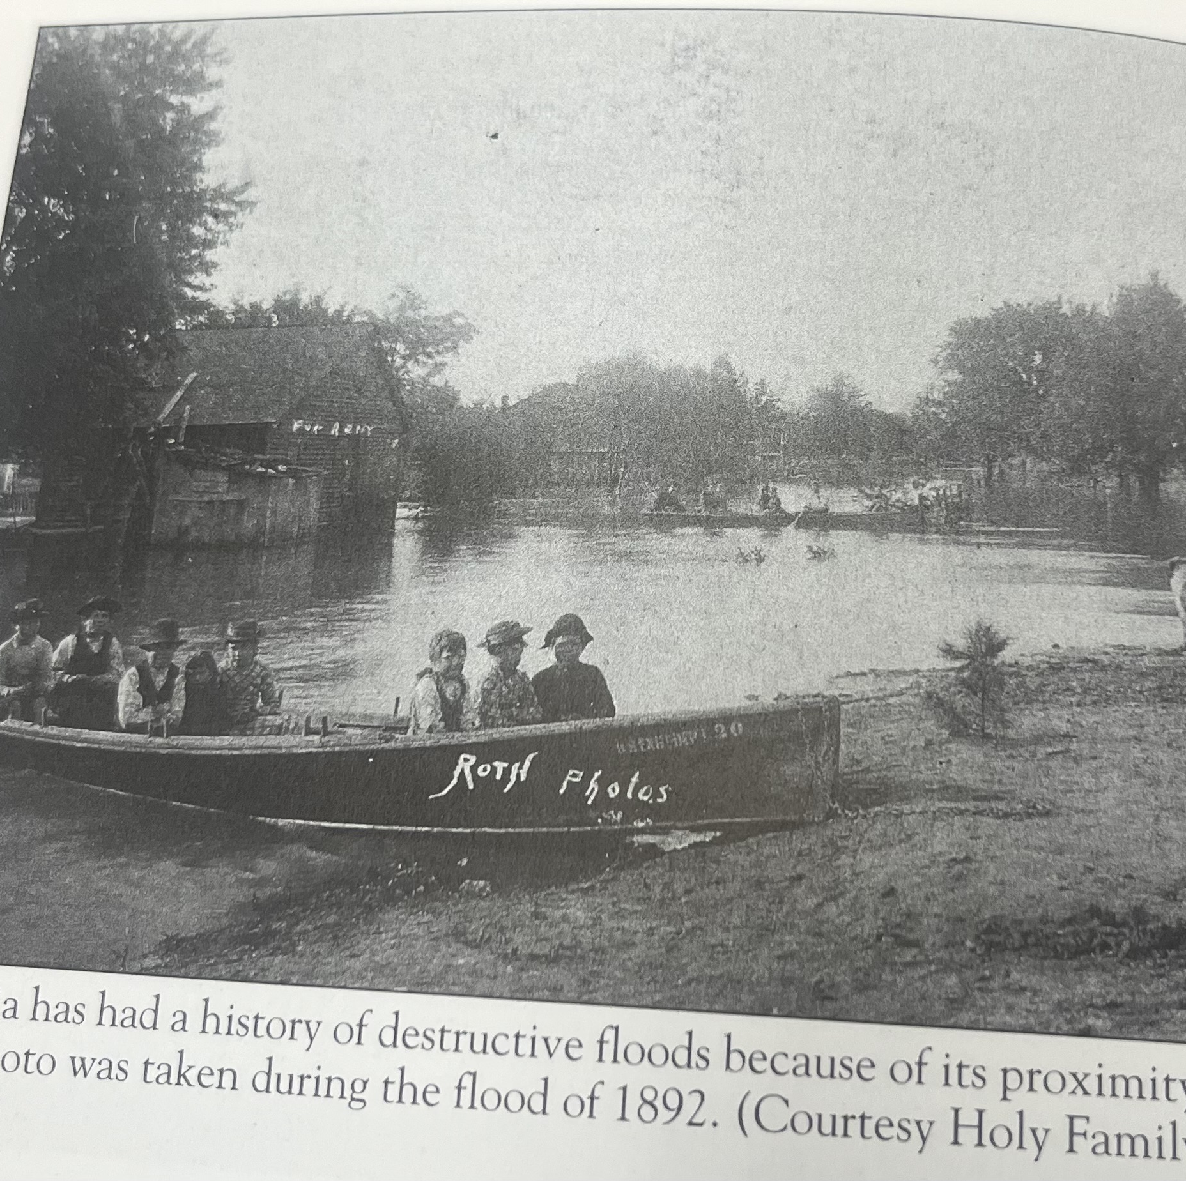
Lindell
Flooding in Cahokia Heights has been a problem for a long time, so I focused on the history of the floods in the city.
Online research
SIUE Archives research

Slide 4
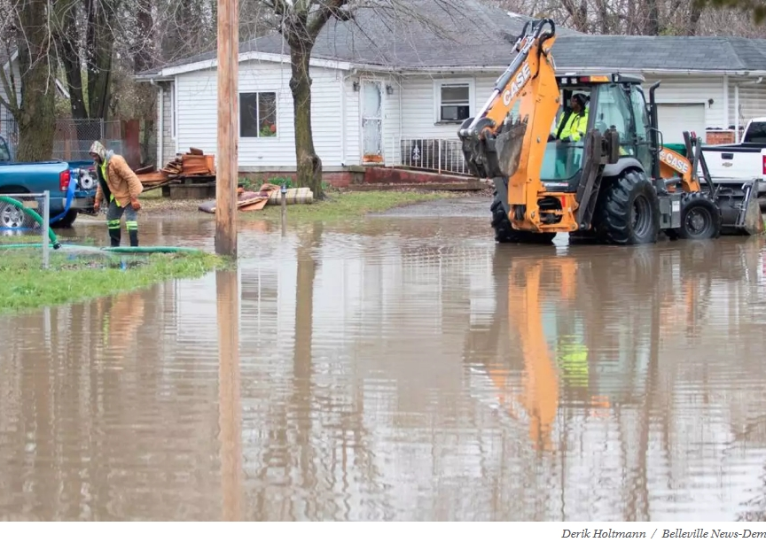
Lindell
Several themes emerged from conducting this historical research
Flooding and sewage
Money spent
Resident frustration

Slide 5
Keith
Five Important Landlord-Tenant Laws
A landlord is required to keep the rental unit in compliance with state and local health and housing codes
A landlord must make all necessary repairs toa home.
If your landlord fails to pay a bill for which they are responsible, you may pay the bill yourself and require your landlord to deduct the payment from your rent.
The Illinois Retaliatory Eviction Act prohibits your landlord from evicting you for complaining to any governmental authority
A landlord must file a lawsuit to properly evict you; they cannot make you move by turning off utilities or removingprivate property
What To Do If Your Rights Are Violated
Gather evidence
Contact your landlord: send them a formal request explaining problems and suggesting solutions. (keep copies of communication)
If the issue cannot be resolved with the landlord, report to the St. Clair County Housing authority (Hire an attorney to represent you if you can afford one)
If St. Clair doesn't work out, you can file a complaint through Illinois Department of Human Rights
https://www.illinoislegalaid.org/ is a website that provides free legal advice

Slide 6

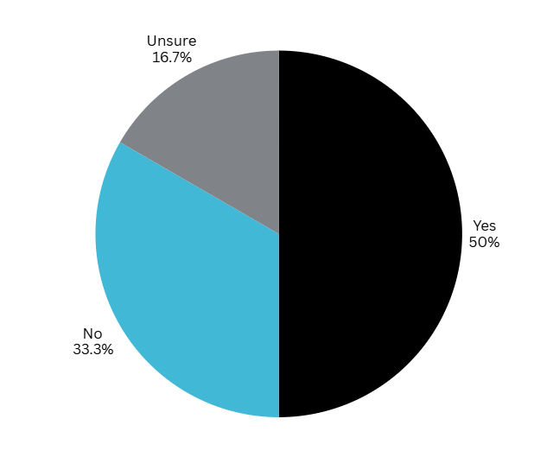
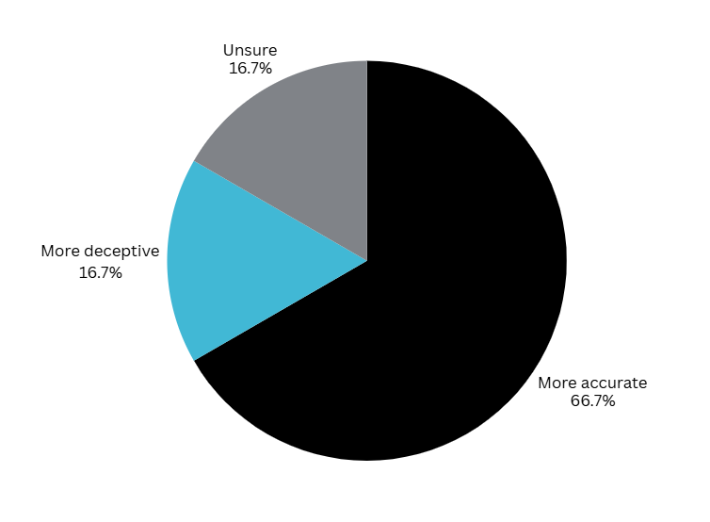
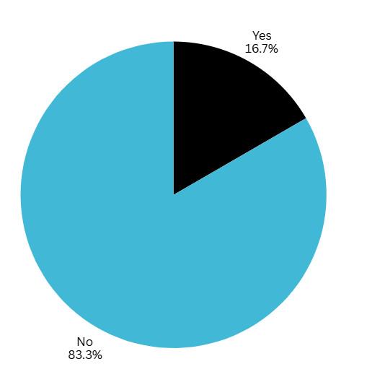
A little bit of survey data
The following pie charts are responses to these questions:
Have you personally had to pay for repairs to your home that you were not responsible for?
When you were originally looking at the listing for your home, did it include deceptive pictures that showed the home in better shape than it was, or were the pictures accurate?
In your opinion, is your home in suitable living conditions?

Slide 7
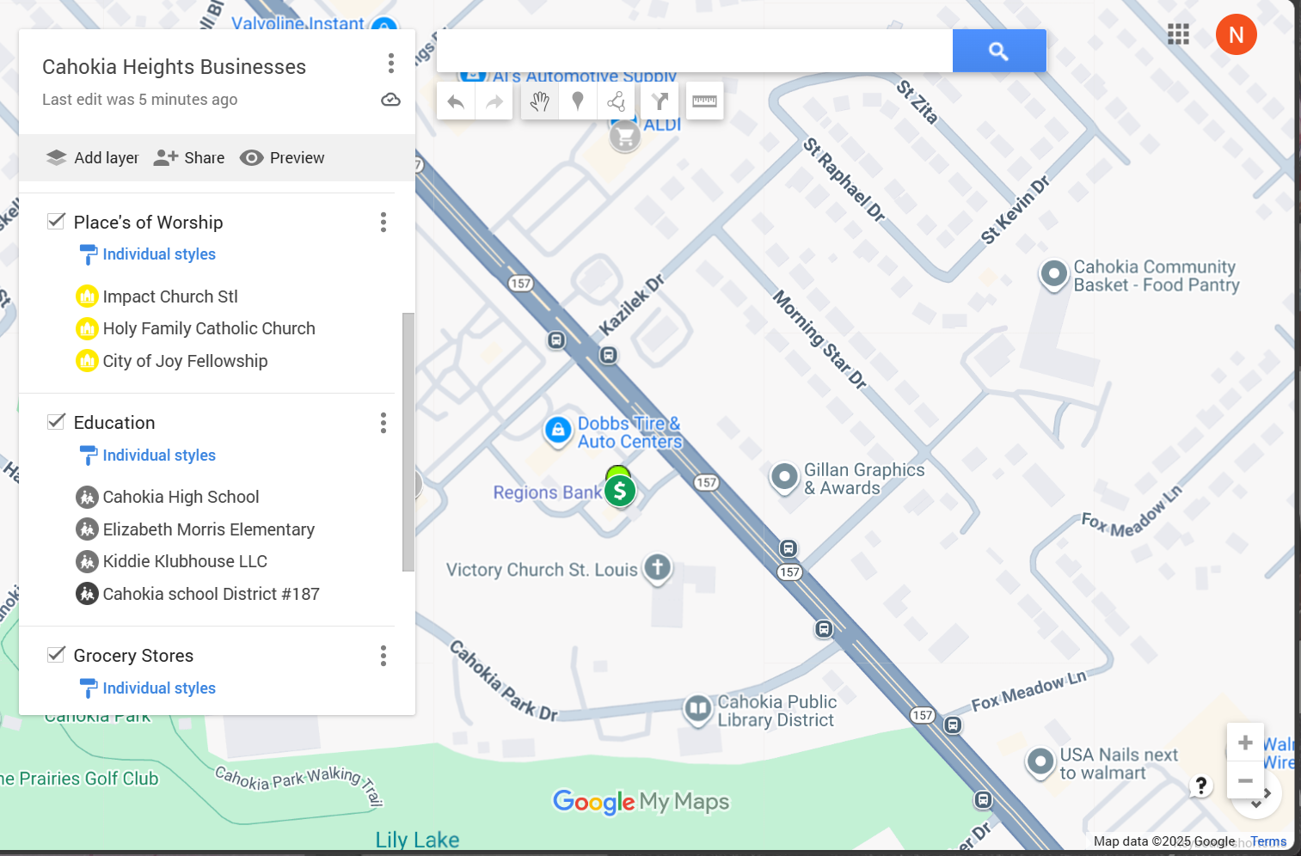
Nadia
Based on oral history data from last semester, it has been a struggle for some residents of Cahokia Heights to locate businesses that support their basic needs.
Through the research process, I've verified businesses that exist and those that don't exist.
Next semester I plan to go out to Cahokia Heights to further determine the existing and non-existing businesses while adding on and removing from the current map.

Slide 8
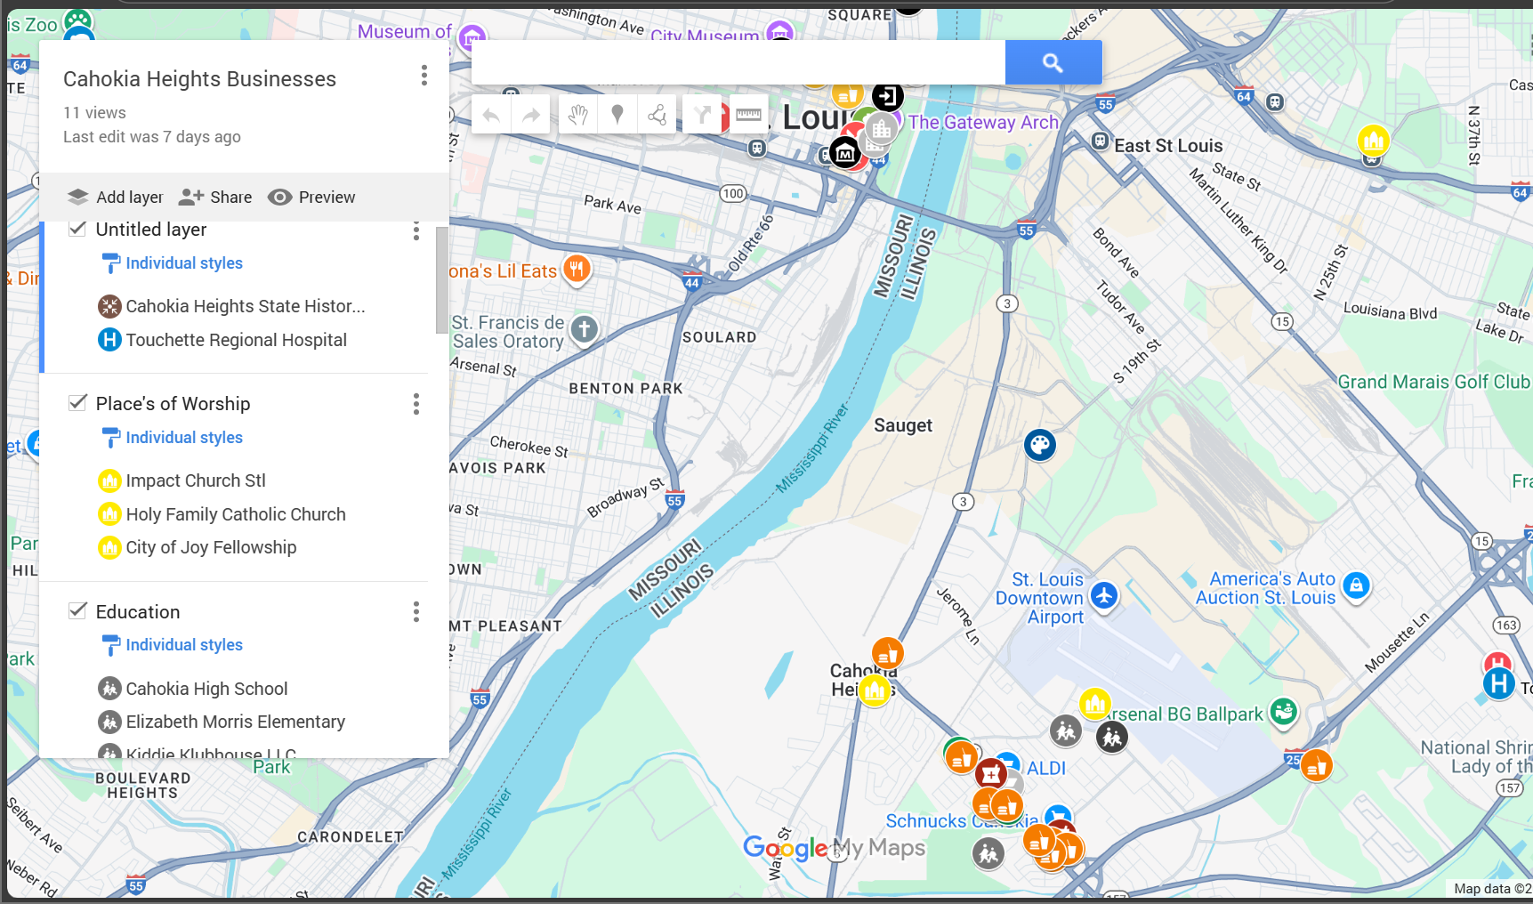
Points on the Map

Slide 9
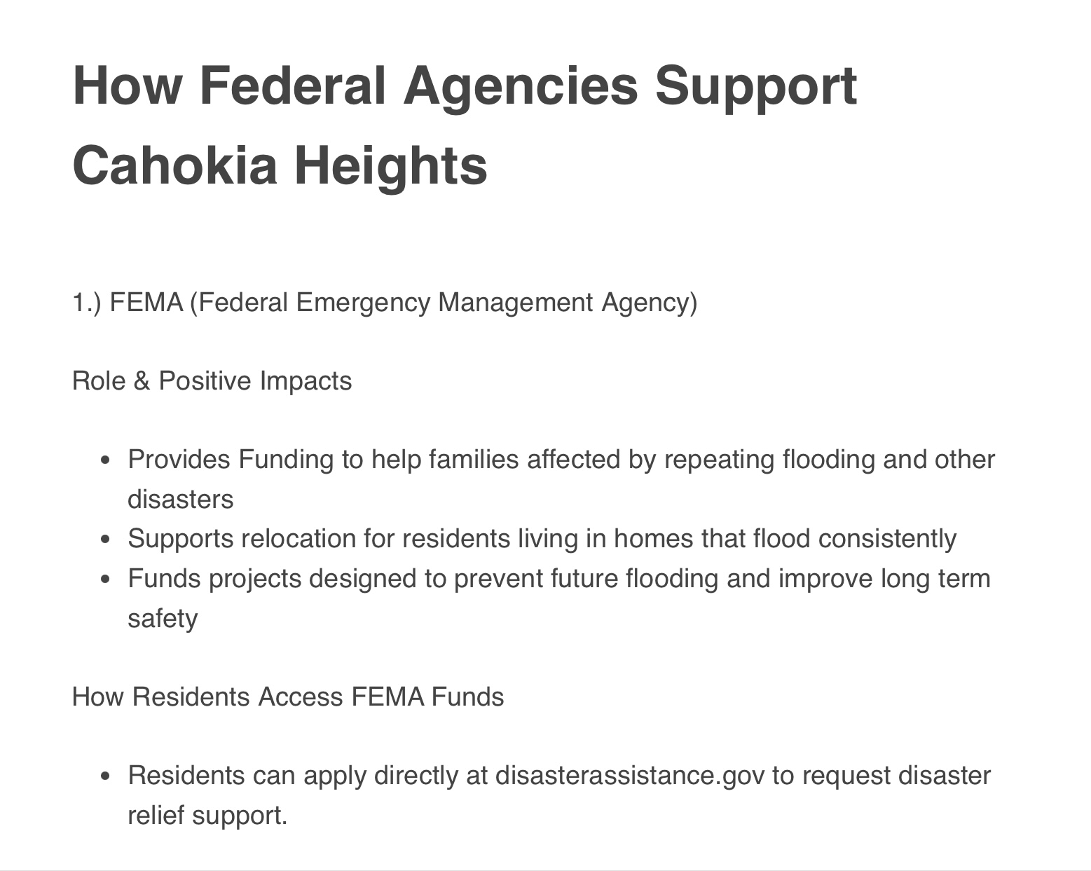
Jada
Throughout this semester, I worked on organizing and breaking down information about how different federal agencies support the community of Cahokia heights.
Those group agencies being:
FEMA (Federal Emergency Management Agency)
EPA (Environmental Protection Agency)
U.S Army Corps
HUD (U.S Department of Housing and Urban Development)

Slide 10

Sa'Dae
My original plan was to connect with local grassroots organizations to provide information on what they do firsthand. This later evolved into a secondary research project.
Grassroots organizations (e.g., Empire 13)
Mutual Aid

Slide 11
Sa'Dae
Mutal Aid Tips
Form a mutual aid group with neighbors, community members, volunteers, and community partners
Use online forums to stay connected, or GroupMe
Set up regular meetings to assess needs and distribute tasks, while also hosting meetings to come up with events, plans, and community service ideas
Create flyers or social media posts to raise awareness and invite open participation
Organize donation drives or supply pick-up/drop-off points
Map out neighborhood needs and available resources for distribution
Community Orgs/ Mutual Aid:
Empire 13
JJK
Cahokia Community Basket
Heartland’s
Glen Ed Food Pantry
Restore Decor
SIUE Gardens
Cougar Cupboards
Cahokia Community Basket

Slide 12
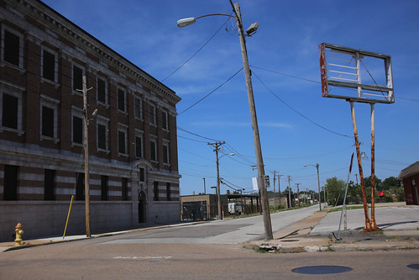
Julez
Throughout this semester, I worked on how to connect local grassroots organizations and how they helped their communities.
This brought a challenge and reached many dead ends, so I talked about changing my plan and we found something better.
I interviewed my friend about flooding in East Saint Louis, and we had some frequently asked questions.
What are the ways people deal with flooding & how does the city recover?
What are some ways you prepare for a natural disaster?
Has this area experienced flooding before? If so, how often and how severe?
These questions created a space where knowledge could be shared and help other people in the community who face similar issues.
ThePhoto by PhotoAuthor is licensed under CCYYSA.

Slide 13
Conclusion
As we continue our work in the semesters ahead, we hope that our website and research will support the residents of Cahokia Heights as well as communities throughout southern Illinois. Reflecting on what we've accomplished so far, we are grateful for the opportunity to help, learn, and give back, moving forward to continue this work and expand the impact we can make.

