Slide 1
Engagement at Missouri Botanical Gardens
Juanito Espericueta and troy Shaffer

Slide 2
Research Question
how do different methods of displaying knowledge keep visitors of Missouri Botanical Gardens engaged with the knowledge displayed?

Slide 3
Why we are interested in this topic
We are interested in this because of our projects in Dr. Hildebrandt’s and Dr. Jack’s classes. We want to make our projects something that will actually grab people's attention and make a positive impact at the garden. We do not want to make something that people just quickly glance at and ultimately end up being ignored.

Slide 4
Summary of Evidence
Expanding the role of Botanical gardens
Typically botanical Gardens are seen as a place of plant research and conservation, but if we expand the role of gardens be a place to educate the public about environmental issues, conservation, sustainable practices, and the cultural and ecological significance of plants, it will lead to more conversation and engagement.
Landscape narratives
Plant taxonomy and scientific information typically isn't the most interesting information, but it was found that if you create a narrative while displaying the information it becomes more engaging and will hold visitors attention for longer.
QR Codes
QR Code integration into museum displays overall increases engagement. If used correctly, QR codes can make a museum or botanical garden experience more interactive and immersive, which ultimately creates more engagement.
Sanders, Dawn L., et al. “Navigating Nature, Culture and Education in Contemporary Botanic Gardens.” Environmental Education Research, vol. 24, no. 8, 29 May 2018, pp. 1077–1084, https://doi.org/10.1080/13504622.2018.1477122.
Chang, Li-Shin, et al. “Improving Educational Functions in Botanic Gardens by Employing Landscape Narratives.” Landscape and Urban Planning, vol. 86, no. 3-4, June 2008, pp. 233–247, https://doi.org/10.1016/j.landurbplan.2008.03.003.
Pérez-Sanagustín, Mar, et al. “Using QR Codes to Increase User Engagement in Museum-like Spaces.” Computers in Human Behavior, vol. 60, July 2016, pp. 73–85, www.sciencedirect.com/science/article/pii/S0747563216300644, https://doi.org/10.1016/j.chb.2016.02.012.

Slide 5
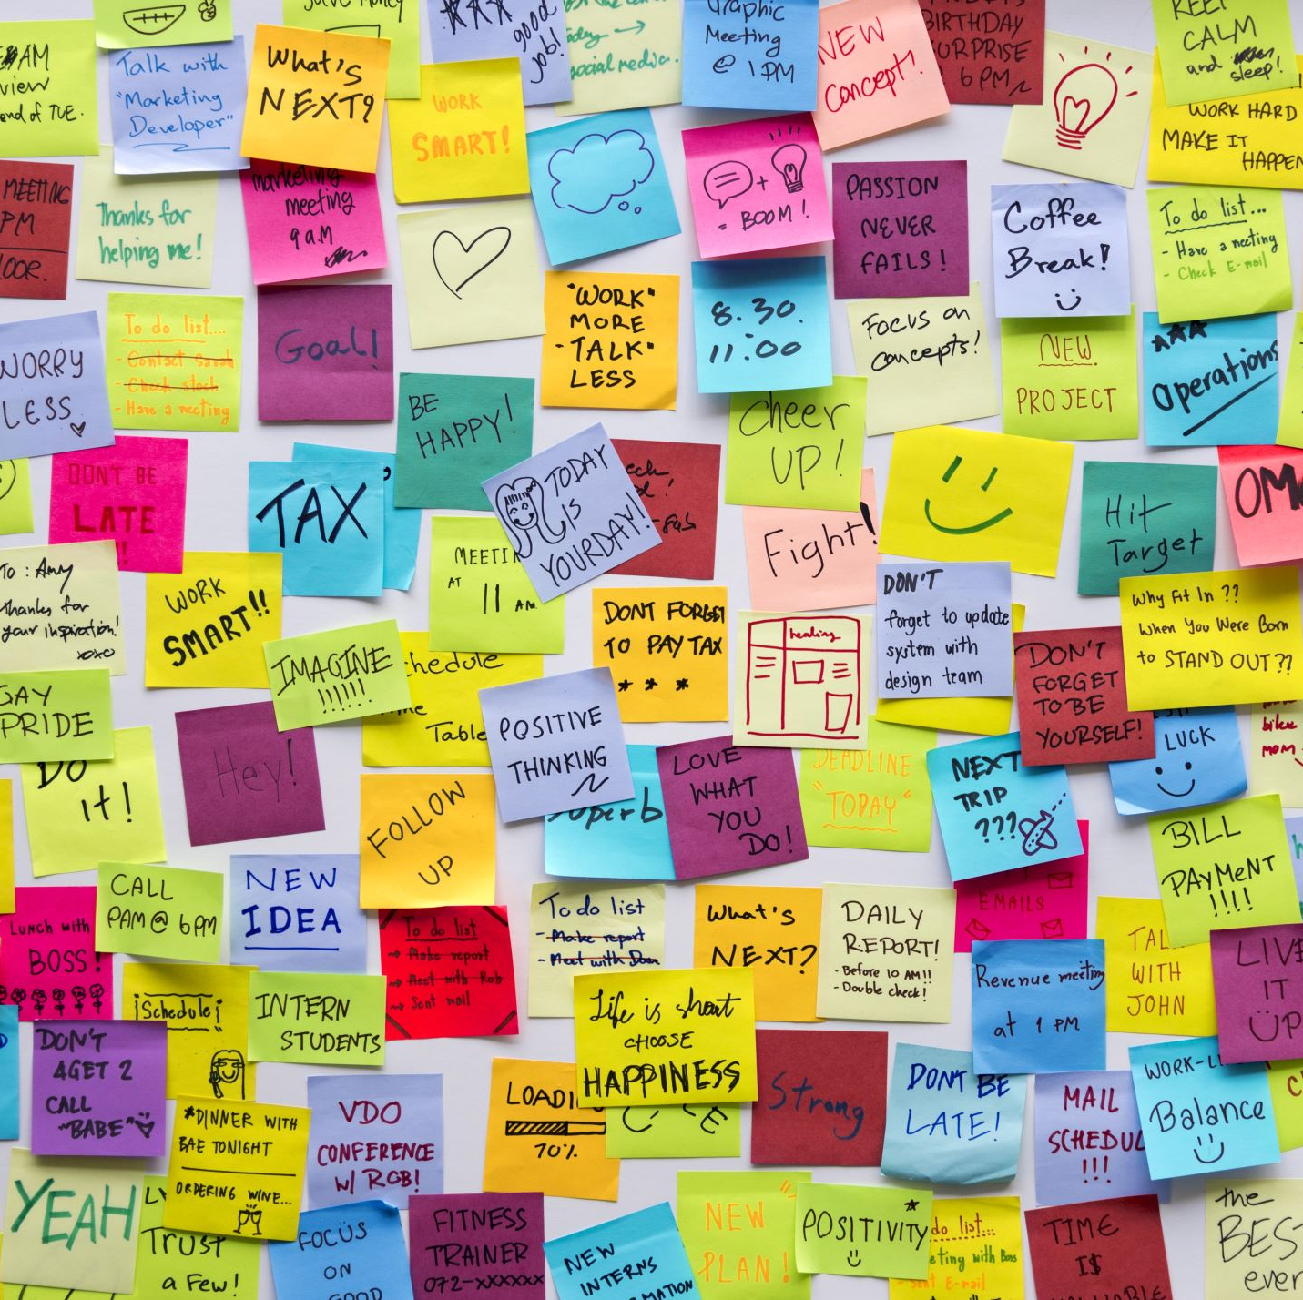
Summary of Evidence
Importance of details on displays
Having intentionality with the combination of design, text, and arrangement of displays can help keep visitors engaged while educating them.
Displays should create knowledge not just showcase it.
Moser, Stephanie. “THE DEVIL IS in the DETAIL: Museum Displays and the Creation of Knowledge.” Museum Anthropology, vol. 33, no. 1, Mar. 2010, pp. 22–32.

Slide 6
Summary of Evidence
The article "The role of digital technology in visual display methods in natural history museums around the world," highlights the use of digital technology in Natural History museums, enhancing audience engagement though virtual and augmented reality exhibits, 3D models and smart devices, fostering cultural exchange and global audience interaction.

Slide 7
Proposed Experiment

Slide 8
Summary & Reflections
Overall, the articles we reviewed collectively come to a conclusion that to enhance or create engagement at Missouri Botanical Gardens, it requires an integration of storytelling, interactive elements, and fun designs.
This research will be very helpful next semester as we start building and creating both of our projects that we have been drafting in our Research Teams.

Slide 9
References
Sanders, Dawn L., et al. “Navigating Nature, Culture and Education in Contemporary Botanic Gardens.” Environmental Education Research, vol. 24, no. 8, 29 May 2018, pp. 1077–1084, https://doi.org/10.1080/13504622.2018.1477122.
Chang, Li-Shin, et al. “Improving Educational Functions in Botanic Gardens by Employing Landscape Narratives.” Landscape and Urban Planning, vol. 86, no. 3-4, June 2008, pp. 233–247, https://doi.org/10.1016/j.landurbplan.2008.03.003. Accessed 17 Oct. 2021.
Pérez-Sanagustín, Mar, et al. “Using QR Codes to Increase User Engagement in Museum-like Spaces.” Computers in Human Behavior, vol. 60, July 2016, pp. 73–85, www.sciencedirect.com/science/article/pii/S0747563216300644, https://doi.org/10.1016/j.chb.2016.02.012. Accessed 9 Nov. 2019.
Moser, Stephanie. “THE DEVIL IS in the DETAIL: Museum Displays and the Creation of Knowledge.” Museum Anthropology, vol. 33, no. 1, Mar. 2010, pp. 22–32.

